Slide 1

Climate Change, Greenhouse Effect and Climate Mitigation
Lee Jowett

Slide 2

Weather v Climate (definitions)
weather refers to short-term changes in the atmosphere - from minutes to hours or days. Familiar examples include rain, snow, clouds, winds, floods or thunderstorms.
climate is the long-term regional or even global average of temperature, humidity and rainfall patterns over seasons, years or decades. It describes what the weather is like over a long period of time in a specific area and includes statistics of weather extremes.
Notes:
WEATHER V CLIMATE (ANIMATED SLIDE - RECOMMENDED)
To start us off I have a question for you – which is what do you think the difference is between weather and climate?
[For online delivery: Request answers in the chat. Give participants time to respond. Pick up on one or two responses that are correct / heading in the right direction and respond to them verbally, before giving the formal definitions using the slide.
For in-person delivery: Ask participants to discuss with the person sitting next to them. Give them 1-2 mins to discuss, then ask for answers. Give positively framed feedback (if answers note quite right you might want to ask another pair) before giving the definitions using the slide.]
CLICK - Weather: is the day-to-day state of the atmosphere, and its short-term variation – it’s a combination of temperature, humidity, precipitation, cloudiness, visibility, and wind. It describes what’s happening now and in the immediate short-term future, "How hot is it right now?“"What will it be like tomorrow?"
CLICK - Climate: the weather of a locality averaged over a long period (usually 30 yrs) + statistics of weather extremes. In popular usage it describes the average weather conditions.
"It’s important to distinguish between weather and climate. Weather is what we experience day to day. Climate is the average of those conditions over decades. A single storm doesn’t prove climate change—but patterns over time do."

Slide 3
Weather v Climate (adage)
climate is what you expect…
…weather is what you get
Notes:
USEFUL CLIMATE ADAGE (ANIMATED SLIDE - RECOMMENDED)
A really useful adage is…
CLICK Climate is what you expect
CLICK Weather is what you get
So, for example, if you’re going on holiday somewhere – the climate of that region for that time of year helps you decide what to pack in your suitcase. The weather you actually experience when you’re there will tell you what to wear each day.

Slide 4
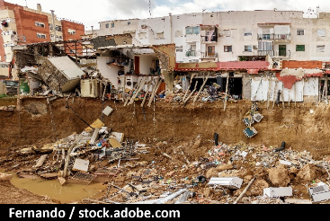
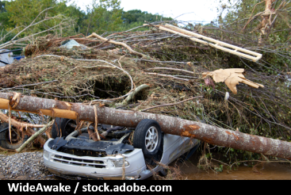


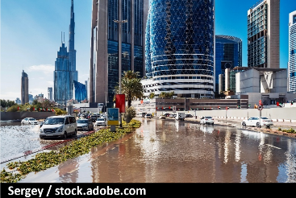
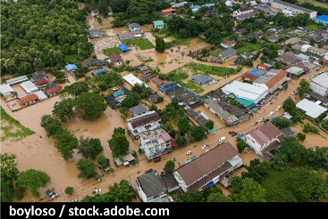
Extreme Weather Events in 2024
Notes:
EXTREME WEATHER EVENTS IN 2024 (OPTIONAL)
2024 was the hottest year ever recorded, with global temperatures averaging 1.55°C above pre-industrial levels. This record heat drove a cascade of extreme events across every continent.
In Europe, intense heatwaves across the Mediterranean caused tens of thousands of deaths and widespread wildfires, while deadly floods hit central regions and Spain.
Across the Atlantic in the US, hurricanes intensified by warm ocean waters brought catastrophic flooding and loss of life.
In Latin America, Brazil faced both its worst drought in over a century in the Amazon and devastating floods in the south, affecting millions.
The Caribbean endured prolonged, dangerous heat, with many areas experiencing over 30 days of extreme temperatures.
West Africa suffered one of the most deadly heatwaves ever recorded, coinciding with Ramadan and exacerbating health risks.
Meanwhile, the UAE was hit by an unprecedented deluge, with Dubai receiving a year’s worth of rain in just 24 hours.
Across Asia, a months-long heatwave disrupted lives and ecosystems, with India reaching 47°C during its May election. Southeast Asia faced a barrage of destructive storms, including six typhoons hitting the Philippines in under a month.
These events are not isolated - they’re part of a pattern. As global temperatures rise, climate extremes are becoming more intense and more frequent – with compounding effects that exacerbate impacts.
INFORMATION SOURCES
All of the examples mentioned above are extreme weather events that attribution studies have found to be more likely and/or more intense due to human-driven climate change. For an overview of the attribution of 2024 extreme weather events to human-driven climate change, see:
Climate Central & World Weather Attribution (2025). When Risks Become Reality – Extreme Weather in 2024. Available at: https://www.worldweatherattribution.org/when-risks-become-reality-extreme-weather-in-2024/
IMAGE CREDITS
Europe
Buildings half destroyed by the flood in the Poyo ravine caused by the intense rains of the Dana over the Valencian Community. By Fernando (https://stock.adobe.com/uk/contributor/208650366/Fernando)
North America
Upside Down Car Crushed Under Tree During Tropical Storm Helene. By WideAwake (https://stock.adobe.com/uk/contributor/202074868/wideawake)
Latin America
Manaus, Amazonas, Brazil - September 28, 2024: The changed natural scenario of rivers and lakes, whose lack of fishing and river transport punishes the local population. By Alonso Correia (https://stock.adobe.com/uk/contributor/209591656/alonso-correia)
Africa
Two Senegalese men praying outdoors during Ramadan in traditional dashiki dress. By unai (https://stock.adobe.com/uk/contributor/208825629/unai)
Middle East
Dubai. Heavy Rain and Flooded Street in UAE. horizontal. By Sergey (https://stock.adobe.com/uk/contributor/209499027/sergey)
Asia
Aerial view of Chiang Rai (Thailand) downtown flooding by Kok river after typhoon Yagi has swept Southeast Asia. By boyloso (https://stock.adobe.com/uk/contributor/205087835/boyloso)

Slide 5
Tipping Points
Tipping points are thresholds in the Earth system where a small change can trigger a large, often irreversible shift.
Notes:
TIPPING POINTS (ANIMATED SLIDE)
Not all climate impacts unfold gradually. Some changes in the Earth system may be abrupt and irreversible.
These “tipping points” are critical thresholds where small changes can trigger large shifts in a system’s state. Like a seesaw [CLICK], a slight nudge can tip the balance into a new, qualitatively different state. Understanding tipping points is vital, as they mark boundaries beyond which climate change could accelerate, with cascading consequences.
INFORMATION SOURCES
The seminal paper that introduced the concept of tipping points is:
Lenton, T.M., Held, H., Kriegler, E., Hall, J.W., Lucht, W., Rahmstorf, S. and Schellnhuber, H.J. (2008) ‘Tipping elements in the Earth’s climate system’, PNAS, 105(6), pp. 1786–1793. doi:10.1073/pnas.0705414105.
For an up-to-date comprehensive overview, see:
Lenton, T.M., Laybourn, L., Armstrong McKay, D.I., Loriani, S., Abrams, J.F., Lade, S.J., Donges, J.F., Milkoreit, M., Smith, S.R., Bailey, E., Powell, T., Fesenfeld, L., Zimm, C., Boulton, C.A., Buxton, J.E., Dyke, J.G., Ghadiali, A. (2023). Global Tipping Points Report 2023. University of Exeter, Exeter, UK. Available at: global-tipping-points.org

Slide 6
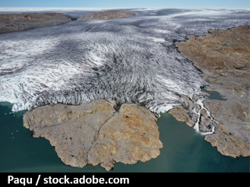
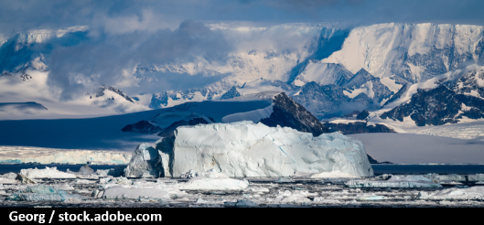
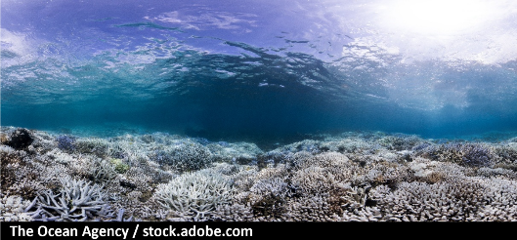
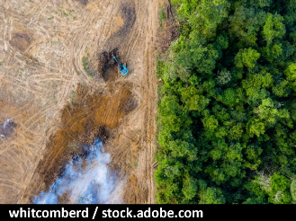
Tipping Points in the Earth System
Greenland Ice Sheet
West Antarctic Ice Sheet
Warm-water Coral Reefs
Amazon Rainforest
Notes:
EXAMPLES OF TIPPING POINTS
Some examples of tipping points include:
The Greenland and West Antarctic Ice Sheets, which could lose vast amounts of ice if warming continues, together raising global sea levels by several metres over centuries.
Warm-water coral reefs, already experiencing major bleaching events at current levels of warming, face widespread mortality and collapse if global temperatures exceed 1.5 to 2°C.
And the Amazon rainforest, which could shift from lush forest to dry savanna if deforestation and warming continue, releasing vast amounts of stored carbon.
INFORMATION SOURCES
The seminal paper that introduced the concept of tipping points is:
Lenton, T.M., Held, H., Kriegler, E., Hall, J.W., Lucht, W., Rahmstorf, S. and Schellnhuber, H.J. (2008) ‘Tipping elements in the Earth’s climate system’, PNAS, 105(6), pp. 1786–1793. doi:10.1073/pnas.0705414105.
For an up-to-date comprehensive overview, see:
Lenton, T.M., Laybourn, L., Armstrong McKay, D.I., Loriani, S., Abrams, J.F., Lade, S.J., Donges, J.F., Milkoreit, M., Smith, S.R., Bailey, E., Powell, T., Fesenfeld, L., Zimm, C., Boulton, C.A., Buxton, J.E., Dyke, J.G., Ghadiali, A. (2023). Global Tipping Points Report 2023. University of Exeter, Exeter, UK. Available at: global-tipping-points.org
IMAGE CREDITS
Aerial photo of inland ice. Near Narsaq, South Greenland. By Paqu (https://stock.adobe.com/uk/contributor/211103433/paqu)
Tabular Iceberg in front of Antarctic Peninsula pictured inside Larsen A inlet with a very scenic cloudy sky and mountains at the background. By Georg (https://stock.adobe.com/uk/contributor/210933353/georg)
Coral bleaching landscape underwater in Okinawa, Japan during a global bleaching event. By The Ocean Agency (https://stock.adobe.com/uk/contributor/208154829/the-ocean-agency)
Aerial view of deforestation. Rainforest being removed to make way for palm oil and rubber plantations. By whitcomberd (https://stock.adobe.com/uk/contributor/205336102/whitcomberd)

Slide 7

Tipping Cascades
Crossing one tipping point may increase the risk of crossing others
global-tipping-points.org
Notes:
TIPPING CASCADES
These systems are interconnected - crossing one tipping point can increase the risk of triggering others - a phenomenon known as a tipping cascade.
While this sounds (and is) alarming – it’s important to remember…
INFORMATION SOURCES
Lenton, T.M., Laybourn, L., Armstrong McKay, D.I., Loriani, S., Abrams, J.F., Lade, S.J., Donges, J.F., Milkoreit, M., Smith, S.R., Bailey, E., Powell, T., Fesenfeld, L., Zimm, C., Boulton, C.A., Buxton, J.E., Dyke, J.G., Ghadiali, A. (2023). Global Tipping Points Report 2023. University of Exeter, Exeter, UK. Available at: global-tipping-points.org
For an accessible news style article see:
Carbon Brief. 15 April 2025. Guest post: Exploring the risks of ‘cascading’ tipping points in a warming world: https://www.carbonbrief.org/guest-post-exploring-the-risks-of-cascading-tipping-points-in-a-warming-world/
Where the review paper this article refers to is:
Wunderling, N., von der Heydt, A. S., Aksenov, Y., Barker, S., Bastiaansen, R., Brovkin, V., Brunetti, M., Couplet, V., Kleinen, T., Lear, C. H., Lohmann, J., Roman-Cuesta, R. M., Sinet, S., Swingedouw, D., Winkelmann, R., Anand, P., Barichivich, J., Bathiany, S., Baudena, M., Bruun, J. T., Chiessi, C. M., Coxall, H. K., Docquier, D., Donges, J. F., Falkena, S. K. J., Klose, A. K., Obura, D., Rocha, J., Rynders, S., Steinert, N. J., and Willeit, M.: Climate tipping point interactions and cascades: a review, Earth System Dynamics, 15, 41–74, https://doi.org/10.5194/esd-15-41-2024, 2024.
Guest post: Exploring the risks of ‘cascading’ tipping points in a warming world - Carbon Brief
ESD - Climate tipping point interactions and cascades: a review
IMAGE CREDIT
Wooden dominoes on grey table. By Africa Studio (https://stock.adobe.com/uk/contributor/293313/africa-studio)

Slide 8
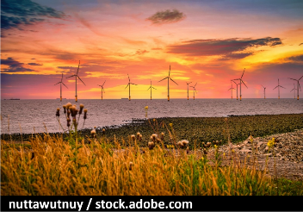
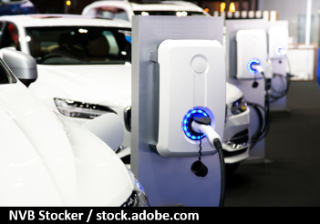

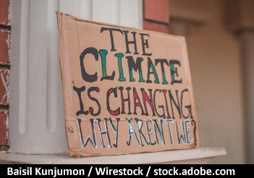
Positive Tipping Points
Just as negative tipping points can accelerate damage positive tipping points in technology, economy & society can accelerate solutions.
global-tipping-points.org
Notes:
POSITIVE TIPPING POINTS
…the story doesn’t end with risks.
There are also positive tipping points in how we respond to climate change - moments when progress accelerates and becomes self-reinforcing –delivering solutions at the pace and scale needed.
Let’s look at a few examples already underway…
INFORMATION SOURCES
For further information on Positive Tipping Points from The Global Tipping Points Project see: ‘Section 4: Positive tipping points in technology, economy and society’, pp 24-29 in Lenton, T.M., Laybourn, L., Armstrong McKay, D.I., Loriani, S., Abrams, J.F., Lade, S.J., Donges, J.F., Milkoreit, M., Smith, S.R., Bailey, E., Powell, T., Fesenfeld, L., Zimm, C., Boulton, C.A., Buxton, J.E., Dyke, J.G., Ghadiali, A. (2023). Global Tipping Points Summary Report 2023. University of Exeter, Exeter, UK. Available at: global-tipping-points.org
For an accessible news style article see World Economic Forum. 2 July 2024. Climate crisis: How positive tipping points could save the planet: https://www.weforum.org/stories/2024/07/positive-tipping-points-climate-tim-lenton/
IMAGE CREDITS
Offshore Wind Turbine in a Wind farm under construction off the England coast at sunset. By nuttawutney (https://stock.adobe.com/uk/contributor/205731677/nuttawutnuy)
Power supply for electric car charging. Electric car charging station. By NVB Stocker (https://stock.adobe.com/uk/contributor/206862554/nvb-stocker)
Vegan protein source. Legumes, beans, lentils, nuts, broccoli, spinach and seeds. Top view on stone table. Healthy vegetarian food. By Nadianb (https://stock.adobe.com/uk/contributor/203046732/nadianb)
Closeup shot of a poster with a message saying “The climate is changing why aren't we”. By Baisil Kunjumon/Wirestock (https://stock.adobe.com/uk/contributor/208428317/baisil-kunjumon-wirestock)

Slide 9
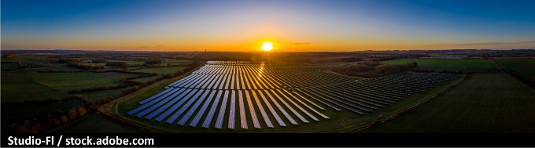
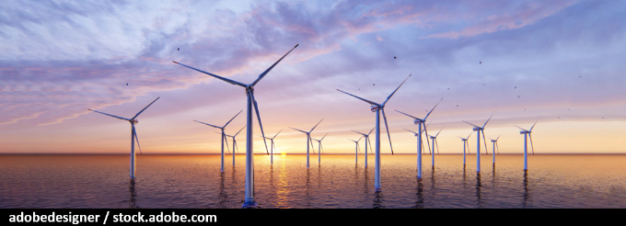
Renewable Energy - Price & Power
Price
Solar and wind power have passed a cost tipping point and are now cheaper than fossil fuels in most countries around the world.
Power
The first 6 months of 2025 saw global renewable electricity generation outstrip coal fired generation for the first time.
Notes:
RENEWABLE ENERGY – PRICE & POWER
Solar and wind power have passed a cost tipping point and are now cheaper than fossil fuels in most regions.
Furthermore, in October 2025, renewables overtook coal in global electricity generation for the first time - a historic milestone.
INFORMATION SOURCES
International Renewable Energy Agency (IRENA) – Renewable Power Generation Costs in 2024: https://www.irena.org/Publications/2025/Jun/Renewable-Power-Generation-Costs-in-2024
91% of newly commissioned renewable power projects in 2024 delivered electricity cheaper than the lowest-cost fossil fuel alternative.
Solar PV was on average 41% cheaper, and onshore wind was 53% cheaper than fossil fuels.
This cost advantage applied across most global markets, including emerging economies.
International Energy Agency (IEA) – Renewables 2024 Executive Summary: https://www.iea.org/reports/renewables-2024/executive-summary
Climate and energy security policies in nearly 140 countries have made renewables cost-competitive with fossil-fired power plants.
Solar PV and wind account for 95% of all renewable capacity growth due to their economic attractiveness in almost all countries.
Nearly 70 countries, representing 80% of global capacity, are on track to meet or exceed their 2030 renewable targets.
EMBER – Global Electricity Mid-Year Insights 2025: https://ember-energy.org/latest-insights/global-electricity-mid-year-insights-2025/
A strong rise in solar, and to a lesser extent wind, led to renewables overtaking coal generation for the first time on record in the first half of 2025. Renewables grew by 363 TWh (+7.7%) to reach 5,072 TWh, while coal generation fell by 31 TWh to 4,896 TWh. As a result, renewables’ share of global electricity rose to 34.3% (from 32.7%), while coal’s share fell to 33.1% (from 34.2%).
IMAGE CREDITS
Aerial looking over a modern solar farm at sunrise in the English countryside panoramic. By Studio-FI (https://stock.adobe.com/uk/contributor/201172464/studio-fi)
Windmill park. Offshore wind turbines farm on the ocean. Close up view. Sustainable energy production, clean power. By adobedesigner (https://stock.adobe.com/uk/contributor/209420746/adobedesigner)

Slide 10

EVs - From Niche to Norm
Norway: tipped in 2020
EVs = 50% of new car sales in 2020
By Jan-Apr 2025, 97% of new cars were EVs (dominantly BEVs)
China: just tipped
EV sales have outstripped conventional cars since July 2024
UK: approaching the threshold
EVs = 28% of new car sales in 2024
Projected to reach 40% by 2026
Notes:
ELECTRIC VEHICLES (EVs)
Reaching 50% market share for electric vehicles [both Battery EVs – BEVs – and Plug-in Hybrid EVs – PHEVs] is often seen as a tipping point - once EVs become the majority of new car sales, consumer norms shift, infrastructure investment scales up, and policy momentum builds.
Norway crossed this threshold in 2020, and by early 2025, EVs had surged to 97% of new car registrations. China tipped in 2024 – and here in the UK we’re making reasonable progress with sales projected to grow to 40% by 2026.
INFORMATION SOURCES
European Commission. European Alternative Fuels Observatory. News Article 5 May 2025. Norway’s Electric Vehicle Market Accelerates in April 2025: https://alternative-fuels-observatory.ec.europa.eu/general-information/news/norways-electric-vehicle-market-accelerates-april-2025
International Energy Agency (IEA). Global EV Outlook 2025 - Expanding sales in diverse markets: https://www.iea.org/reports/global-ev-outlook-2025
The Society of Motor Manufacturers and Traders (SMMT) UK New Car and Van Outlook – July 2025 Outlook: https://www.smmt.co.uk/vehicle-data/uk-new-car-and-van-outlook/
IMAGE CREDIT
Power supply for electric car charging. Electric car charging station. By NVB Stocker (https://stock.adobe.com/uk/contributor/206862554/nvb-stocker)

Slide 11
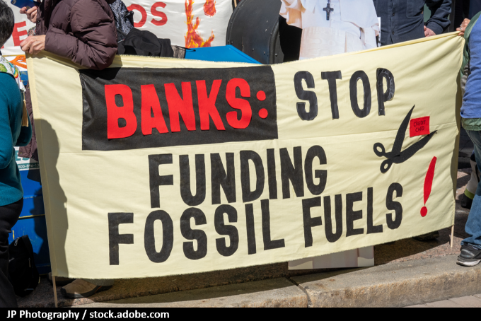
Divestment - Redirecting the Flow
Shifting investment flows
Investors reducing exposure to climate-related financial risk
Weakens fossil fuel industries while enabling clean tech innovation & scale-up
Public pressure drives accountability (e.g. pensions & banking)
Notes:
FOSSIL FUEL DIVESTMENT
Institutional investors are increasingly divesting from fossil fuels to manage climate-related financial risk. As well as reducing exposure, divestment helps redirect capital toward low-carbon sectors, accelerating innovation and market transformation.
INFORMATION SOURCES
Institute for Energy Economics and Financial Analysis (IEEFA). September 12 2024. Institutional investors increasingly pair engagement and divestment to address climate-related financial risk. https://ieefa.org/articles/institutional-investors-increasingly-pair-engagement-and-divestment-address-climate
IMAGE CREDIT
Stop Funding Fossil Fuels. By JP Photography (https://stock.adobe.com/uk/contributor/5754/jp-photography)

Slide 12

Powered by Plants
Dietary Shifts
Plant-based diets are gaining traction.
As demand grows, supply chains adapt and cultural norms shift.
This can help reduce emissions from agriculture and improve public health.
Notes:
DIETARY SHIFTS
Turning to food - plant-based diets are gaining traction. As demand grows, supply chains adapt, and cultural norms begin to shift. Even small changes in what we eat can make a meaningful difference when they happen at scale – helping to reduce emissions from agriculture and improve public health.
INFORMATION SOURCES
Kozicka, M., Havlík, P., Valin, H., Wollenberg, E., Deppermann, A., Leclère, D., Lauri, P., Moses, R., Boere, E., Frank, S., Davis, C., Park, E., Gurwick, N. (2023). ‘Feeding climate and biodiversity goals with novel plant-based meat and milk alternatives.’ Nature Communications, 14(1), 5316 DOI: 10.1038/s41467-023-40899-2
Replacing 50% of meat and milk with plant-based alternatives by 2050 could cut agriculture-related GHG emissions by 31%, halt degradation of forests and natural land, and contribute up to 25% of global land restoration targets
WHO Europe (2021) Plant-based diets and their impact on health, sustainability and the environment: A review of the evidence. Available at: https://www.who.int/europe/publications/i/item/WHO-EURO-2021-4007-43766-61591
Reports a growing shift toward plant-based diets across Europe, driven by health, climate, and ethical concerns. Plant-based diets are associated with lower risk of premature mortality and protection against noncommunicable diseases.
IMAGE CREDIT
Vegan protein source. Legumes, beans, lentils, nuts, broccoli, spinach and seeds. Top view on stone table. Healthy vegetarian food. By Nadianb (https://stock.adobe.com/uk/contributor/203046732/nadianb)

Slide 13

Accelerating the Transition
Notes:
ACCELERATING THE TRANSITION TOGETHER
These shifts don’t happen on their own - they’re enabled by people – where creating the right conditions means pulling multiple levers: technology, finance, behaviour, and governance.
That’s where we all come in – now and in the future.
From our everyday choices, to how we design, buy, make, educate, and advocate, our personal and professional choices matter and can help reshape systems - creating our own domino effect with each action triggering the next and accelerating progress.
The transition is underway, but pace matters. Every system shifted sooner, every tonne of carbon emissions avoided, every fraction of a degree of warming prevented makes a difference.
And that’s what Carbon Literacy training is about: exploring how we can act now to create the change we want to see - in our institutions, our communities, and our own lives. Together, we can tip the balance toward a safer, fairer future.
INFORMATION SOURCES
For further information on Positive Tipping Points from The Global Tipping Points Project see: ‘Section 4: Positive tipping points in technology, economy and society’, pp 24-29 in Lenton, T.M., Laybourn, L., Armstrong McKay, D.I., Loriani, S., Abrams, J.F., Lade, S.J., Donges, J.F., Milkoreit, M., Smith, S.R., Bailey, E., Powell, T., Fesenfeld, L., Zimm, C., Boulton, C.A., Buxton, J.E., Dyke, J.G., Ghadiali, A. (2023). Global Tipping Points Summary Report 2023. University of Exeter, Exeter, UK. Available at: global-tipping-points.org
For an accessible news style article see World Economic Forum. 2 July 2024. Climate crisis: How positive tipping points could save the planet: https://www.weforum.org/stories/2024/07/positive-tipping-points-climate-tim-lenton/
IMAGE CREDIT
Crowd of people gathered together in the shape of domino effect symbol, top view, chain reaction concept, isolated on transparent background. By Arthimedes (https://stock.adobe.com/uk/contributor/208427312/arthimedes)

Slide 14
The Greenhouse Effect
Notes:
This activity is from a complete set of Carbon Literacy training materials & accompanying trainer guide created by Carbon Literacy Consultants Rachel Dunk & Jane Mörk, with contributions from Liam Bluer & Cormac Lawler, Manchester Metropolitan University.
The Carbon Literacy training materials are licensed for re-use under a Creative Commons Attribution – Non Commercial – No Derivatives 4.0 International License (CC BY-NC-ND 4.0) – see https://creativecommons.org/licenses/by-nc-nd/4.0/
This license does not apply to third party material incorporated in the Carbon Literacy Training materials. The Earthrise image included in this presentation is third party content. Full attribution and marking of third party content is provided in the notes page of the appropriate slide.
This slide set is accompanied by a trainer guide which provides information on how to prepare and deliver the activity. We have made these materials freely available to support the roll out of carbon literacy training to as many people as possible. All we ask is that you acknowledge Manchester Metropolitan University as the creator of this work – and we would really appreciate it if you would take the time to email us and let us know how you are using the materials (and give any feedback you may have) at carbonliteracy@mmu.ac.uk
We would strongly prefer it if you used our slides as provided – and request that at a minimum our logo and the creative commons license information is included on all slides related to this activity. If you have any questions, please email us.

Slide 15
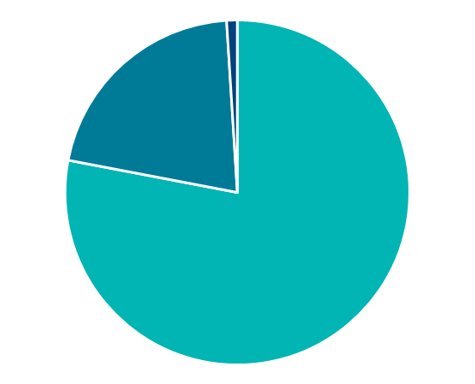
The composition of the atmosphere
Argon (Ar)
Trace Gases
Carbon Dioxide (CO₂)
Nitrous Oxide (N₂O)
Oxygen
(O₂)
Methane (CH₄)
Ozone (O₃)
Hydrogen (H₂)
Helium (He)
Nitrogen
(N₂)
Neon (Ne)
Krypton (Kr)
Xenon (Xe)
+ water vapour
Notes:
Composition of the Atmosphere
Before we take a closer look at the greenhouse effect, let’s just remind ourselves about the composition of the Earth’s atmosphere.
It’s about 78% nitrogen, 21% oxygen, and 1% argon.
However, in addition to these main constituents, there are also a number of what we call “trace gases” – these are gases present at very low concentrations – collectively they account for less than 0.1% of the atmosphere. However – while they are present at very low concentrations – the effect they exert is far from tiny, where some of these gases are what we call greenhouse gases (shown in bold on the slide).
It’s also important to note that these proportions are based on a “dry” atmosphere – and of course there’s also water vapour present… where water vapour is also a greenhouse gas.
FOR INFO: water content of the atmosphere varies in space and time based on temperature – typically in range 0.2-4% (0.2% would be very cold air – e.g. at the poles, 4% would be warm tropical air).

Slide 16
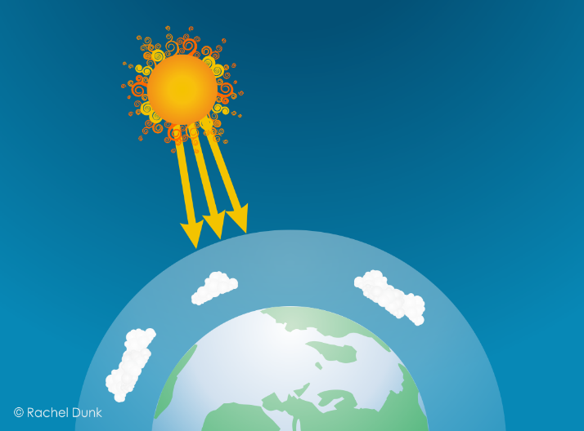
The Greenhouse Effect (1/7)
Energy from the Sun is transmitted through space to the Earth
(mainly visible light)
Notes:
The Greenhouse Effect – Scientific Explanation - 1/7
So now let’s consider the Greenhouse Effect.
We start with the Sun – which is basically a giant nuclear fusion reactor that is kicking out an enormous amount of energy. That energy is transmitted through space to the Earth - mainly as visible light – that is short wavelength radiation in the visible part of the electromagnetic spectrum.

Slide 17

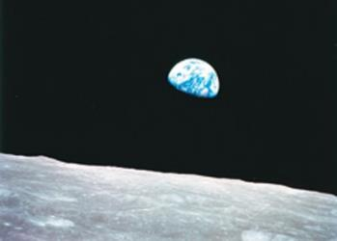
The Greenhouse Effect (2/7)
Some of this energy is reflected back into space from clouds and the Earth's surface.
This is why we can see the Earth from space!
Notes:
The Greenhouse Effect – Scientific Explanation - 2/7
Some of this energy is reflected straight back to space. How much solar radiation is reflected depends on the Earths albedo – how reflective or shiny the Earth is – where a significant portion of the Earth’s albedo is due to clouds.
This reflection of solar radiation is why the Earth - our blue marble - is visible from space, where the photograph shown here is the famous NASA Earthrise picture, taken by Bill Anders on December 24th 1968 as Apollo 8 entered lunar orbit.
IMAGE CREDIT:
Earthrise: NASA/Bill Anders. Earthrise (photo of the Earth taken from Apollo 8 in 1968). Photograph is in the public domain as it was solely created by NASA (NASA material is not protected by copyright unless noted). Available here: https://commons.wikimedia.org/wiki/File:NASA-Apollo8-Dec24-Earthrise.jpg

Slide 18

The Greenhouse Effect (3/7)
The energy that isn’t reflected passes through the atmosphere and is absorbed by the Earth’s surface.
This is because the Earth’s atmosphere is largely transparent to visible light.
Notes:
The Greenhouse Effect – Scientific Explanation - 3/7
The solar radiation that isn’t reflected back to space passes through the atmosphere and is absorbed by the Earth’s surface.
This is because the Earth’s atmosphere is largely transparent to visible light.

Slide 19
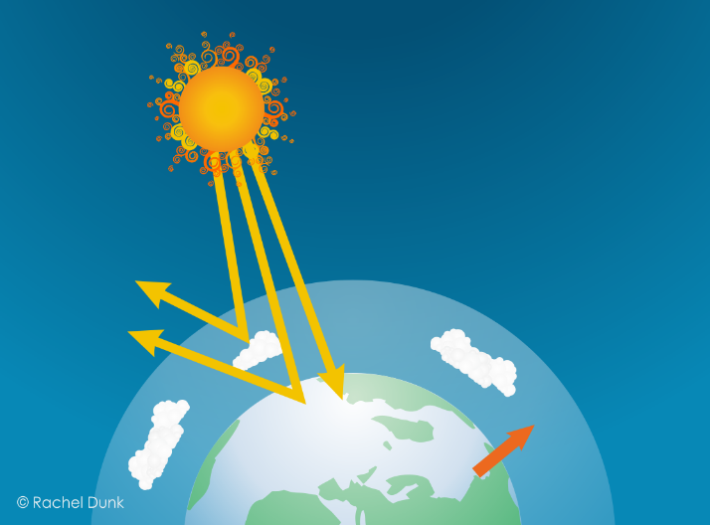
The Greenhouse Effect (4/7)
The Earth warms up and emits infrared radiation.
The atmosphere is NOT transparent to infrared radiation…due to the “excitability” of the greenhouse gases…
Notes:
The Greenhouse Effect – Scientific Explanation - 4/7
This heat’s the Earth’s surface. Any heated object emits electromagnetic radiation – where the Earth emits in the infrared part of the spectrum - this is longer wavelength and lower energy radiation than the incoming visible light from the Sun.
While the atmosphere is what we call “transparent” to visible light it is not transparent to infrared.
That is because of the excitability of the greenhouse gases, which can absorb infrared radiation.

Slide 20

The Greenhouse Effect (5/7)
…so while some infrared radiation will escape to space, most is absorbed by the greenhouse gases…
Notes:
The Greenhouse Effect – Scientific Explanation - 5/7
So while some infrared radiation escapes directly to space through the atmospheric “window” (this is gaps in the absorbance of the atmosphere) - most is absorbed by the greenhouse gases.

Slide 21
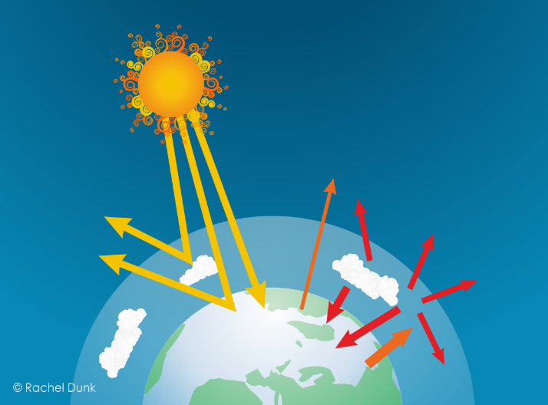
The Greenhouse Effect (6/7)
…they then emit even longer wavelength lower energy infrared radiation in all directions.
This traps heat, warming the Earth and the lower atmosphere.
Notes:
The Greenhouse Effect – Scientific Explanation - 6/7
The greenhouse gases then emit even longer wavelength lower energy radiation in all directions – so some escapes to space but some is re-absorbed by the Earth’s surface and the lower atmosphere.
This effectively traps heat, warming the Earth – where this process will continue – and the system will continue to warm up - until the total amount of energy escaping from the top of the atmosphere is equal to the amount that came in from the Sun.

Slide 22
The Greenhouse Effect (7/7)
The natural Greenhouse Effect is a good thing.
Without it, the Earth would be about -18°C.
The problem is that human activities are enhancing this effect by adding more greenhouse gases to the atmosphere.
Notes:
The Greenhouse Effect – Scientific Explanation - 7/7
The Greenhouse Effect is a natural process – and a very good thing. Without it the Earth’s average temperature would be around minus 18°C – liquid water would not exist and life as we know it would not have evolved.
However, for the past 250 years or so, human activities have been increasing the concentrations of greenhouse gases in the atmosphere – thereby enhancing the Greenhouse Effect - further warming the Earth – and leading to the climate change that we are now experiencing.

Slide 23
Human influences on climate
There are two main factors within the sphere of human influence that control Earth’s T:
The amount of solar radiation that is reflected or absorbed
The concentration of greenhouse gases (GHGs) in the atmosphere
If we change albedo (how reflective Earth is) we should expect the Earth’s T to change
If we change the concentration of GHGs we should expect the Earth’s T to change
More reflective = cooling
Less reflective = warming
Add GHGs = warming
Remove GHGs = cooling
Notes:
Human influences on climate 1/1 (OPTIONAL – HIDE if you don’t want to use)
ANIMATED SLIDE
CLICK: From an understanding of the basic physics of the greenhouse effect we can see that there are two key factors within the sphere of human influence that control the Earth’s temperature.
CLICK: Firstly, if we change how reflective the Earth is we should expect the Earth’s temperature to change.
CLICK: More reflective (e.g. deforestation) would be cooling. Less reflective (e.g. melting ice caps, black carbon (soot) on snow) would be warming.
CLICK: Secondly (and dominantly) if we change the concentration of GHGs in the atmosphere we should expect the Earth’s temperature to change.
CLICK: Adding GHGs would be warming. Removing GHGs would be cooling.

Slide 24


The Greenhouse Effect (blanket analogy)
The natural Greenhouse Effect is a good thing.
Without it, the Earth would be about -18°C.
The problem is that human activities are enhancing this effect by adding more greenhouse gases to the atmosphere.
Notes:
The Greenhouse Effect - Blanket Analogy 1/1 (UNHIDE to use)

Slide 25

The Greenhouse Effect (greenhouse analogy)
The natural Greenhouse Effect is a good thing.
Without it, the Earth would be about -18°C.
The problem is that human activities are enhancing this effect by adding more greenhouse gases to the atmosphere.
Notes:
The Greenhouse Effect – Greenhouse Analogy 1/1 (UNHIDE to use)

Slide 26
The Greenhouse Gas Game
Notes:
This activity is from a complete set of Carbon Literacy training materials & accompanying trainer guide created by Carbon Literacy Consultants Rachel Dunk & Jane Mörk, with contributions from Liam Bluer & Cormac Lawler, Manchester Metropolitan University.
The Carbon Literacy training materials are licensed for re-use under a Creative Commons Attribution – Non Commercial – No Derivatives 4.0 International License (CC BY-NC-ND 4.0) – see https://creativecommons.org/licenses/by-nc-nd/4.0/
This license does not apply to third party material incorporated in the Carbon Literacy Training materials. All photographic images used in this slide set are third party content. Attribution and marking of third party content offered under different CC licenses is provided in the notes pages of the appropriate slides.
This slide set is for the Greenhouse Gas Game and is accompanied by two card sets (GHG Gases and Sources – Core Pack; GHG Sources – Expansion Pack) and a trainer guide on how to run the activity. An alternative version – the Greenhouse Gas Quiz – suitable for large group (conference style) training or remote (webinar) delivery is also available. We have made these materials freely available to support the roll out of carbon literacy training to as many people as possible. All we ask is that you acknowledge Manchester Metropolitan University as the creator of this work – and we would really appreciate it if you would take the time to email us and let us know how you are using the materials (and give any feedback you may have) at carbonliteracy@mmu.ac.uk
We would strongly prefer it if you used our slides as provided – and request that at a minimum our logo and the creative commons license information is included on all slides related to this activity. If you have any questions, please email us.

Slide 27



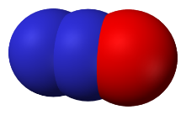
The greenhouse gases
carbon dioxide
CO₂
methane
CH₄
nitrous oxide
N₂O
F gases
(various)
1
28
265
10s-10,000s
mass x GWP → common currency of carbon dioxide equivalents (CO₂e)
Notes:
Introduce the GHGs and Global Warming Potentials (GWPs).
Now we’re going to focus on the greenhouse gases that our (human) activities are adding to the atmosphere.
The main greenhouse gases are carbon dioxide, methane, nitrous oxide and fluorinated gases (F-gases).
Not all GHGs are equal – some are more potent than others. The numbers below each gas are their Global Warming Potentials (GWPs) - a measure of the gases ability to trap heat in the atmosphere compared to carbon dioxide on a weight for weight basis. For any greenhouse gas we can then multiply the mass emitted by the GWP to express the emissions as CO2 equivalents.
For example, emitting 1 tonne of methane has the same warming effect as emitting 28 tonnes of carbon dioxide (it is 28 times more potent!).
Likewise, emitting one tonne of nitrous oxide has the same warming effect as emitting 265 tonnes of carbon dioxide.
If we look at the F-gases – which is a family of different compounds, they are 10s to 1000s of times more potent than carbon dioxide.
NOTE: Be careful NOT to mention any sources of the GHGs here – as this is covered in the game!
For information – the F-gases shown are:
CF4 (PFC-14, carbon tetrafluoride) = 6,630
SF6 (sulfur hexafluoride) = 23,500
NOTE: Global Warming Potentials presented here are the 100-year values from the Intergovernmental Panel on Climate Change Assessment Report 5 (IPCC AR5) - see Trainer Guide for further information. These are the GWPs that have been identified as those the Parties to the Convention should use for reporting their commitments under the Paris Agreement. https://unfccc.int/process-and-meetings/transparency-and-reporting/methods-for-climate-change-transparency/common-metrics

Slide 28



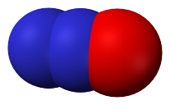
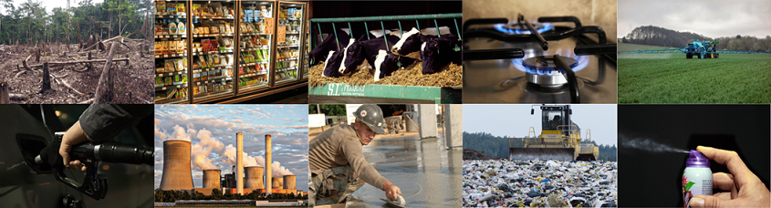
The greenhouse gas game (instructions)
Match the greenhouse gases with their sources!
Notes:
Introduce and explain the matching activity (e.g. “Your task is to match the GHGs with their sources”).
Give the participants 5 minutes to complete the task
Co-trainer: Give each group a set of GHG Gases & Sources cards while the activity is introduced.
Lead & co-trainer: Circulate around the groups during the activity – give hints if necessary but try not to simply give the answers away (e.g. “You’ve got most of them right, but two are wrong…which ones do you think might be wrong?”)
IMAGE ATTRIBUTION & MARKING
Burning of Natural Gas: Image by PublicDomainPictures from Pixabay (pixabay.com/photos/appliance-burn-burner-cook-cooker-2257/)
Burning of Oil: Image by Rudy and Peter Skitterians from Pixabay (pixabay.com/photos/petrol-gasoline-diesel-gas-996617/)
Burning of Coal: Image by Benita Welter from Pixabay (pixabay.com/photos/power-plant-industry-chimney-2411932/ )
Cement Production: Image by 272447 from Pixabay (pixabay.com/photos/mason-concrete-float-smooth-cement-694271/)
Land Use Change: Shift cultivation in Columbia from Wikimedia Commons (https://commons.wikimedia.org/wiki/File:Amazon_slash_and_burn_agriculture_Colombia_South_America.jpg). Image by Matt Zimmerman, licensed for reuse under the Creative Commons Attribution 2.0 Generic license (CC BY 2.0) (creativecommons.org/licenses/by/2.0/). No changes made to image.
Ruminant Livestock: Image by 272447 from Pixabay (pixabay.com/photos/cows-cattle-dairy-holstein-farm-526771/)
Landfilling of Waste: Image by Pasi Mäenpää from Pixabay (pixabay.com/photos/landfill-waste-management-waste-879437/)
Fertilisers: Image by Franck Barske from Pixabay (pixabay.com/photos/tractor-fertilizer-pesticide-spray-4217686/)
Refrigerant Gases: Image by Kevin Phillips from Pixabay (pixabay.com/photos/supermarket-fridge-produce-food-949912/).
Aerosol Propellants: Image by 955169 from Pixabay (pixabay.com/photos/fragrance-spray-box-graffiti-night-1502844/).

Slide 29
Cement production
CaCO₃ + Δ → CaO + CO₂

Slide 30
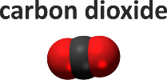
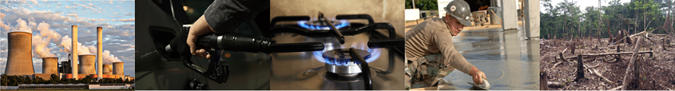

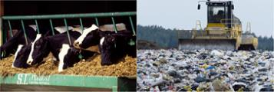
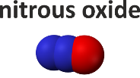

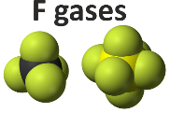

The greenhouse gas sources
Notes:
CORE GHG Sources Activity Feedback 1/1 (ANIMATED SLIDE)
SELECT THIS FOR FAST FEEDBACK AND HIDE SLIDES 5-8. IF YOU WANT TO DO DETAILED FEEDBACK, HIDE THIS SLIDE.
Carbon dioxide
Ask the first group for the sources of carbon dioxide [burning of coal, oil and gas, cement production, land use change]. If they do not name all of them, ask a second group. CLICK to reveal pictures on slide. Note that burning of fossil fuels (coal, oil, gas) and cement are all fossil sources of carbon. Comment that these fossil sources account for the majority of carbon dioxide emissions with land use change – dominantly deforestation - accounting for the remainder.
Methane
Ask another group for the sources of methane [ruminant livestock, landfilling of waste]. CLICK to reveal pictures on slide. Ruminant animals like cattle and sheep (any animal that chews cud – so also goats and deer) produce methane (which is mainly released through belching!). Ruminants have very different digestive systems to ours – with four stomach compartments. Their first stomach, called a rumen, is packed full of microbes that breakdown the cud, where this happens under anaerobic (low or no oxygen) conditions. Whenever organic matter (like grass) is broken down under anaerobic conditions, it produces methane (instead of carbon dioxide). A similar process happens in landfill sites. Biodegradable waste (like food or paper) is broken down by microbes (under low oxygen conditions) producing methane. Note that leakage of methane during extraction and transport of fossil fuels is also a significant source.
Nitrous Oxide
Ask another group for sources of nitrous oxide [fertilisers]. CLICK to reveal picture on slide. Anything that is really nitrogen rich will stimulate the microbial nitrogen cycle to produce nitrous oxide. The major source is applying excess nitrogen fertilisers. Note that wastewater treatment (with all the excess nitrogen!) is also a significant source.
F-gases (fluorinated gases – hydrofluorocarbons and perfluorocarbons)
Ask a final group for the sources of the F-gases [refrigeration gases, aerosol propellants]. CLICK to reveal pictures on slide. Note that the F-gases are all manmade chemicals, and that many of them were produced to replace CFCs (which are also GHGs) when they were banned to protect the ozone layer (Montreal Protocol on Ozone Depleting Substances).

Slide 31
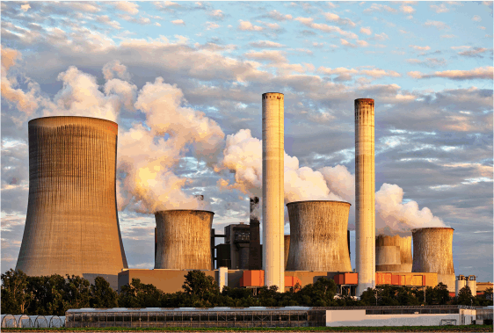
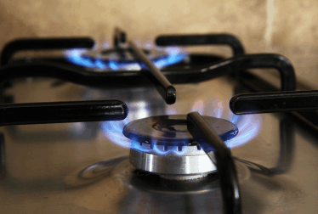
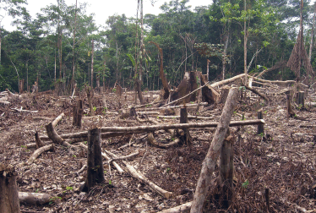


Sources of carbon dioxide (CO₂)
Burning of Coal
Burning of Gas
Land Use Change
Burning of Oil
Cement Production
Notes:
DETAILED FEEDBACK ON SOURCES OF THE GHGs (HIDE QUICK FEEDBACK SLIDE IF YOU WANT TO USE THESE)
Sources Activity Feedback 1/4 – CO₂ (ANIMATED)
Now – I think we all know that by far the most significant source of anthropogenic greenhouse gases, that is greenhouse gas emissions arising from human activities, is the release of carbon dioxide from fossil fuel combustion: the burning of coal and oil and gas. CLICK.
But what other sources of carbon dioxide did you identify?
CLICK. Carbon dioxide is also produced during cement production in the process of making clinker which is a main ingredient of cement. Limestone (which is calcium carbonate) is heated in a kiln at a very high temperature and it breaks down to form calcium oxide and carbon dioxide.
Fossil fuels and cement production are all fossil sources of carbon dioxide – so in all these cases we’re taking carbon that has been locked up for millions of years in geological reservoirs (be that limestone rocks, or coal seams, or oil and gas fields) and we’re adding it to the atmosphere.
CLICK. Land use change is a significant secondary source of carbon dioxide. This is when carbon is released from deforestation or land use changes such as draining peatlands or wetlands. Plants and soils store carbon that was fixed from the atmosphere by plants during photosynthesis. When we cut down forests and degrade soils, this carbon is released back to the atmosphere. Sadly this is getting more significant as time goes on – not because we’re managing to decrease fossil emissions, but because global deforestation rates are increasing.
IMAGE ATTRIBUTION
Burning of Natural Gas: Image by PublicDomainPictures from Pixabay (pixabay.com/photos/appliance-burn-burner-cook-cooker-2257/)
Burning of Oil: Image by Rudy and Peter Skitterians from Pixabay (pixabay.com/photos/petrol-gasoline-diesel-gas-996617/)
Burning of Coal: Image by Benita Welter from Pixabay (pixabay.com/photos/power-plant-industry-chimney-2411932/ )
Cement Production: Image by 272447 from Pixabay (pixabay.com/photos/mason-concrete-float-smooth-cement-694271/)
Land Use Change: Shift cultivation in Columbia from Wikimedia Commons (https://commons.wikimedia.org/wiki/File:Amazon_slash_and_burn_agriculture_Colombia_South_America.jpg). Image by Matt Zimmerman, licensed for reuse under the Creative Commons Attribution 2.0 Generic license (CC BY 2.0) (creativecommons.org/licenses/by/2.0/). No changes made to image.

Slide 32
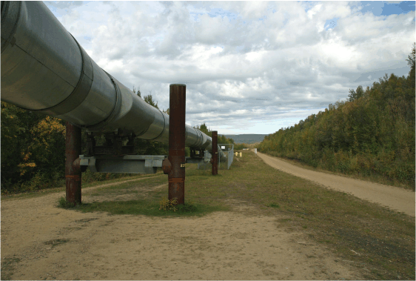
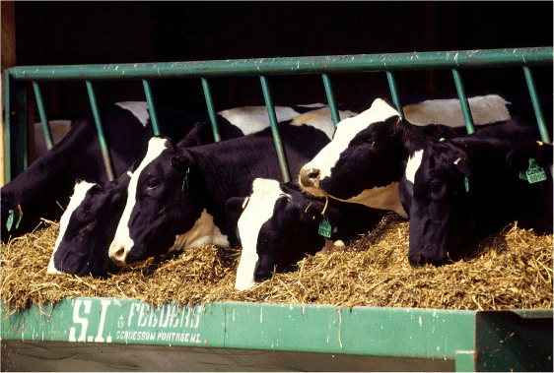
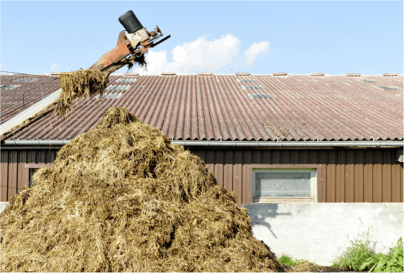
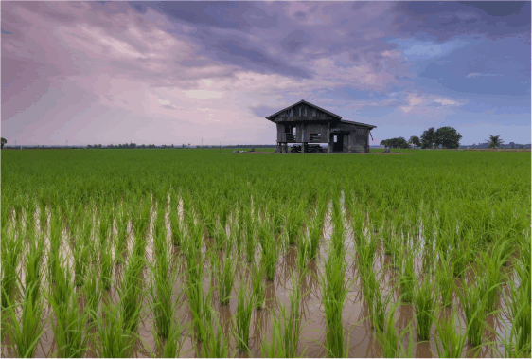
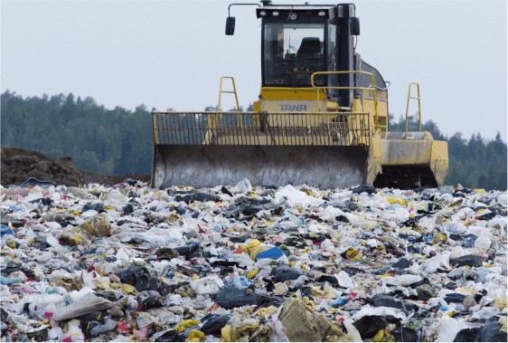
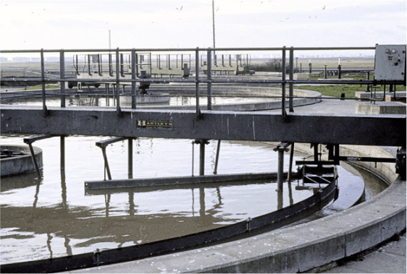
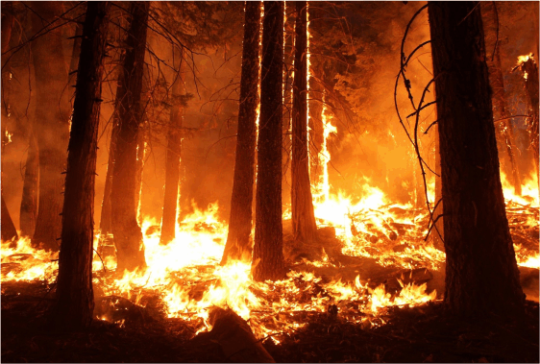
Sources of methane (CH₄)
FF Extraction & Transport
Ruminant Livestock
Manure Management
Rice Paddies
Landfilling of Waste
Wastewater Treatment
Biomass
Burning
Notes:
GHG Sources Activity Feedback 2/4 – CH₄ (ANIMATED SLIDE)
DETAILED FEEDBACK ON SOURCES OF THE GHGs (HIDE QUICK FEEDBACK SLIDE IF YOU WANT TO USE THESE)
So which sources did you have for methane?...[the sources in the game are Ruminant Livestock and Landfilling of Waste] …excellent – well as you may know, these aren’t the only significant sources of methane…
First, we should note that fossil fuel combustion also produces some methane – but this is relatively small compared to the amount of carbon dioxide released, and only accounts for around 4% of global methane emissions.
Much more significant for methane is fossil fuel extraction and transport CLICK– which accounts for around one third – or 33% - of global methane emissions. [Methane is found associated with any fossil fuel deposit – and when we extract those fossil fuels, invariably some methane will be released. Leakage also occurs during transport – by pipeline or other methods such as shipping - where this is referred to as fugitive (or escaping) emissions.]
Now, collectively, the main source of anthropogenic methane is agriculture, which accounts for around 42% of global emissions and is dominated by livestock production – and specifically ruminant animals (which was one of your cards)- CLICK
A ruminant is any animal that chews the cud – so cattle, sheep, goats, deer, and camels are all ruminants. Ruminants have very different digestive systems to ours – with four stomach compartments. Their first stomach, called a rumen, is packed full of microbes that breakdown the cud in a process known as enteric fermentation, where this happens under anaerobic conditions – that is low or no oxygen conditions. Whenever biomass (that’s organic material that comes from plants and animals) is broken down under low oxygen conditions, some methane will be produced.
Indeed, this is what is happening in all our other sources of methane…
So our other agricultural sources of methane are…
CLICK …manure management… [anaerobic conditions often occur where manure is stored in large piles or settlement ponds – so the microbes breaking down the manure will produce methane.]
CLICK …and rice paddies – the waterlogged soils are anaerobic – so the microbes in paddy field soils will produce methane
We also see the same microbial processes happening in the management of human wastes – in both landfilling CLICK and in wastewater treatment CLICK, where anaerobic breakdown of organic matter leads to methane emissions. This accounts for around 18% of global emissions.
Our last source of methane is biomass burning – which accounts for around 3% of emissions. This includes crop residue burning, forest fires (resulting from both natural and human activities), and prescribed savannah, pasture, and cropland burning. It also includes emissions from household biomass stoves. [While complete combustion would only produce water vapour and CO₂, when you get incomplete combustion, other gases like methane are also produced. This happens in smouldering combustion, so lower temperature flameless fires, which are less efficient than flaming combustion, but can also happen in large out of control flaming fires when there isn’t enough oxygen to ensure complete combustion.]
The % of global anthropogenic CH₄ emissions in these notes are from this open access paper: Wang, W., Ren, J., Li, X., Li, H., Li, D., Li, H., & Song, Y. (2020). ‘Enrichment experiment of ventilation air methane (0.5%) by the mechanical tower.’ Scientific Reports, 10, 7276 (11pp). https://doi.org/10.1038/s41598-020-63698-x
IMAGE ATTRIBUTION
Fossil Fuel Extraction & Transport: Image by David Mark from Pixabay (pixabay.com/photos/alaska-alaska-pipeline-oil-67304/)
Ruminant Livestock: Image by 272447 from Pixabay (pixabay.com/photos/cows-cattle-dairy-holstein-farm-526771/)
Manure Management: Image by Benjamin Brandt from Pixabay (pixabay.com/photos/crap-agriculture-fertilize-609771/)
Rice Paddies: Image by Pexels from Pixabay (pixabay.com/photos/beautiful-cottage-rice-field-1866498/)
Landfilling of Waste: Image by Pasi Mäenpää from Pixabay (pixabay.com/photos/landfill-waste-management-waste-879437/)
Wastewater Treatment: Benfleet Sewage Treatment Plant: Primary Settling Tanks from geograph.org.uk (geograph.org.uk/photo/1450088). © Copyright John Rostron, licensed for reuse under the Creative Commons Attribution-Share Alike 2.0 Generic license (CC BY-SA 2.0) (creativecommons.org/licenses/by-sa/2.0/). No changes made to image.
Biomass Burning: Image by 272447 from Pixabay (pixabay.com/photos/wildfire-forest-fire-blaze-smoke-1105209/)

Slide 33
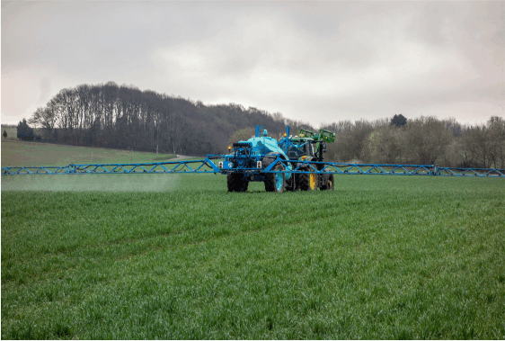

Sources of nitrous oxide (N₂O)
Nitrogen Fertilisers
Manure Management
Wastewater Treatment
Nylon
Production
Biomass
Burning
Notes:
Activity Feedback 3/4 – N₂O (ANIMATED SLIDE)
DETAILED FEEDBACK ON SOURCES OF THE GHGs (HIDE QUICK FEEDBACK SLIDE IF YOU WANT TO USE THESE)
So what did you have for nitrous oxide?...
Yes - as with methane, agriculture is our main source of nitrous oxide – accounting for around two-thirds (or 66%) of total emissions. This is dominated by the use of nitrogen based fertilisers CLICK and applying manure (a nitrogen rich material) to soils, with some additional emissions from manure management CLICK. Here, the nitrogen in the fertiliser or the muck stimulates the microbial nitrogen cycle to produce nitrous oxide.
Like animal manure, human sewage is also a nitrogen rich material – and so wastewater management CLICK also produces nitrous oxide.
Now fossil fuel combustion will result in some emissions of nitrous oxide – again these emissions are relatively small compared to the amount of carbon dioxide released – although they do account for around 10% of nitrous oxide emissions.
Indeed, any combustion process will result in some nitrous oxide emissions, and so biomass burning CLICK is also a source of nitrous oxide – accounting for around 11% of global emissions.
In addition to fossil fuel combustion there are other industrial sources of nitrous oxide. The two most significant are adipic and nitric acid production – which account for around 5% of global emissions. Adipic acid is used in the manufacture of synthetic fibres like nylon CLICK. Nitric acid is used in a number of processes, including the manufacture of N based fertilisers and explosives.
The % of global anthropogenic N₂O emissions in these notes are from the following open access paper and report:
Davidson, E.A., Kanter, D. (2014). ‘Inventories and scenarios of nitrous oxide emissions.’ Environmental Research Letters, 9(10), 105012 (12pp). https://doi.org/10.1088/1748-9326/9/10/105012
UNEP (2013). Drawing Down N₂O to Protect Climate and the Ozone Layer: A UNEP Synthesis Report. https://wedocs.unep.org/handle/20.500.11822/8489
IMAGE ATTRIBUTION
Fertilisers: Image by Franck Barske from Pixabay (pixabay.com/photos/tractor-fertilizer-pesticide-spray-4217686/)
Manure Management: Image by Benjamin Brandt from Pixabay (pixabay.com/photos/crap-agriculture-fertilize-609771/)
Wastewater Treatment: Benfleet Sewage Treatment Plant: Primary Settling Tanks from geograph.org.uk (geograph.org.uk/photo/1450088). © Copyright John Rostron, licensed for reuse under the Creative Commons Attribution-Share Alike 2.0 Generic license (CC BY-SA 2.0) (creativecommons.org/licenses/by-sa/2.0/). No changes made to image.
Nylon Production: Public domain image from PxHere (pxhere.com/en/photo/675499)
Biomass Burning: Image by 272447 from Pixabay (pixabay.com/photos/wildfire-forest-fire-blaze-smoke-1105209/)

Slide 34
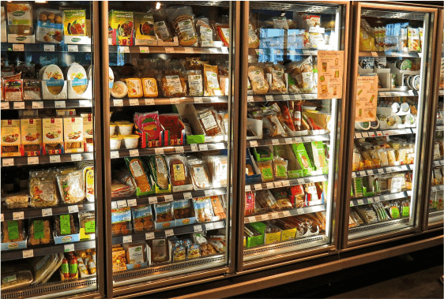
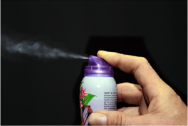
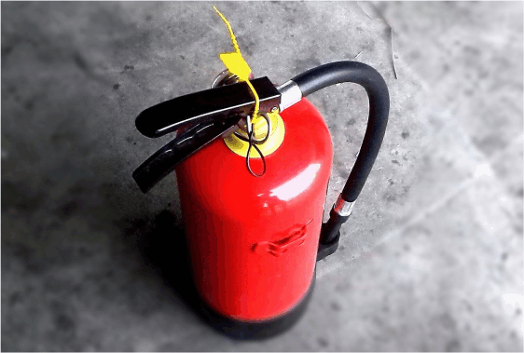


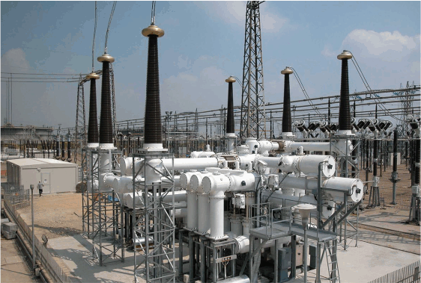
Sources of F-gases
Refrigeration Gases
Aerosol Propellants
Firefighting Agents
Aluminium Smelting
Semiconductor Manufacture
Electrical Insulator
Notes:
Activity Feedback 4/4 – F gases (ANIMATED SLIDE)
DETAILED FEEDBACK ON SOURCES OF THE GHGs (HIDE QUICK FEEDBACK SLIDE IF YOU WANT TO USE THESE)
So what did you have for the F-gases?
The F gases are man-made chemicals – so their only sources are industrial - and their emissions are associated with a wide range of different applications and processes. Many of them were produced as replacements for the chlorofluorocarbons – or CFCs – when they were banned under the Montreal Protocol on Ozone Depleting Substances
HFCs – the hydrofluorocarbons CLICK - are used as aerosol propellants, as refrigeration gases in fridges, freezers and air conditioning systems, and as fire-fighting agents.
PFCs – the perfluorocarbons CLICK – are produced during primary (or new) aluminium smelting, where you don’t get these emissions from secondary (recycled) aluminium.
PFCs are also used as etching gases and cleaning agents in semiconductor manufacture.
Finally, the F-gas sulphur hexafluoride CLICK, is used as an electrical insulator to prevent arcing and electrical fires in high voltage gas insulated switchgear like electricity substations (it is inside the white tubes you can see in the picture).
IMAGE ATTRIBUTION
Refrigerant Gases: Image by Kevin Phillips from Pixabay (pixabay.com/photos/supermarket-fridge-produce-food-949912/).
Aerosol Propellants: Image by 955169 from Pixabay (pixabay.com/photos/fragrance-spray-box-graffiti-night-1502844/).
Firefighting Agents: Image by chitsu san from Pixabay (pixabay.com/photos/fire-fighting-fire-extinguisher-302586/)
Aluminium Smelting: Image by ziodanilo from Pixabay (pixabay.com/photos/cans-texture-aluminum-2542942/)
Semiconductor Manufacture: Image by Republica from Pixabay (pixabay.com/photos/main-board-chips-electronics-89050/)
Electrical Insulator: Sulphur hexafluoride gas circuit breakers in a 420 kV switchyard from Wikimedia Commons (commons.wikimedia.org/wiki/File:GIS_420kV.jpg). Image by Dingy, licensed for reuse under the Creative Commons Attribution-Share Alike 3.0 Unported license (CC BY-SA 3.0) (https://creativecommons.org/licenses/by-sa/3.0/deed.en). No changes made to image.

Slide 35
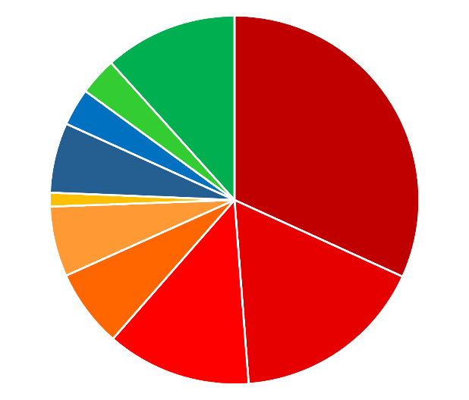
GHG emissions by sector (2019)
Agriculture
5,795 MtCO₂e (12%)
Electricity & Heat
15,835 MtCO₂e (32%)
LUCF
1,642 MtCO₂e (3%)
Energy accounts for 76%
of global GHG emissions
Waste
1,630 MtCO₂e (3%)
Industrial Processes
3,056 MtCO₂e (6%)
Other Fuel
602 MtCO₂e (1%)
Buildings
3,065 MtCO₂e (6%)
Fugitive
3,402 MtCO₂e (7%)
Transportation
8,435 MtCO₂e (17%)
Manufacturing
& Construction
6,297 MtCO₂e (13%)
Notes:
OPTIONAL SUMMARY 1/3 - Breakdown of emissions by sector (all gases expressed as CO₂e)
This pie-chart provides a breakdown of emissions by sector. All the “hot” colours (yellow-red) represent energy related emissions – so we can see our use of energy accounts for nearly three-quarters of global GHG emissions.
Data Source: The data presented here is the 2019 Global (World) emissions (including Land Use Change and excluding Bunker Fuels) from the World Resources Institute CAIT Climate Data set – Historical Emissions – Country GHG Emissions dataset. Available via Climate Watch (climatewatchdata.org).
NOTE: Buildings = energy use in buildings; Fugitive = methane emissions during fossil fuel extraction & transport; Manufacturing & Construction = energy use in manufacturing & construction.

Slide 36
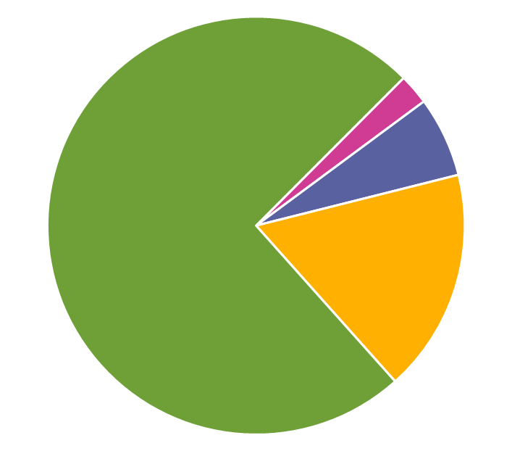
GHG emissions by gas
CO₂ accounts for 74%
of global GHG emissions
F-gases
1,177 MtCO₂e
(2%)
CO₂
36,874 MtCO₂e
(74%)
N₂O
3,097 MtCO₂e
(6%)
CH₄
8,610 MtCO₂e
(17%)
carbon dioxide
methane
nitrous oxide
F-gases
Notes:
OPTIONAL SUMMARY 2/3 - Breakdown of emissions by gas
This pie chart shows a breakdown of global emissions by gas – with emissions of each gas presented as carbon dioxide equivalents. We can see that the dominant anthropogenic greenhouse gas is carbon dioxide, which accounts for nearly three-quarters of total emissions.
Data Source: The data presented here is the 2019 Global (World) emissions (including Land Use Change and excluding Bunker Fuels) from the World Resources Institute CAIT Climate Data set – Historical Emissions – Country GHG Emissions dataset. Available via Climate Watch (climatewatchdata.org).

Slide 37
