Slide 1





Adapt-Ed – Climate Adaptation through Education
Wi-Fi
GreenEstateGuest
1234greenestateguest5678
Welcome
Help yourself to a
drink and sign in

Slide 2




Housekeeping

Slide 3
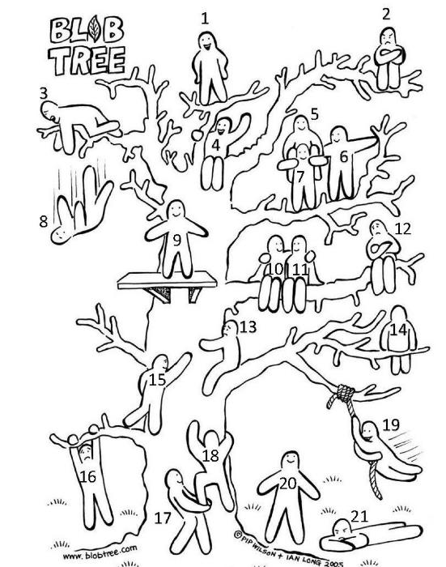
Re-introductions
Who are you?
How have things gone so far?
  Any challenges?
  Any successes?
How are you feeling today?
Pick a number

Slide 4
Teacher and staff consent

Slide 5
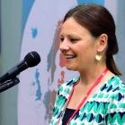



The Team
Alice Jones Hannah Wallace
Lee Jowett Laurie Kooben Professor Aimee Ambrose Dr Pangiota (Giota) Blouchou
Victoria Penman, Sheffield City Council Rob Cattrall, Let’s Go Zero
The Green Estate
Sheffield Hallam
Partners

Slide 6
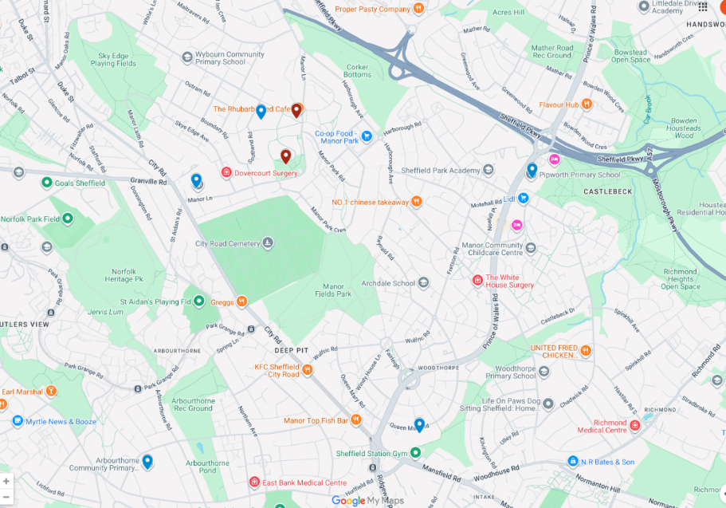
Emmaus Catholic and CoE Primary
Green Estate
Pipworth Primary
Manor Lodge Primary
Prince Edward Primary
Arbourthorne
Primary
Google Maps

Slide 7
Plan for today
9.00-9.30am | Introductions and recaps
9.30-11.00am | Input 1: Green Estate Tour and interventions (Hannah/Alice/Owen) Input 2: Greenhouse effect and climate mitigation(Lee)
11.00-11.15am | Break
11.15-11.45am | Input 3: Climate resilience (Met Office) and data mapping (Lee)
11.45-12.30pm | School visits and activity at GE Let’s Go Zero support and Climate Action Plans
12.30-1.30pm | Lunch
1.30-2.00pm | Sharing your ideas and plans so far
2.00-3.20pm | Planning and development time with the team
3.20-3.30pm | Next steps and feedback

Slide 8
LOGIC MODEL WOrKBOOK
Problem Statement
PROGRAM GOALS
Climate change is already disrupting education and this will get worse. The problem is poorly understood and not part of the curriculum. We need to educate, empower and support schools to provide comfortable, climate resilient environments and use this as a learning opportunity.
Support selected schools to understand and adapt to locally present climate risks through CPD, new curriculum resources and immersive outdoor learning.
INPUTS
ACTIVITIES
OUTPUTS
OUTCOMES
IMPACT
Funding, time, resources (i.e. venues, travel, buy out)
(G) Project governance incl. steering group, mid-way review, adaptive management
Curriculum resources/teaching materials
Better awareness of what GE does and expanded offer from GE
Greater environmental stewardship in community
Expertise (subject, research, evaluation, policy), University infrastructure
(A) 3x teacher CPD sessions, co-design curriculum content
Datasets and reports (evaluation)incl. case studies and recommendations
Proof of concept established (methods)
Community and school ownership of agenda
(A) Experiential, place-based, immersive, creative, outdoor learning activities
Showcases and events
Better knowledge of adaptation challenges and solutions
Climate literacy improved (teachers, students and parents)
Delivery partner (GE) and school participation
(R) Surveys, focus groups, observations, analysis, evaluation, case studies, impact monitoring
Presentations, briefings, publications
Closer, more effective partnership working SHU, GE, SCC, schools
Policy changed in response to evidence (school through to national)
Existing knowledge and frameworks (i.e.RICEF)
(D) Disseminate learning and findings (journals, conferences).
Activities with families – surveys etc.
Learning for other schools extracted and informing policy
Research and policy agenda established
Designed by ©WordLayouts.com

Slide 9
Adapt-Ed Education – Research questions
🧠 RQ1 - Teacher development
How does participation in Adapt-Ed CPD influence teachers’ knowledge, confidence, and capacity to integrate climate adaptation into the primary curriculum?
🌍 RQ2 - Pupil outcomes
How does participation in climate adaptation education influence pupils’ ecological worldview, connectedness to nature, and pro-environmental attitudes?
🏫 RQ3 - School implementation
How do schools embed climate adaptation into curriculum practice, climate action planning, and site-based adaptation measures?
🔧 RQ4 - Intervention effectiveness
What is the impact of a combined model of CPD, curriculum delivery, and immersive outdoor learning on climate adaptation education?
⚖️ RQ5 - Implementation processes
What are the key barriers and enablers experienced by teachers, pupils, and partners when delivering climate adaptation education?
📣 RQ6 - Scalability & transferability
What elements of the Adapt-Ed model are effective and transferable for wider adoption across the education sector?

Slide 10

Funding and Support available
Can cover 2 teachers per school to attend CPD sessions (April, May and September/October) £150 per teacher per day
Green Estate – visit days (covered)
  Travel to Green Estate – can be contributed towards if needed
Celebration event £200 per school
Raise an invoice to us at Sheffield Hallam
  Email to follow

Slide 11
Inputs
Input 1: Green Estate Tour and interventions (Hannah/Alice/Owen)
Input 2: Greenhouse effect and climate mitigation (Lee)
Break
Input 3: Climate resilience (Met Office)
and data mapping (Lee)

Slide 12
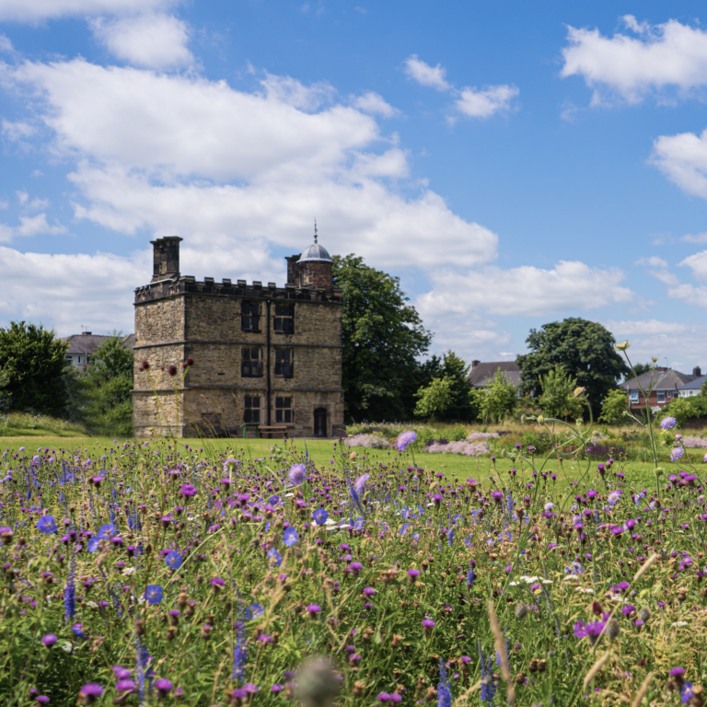
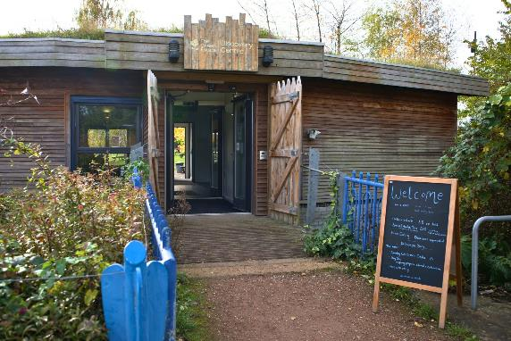

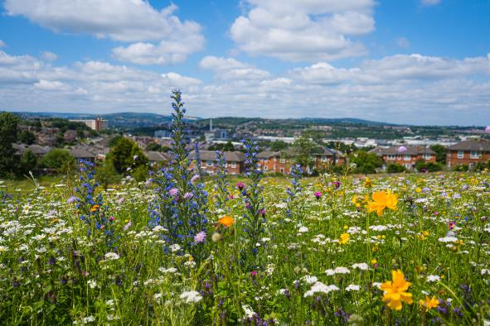

Slide 13
Greenhouse Effect and Climate Mitigation
Lee Jowett

Slide 14

Break

Slide 15
Climate Resilience in Schools (Overheating)
Laura Dawkins
Expert Scientist, Climate Risk and Resilience Met Office

Slide 16
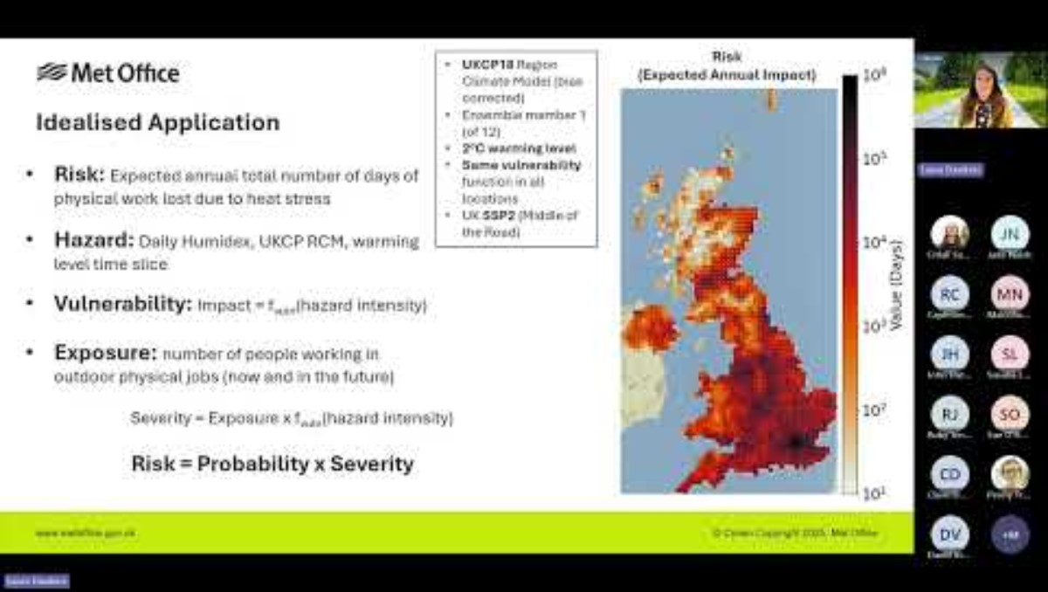
Climate Resilience in schools (overheating)
Notes:
13.48-30.42mins (15 mins)

Slide 18
What does this mean for your school?
It estimates how many school days per year each building is likely to overheat, based on climate projections
Two temperature thresholds are used: 26°C (upper limit of comfortable classroom temperature) and 35°C (a threshold with serious health impacts)
Three scenarios are compared: the current climate, 2°C of global warming, and 4°C of global warming above pre-industrial levels

Slide 19
Caveats to the data
The model groups schools into building "archetypes"
All schools built in the same era and region are given the same overheating estimate, regardless of their individual features (orientation, shading, ventilation, etc.)
Therefore, the figures are indicative rather than precise, best used to start a conversation rather than as definitive predictions

Slide 20
Why does building age matter?
Newer buildings (post-1976) tend to be more airtight and better insulated, which is good for keeping heat in during winter but can trap heat during hot weather
Older buildings like interwar-era schools tend to have higher ceilings and more natural airflow, which provides some natural cooling
This is a real tension between energy efficiency and overheating risk

Slide 21
What does this mean for your school?
School | Building Era | Now (26°C) | 2°C warming (26°C) | 4°C warming (26°C) | Now (35°C) | 2°C warming (35°C) | 4°C warming (35°C)
Arbourthorne Community Primary | Post-1976 | 63 | 76 | 93 | 1 | 3 | 9
Emmaus Catholic and CofE Primary | Post-1976 | 65 | 78 | 95 | 1 | 3 | 10
Prince Edward Primary | Post-1976 | 63 | 76 | 93 | 1 | 3 | 9
Manor Lodge Community Primary | Inter-war | 51 | 65 | 83 | 1 | 2 | 7
Pipworth Community Primary | Inter-war | 51 | 65 | 83 | 1 | 2 | 7
Days per school year (out of 195 total). 26°C = uncomfortable for learning. 35°C = direct health risk.

Slide 22


Slide 23


Slide 24
Spatial Indicators
Climate risk is shaped not just by whether a flood or heatwave happens near you, but by how well your community can cope with it, with factors like income, health, access to transport, and social connections all playing a role.
Researchers have now mapped this vulnerability at neighbourhood level across the whole UK, meaning we can identify with real evidence which schools are serving the communities most exposed to climate harm.

Slide 25
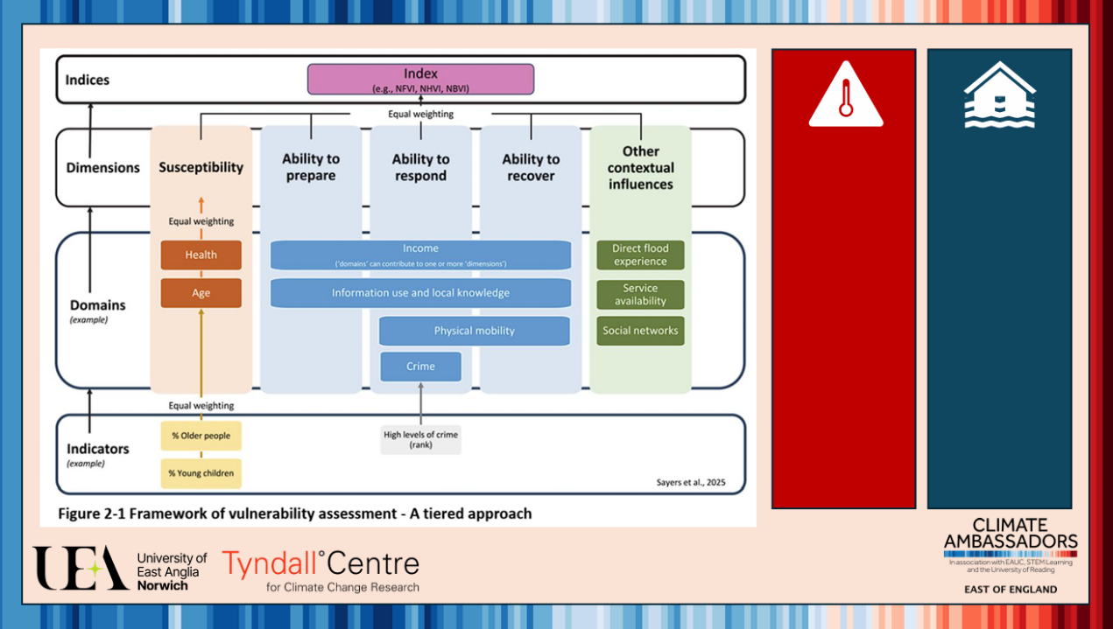

Slide 26
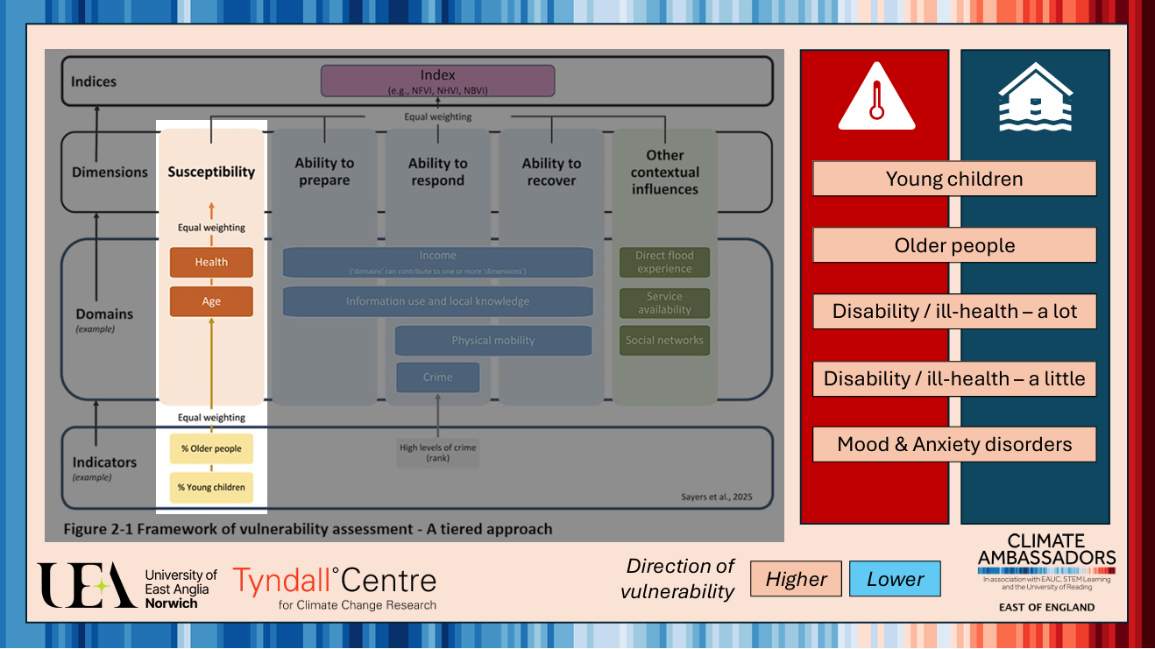

Slide 27
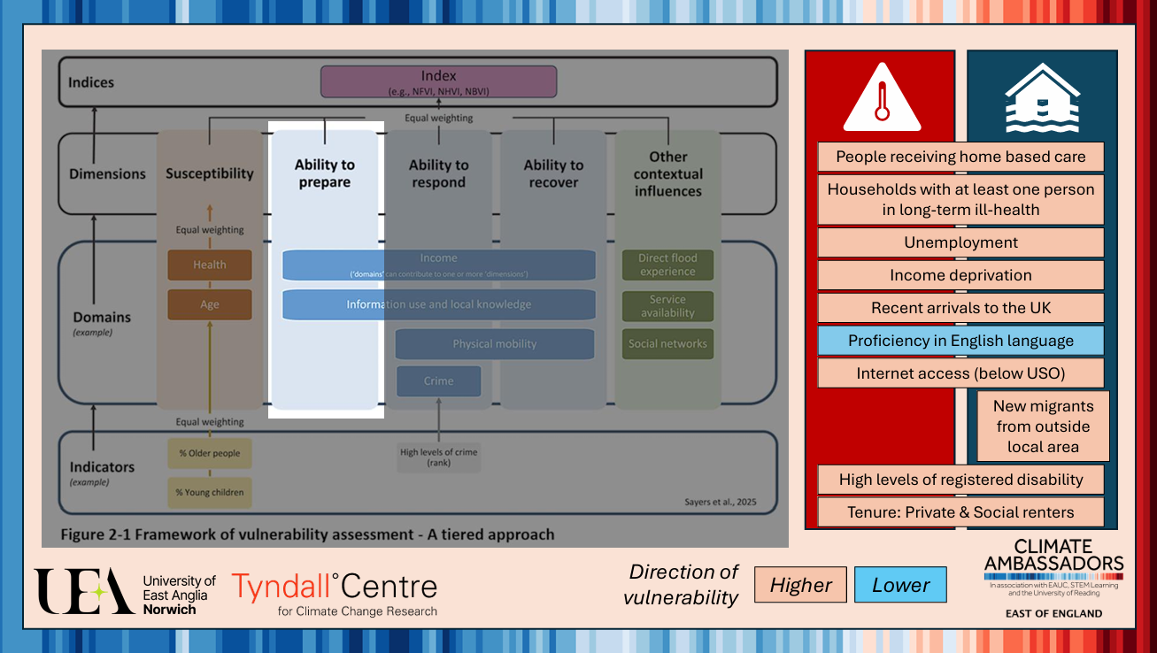

Slide 28
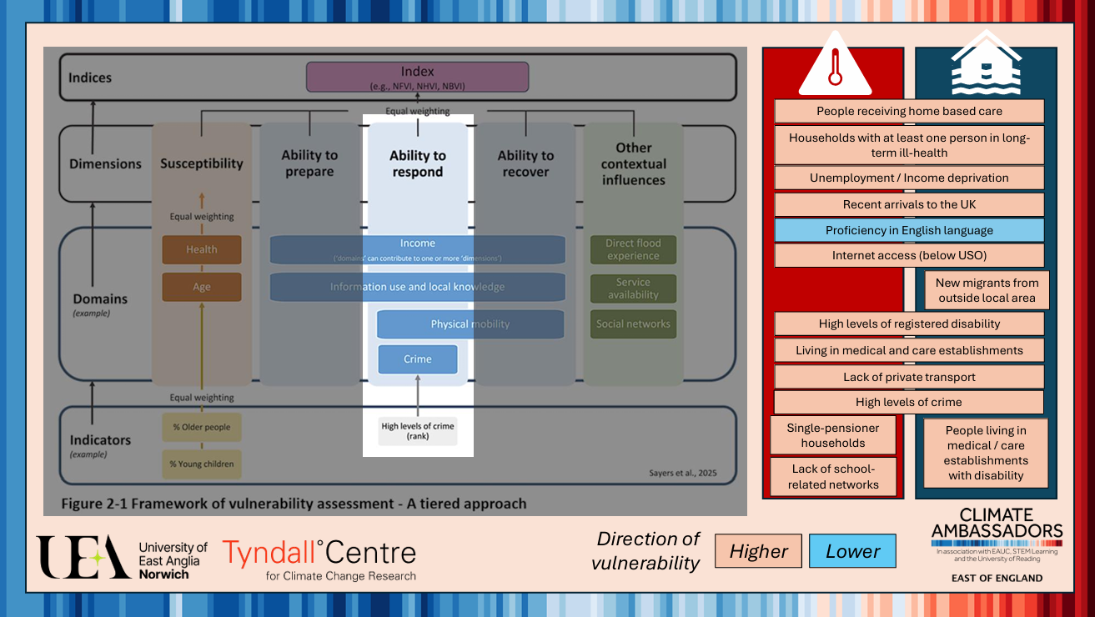

Slide 29
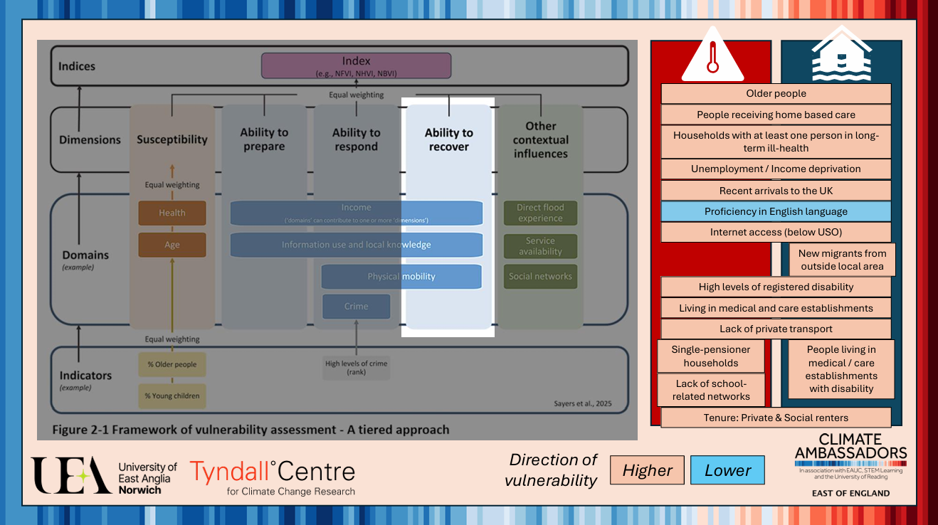

Slide 30
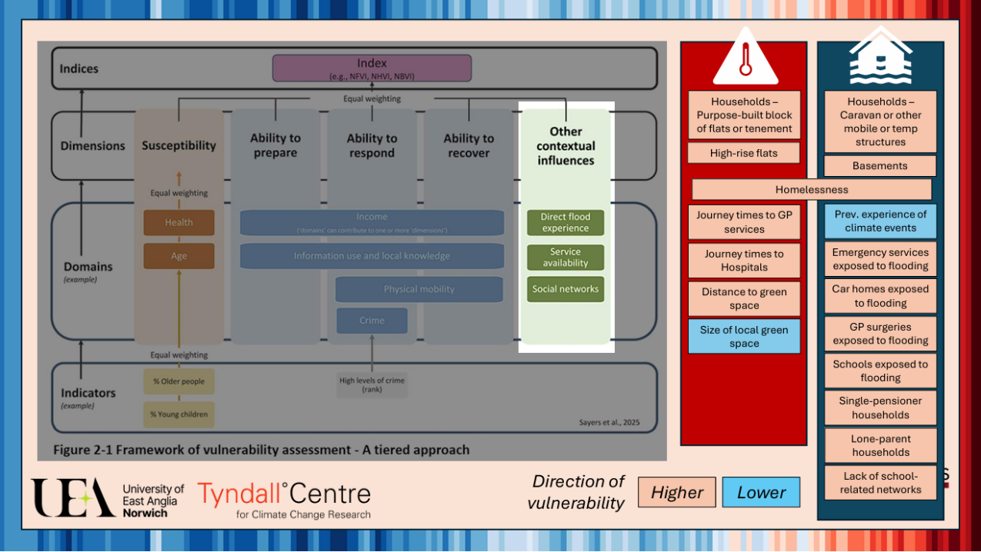

Slide 31
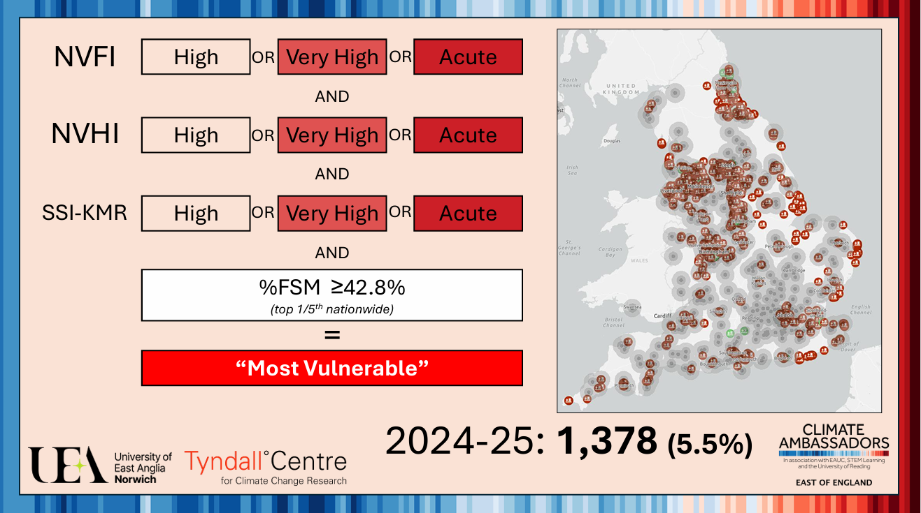
Notes:
NVFI Neighbourhood VulnerabilityFlood Index
NVHI – Neighbourhood VulnerabilityHeat Index
SSI-KMR – School Sustainability Score (KitMarieRackley) – school specific data
Schools Climate Vulnerability Dashboard v1

Slide 32
t.ly/Au69V
Link to heat map, flood risk map and rain map

Slide 33
School visits and activity at GE
In school activities
Celebration events
CPD session 3/celebration
Notes:
w/c 12th or 19th October

Slide 34
Let’s Go Zero support and Climate Action Plans
Notes:
Let's Go Zero is the national campaign of over 9000 schools: uniting teachers, students and communities to tackle climate change. They have a dedicated team of Climate Action Advisors who can offer free support to help your school become more sustainable. This can involve visiting your school, helping you to develop a climate action plan and linking you to local funding and support. If you are interested in the free support, please contact your local advisor Rob.cattrall@letsgozero.org

Slide 35
Lunch

Slide 36
Reflections and discussions
How’s your plans

Slide 37
Delivery model for activities
2 delivery days at Green Estate – either loosely or directly linked to topics you are planning in school
At least 2 activities in school related to climate adaptation
A celebration event in school
What would be useful to support this?

Slide 38
School action planning

Slide 39
Next Steps
Continue with parent consent form (and collect in)
Then, complete the pre-survey with pupils
  We can visit to complete these in school or do via Teams
Look out for an email with purchase orders – pass to finance
Get in touch if you have any questions or issues ☺
  Really looking forward to seeing all the amazing work!

Slide 40
Thank you 🌍

