Slide 1
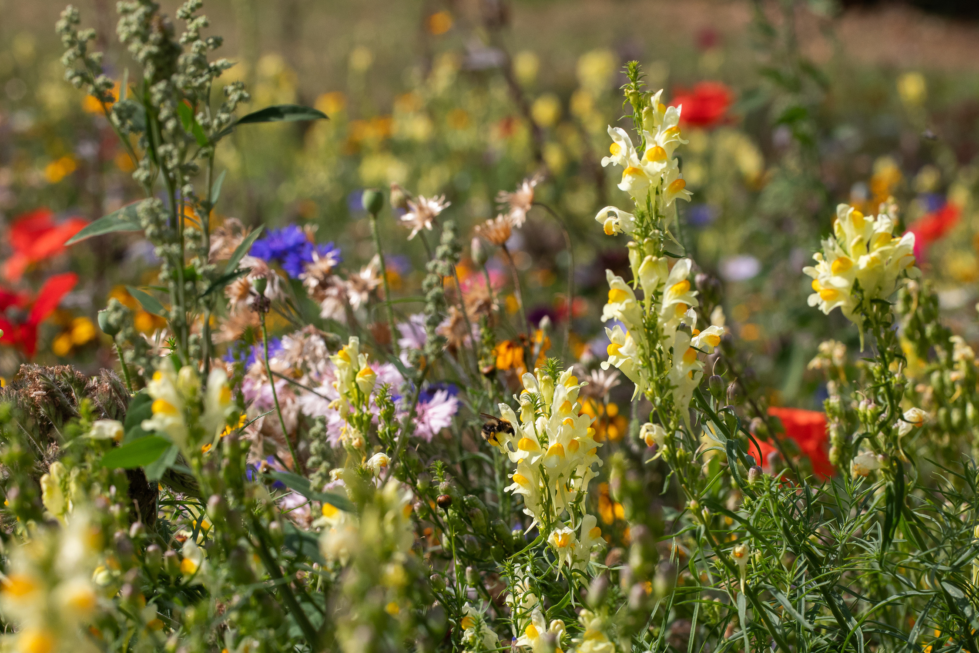


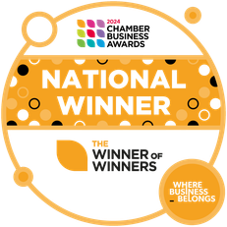
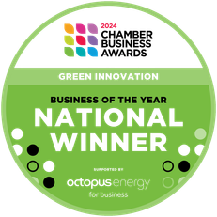

Input 2: Nature-based Solutions
Alice Jones & Hannah Wallace, The Green Estate CIC
Notes:
This presentation is an introduction to our new Three Year Plan 'Roots to Resilience'
Roots - plants/heritage/journey
The plan begins with some work we have begun around understanding what it means to work at place level to build resilience for people and nature.
It includes our mission and values and some fundamental shifts we are making, followed by our 6 goals, some examples of our milestones and the 10 vital signs which we will use to understand the general health of our organisation.
Connected to this summary are more detailed delivery plans, a risks and opportunities register and the budget.

Slide 2


Content
Who are The Green Estate?
What do we mean by Nature-based Solutions?
Flood management
Urban Cooling
Soils and Food Growing
Urban Meadows
Green Space Management
Green Estate & Adapt-Ed

Slide 3

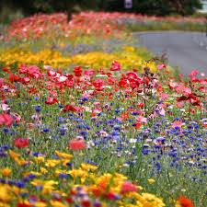
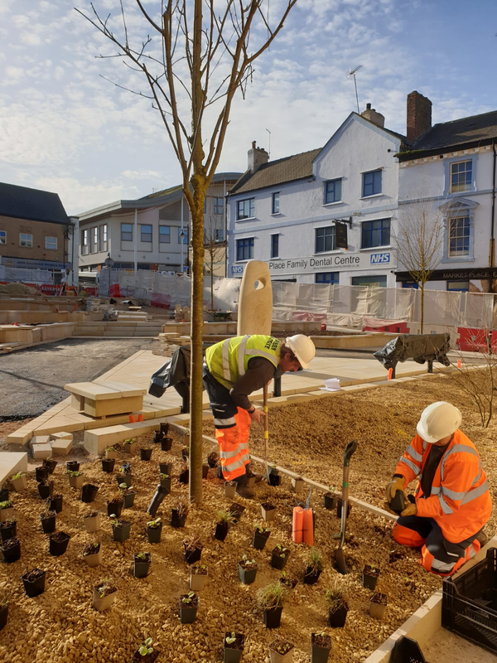
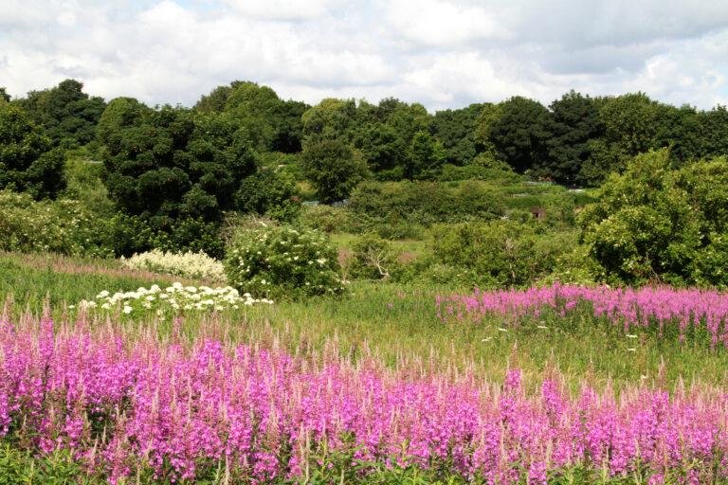
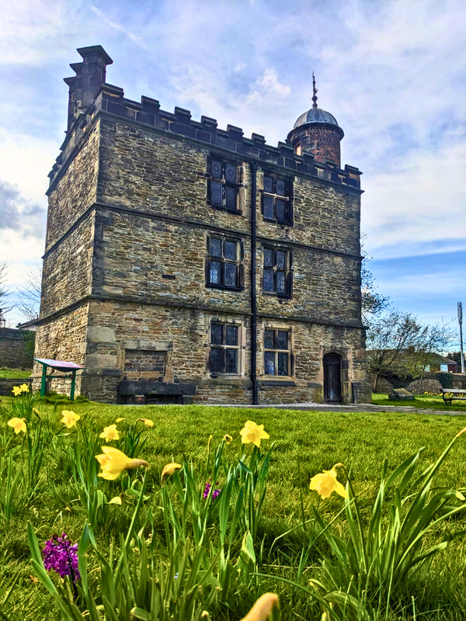

Who are The Green Estate CIC?
Pictorial Meadows
Nature-based
Solutions
Caring for
green space in S2
Manor Lodge
Notes:
This is the first time we have put together a longer than one year plan but it is building on the work we have done over the last four years and it represents a leg of the journey towards our 2030 Ambition.

Slide 4
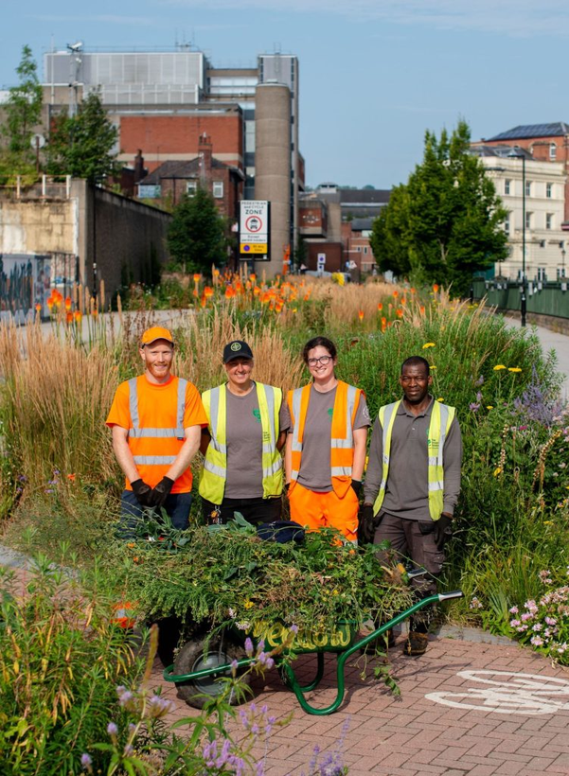
Our Mission
Together we grow green and
resilient urban places for people
and nature to thrive

Slide 5
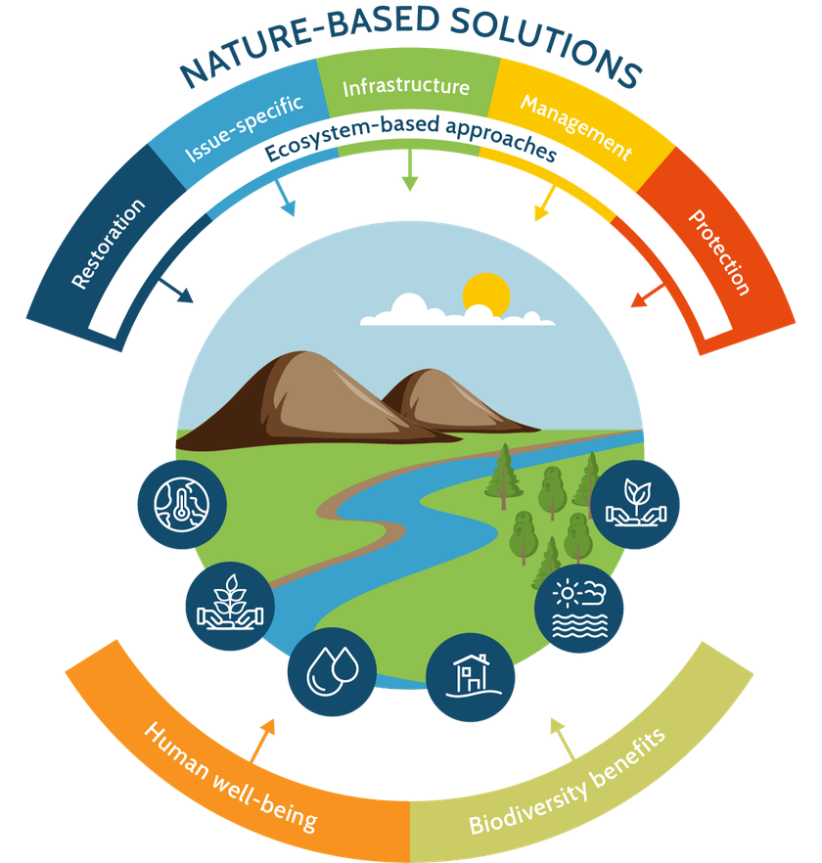
What do we mean by Nature Based Solutions?
  Solutions that leverage nature and the power of healthy ecosystems to address challenges such as climate change, biodiversity crisis and social inequalities
  They are actions that simultaneously benefit people and nature
  They are locally appropriate and adaptive
© IUCN Conceptual framework on Nature-based Solutions

Slide 6
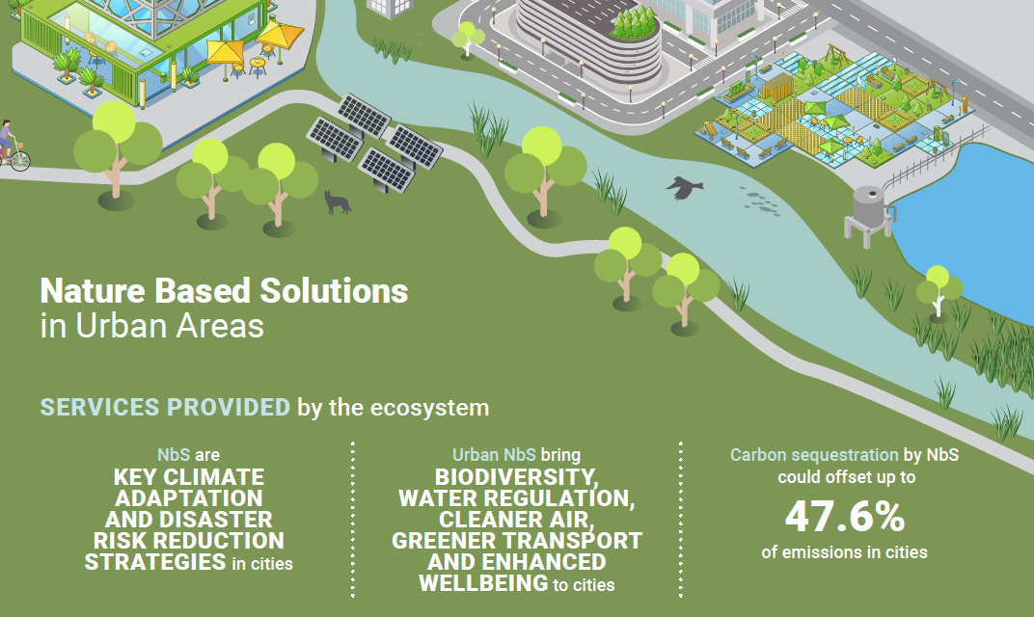
Nature Based Solutions in Urban Areas
Source: United Nations Environment Programme Finance Initiative

Slide 7
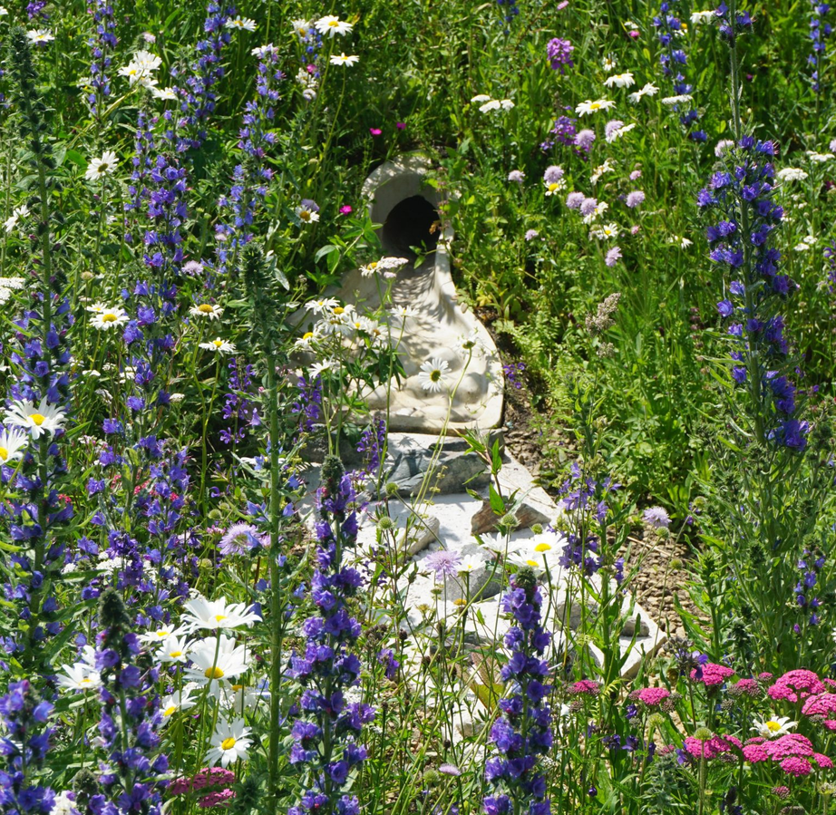
Water Managament in Urban Areas
  Sustainable Urban Drainage Systems (SUDS)
  Slow water flow, increase water absorption and store water
  Use natural elements (like trees, plants and soil)

Slide 8
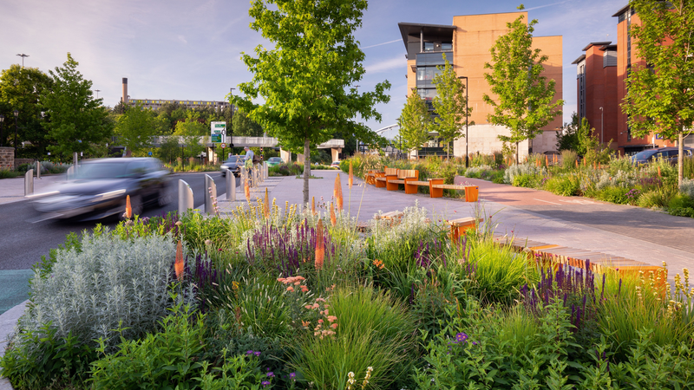
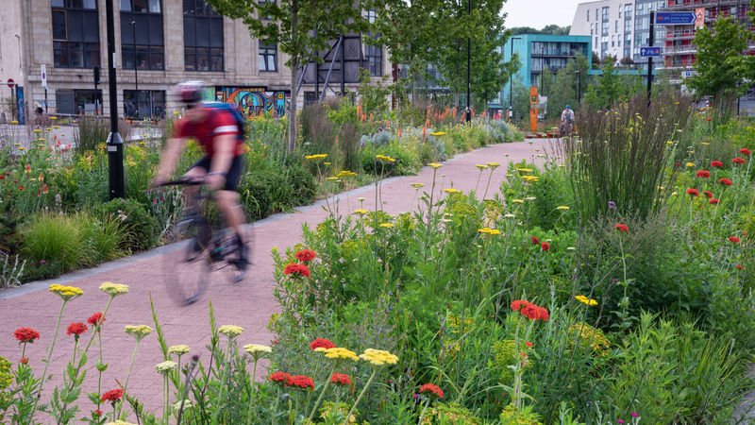
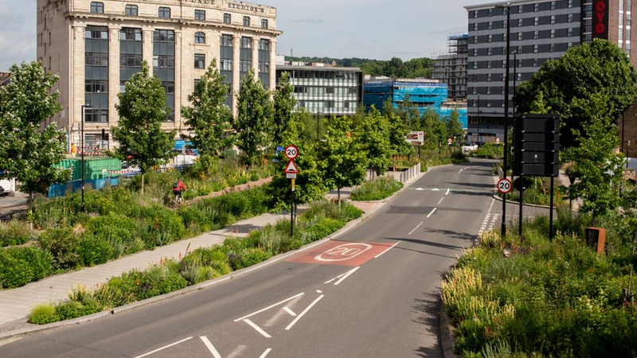
Case Study - Grey to Green
  Prevents 24,000 bathtubs worth of water entering Sheffield’s sewers every year
  Reduces up to 80% flow rate in during high rainfall
  561% increase in biodiversity,
Notes:
- Grey to Green
o Aim to manage surface water in an area dominated by roads
o During periods of heavy rain, rain can drain too quickly leading to flooding and pollutants, such as oil and microplastics, being washed straight into the rivers.
o Cities have underground sewers which carry both wastewater and surface water. With the climate changing, there is expected to be more rain and the system will be overloaded. This could lead to more flooding and increased pollution in our rivers.
o SuDS slow the movement of water and help manage when it is released into the river system. It moves water back into rivers in a way that copies nature – cleanly, slowly, sustainably
o What can be a SuDS?
▪ Plants and soil – using the rainwater, slowing it down, better for wildlife, reduces pollution and heat, can store carbon. Planting holds on to plastics from car tyres
▪ Channels (slowly goes into the ground) and dams (manages flow of water) in the planting, rain can be held for longer; filtering and controlling water before it goes into the river
o Prevents 24,000 bathtubs worth of water entering Sheffield’s sewers every year
o Reduces up to 80% flow rate in during high rainfall.
o 561% increase in biodiversity,
o Nicer for people and the planet
o Cooling the city down during heat waves

Slide 9
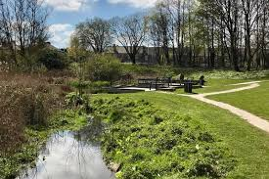
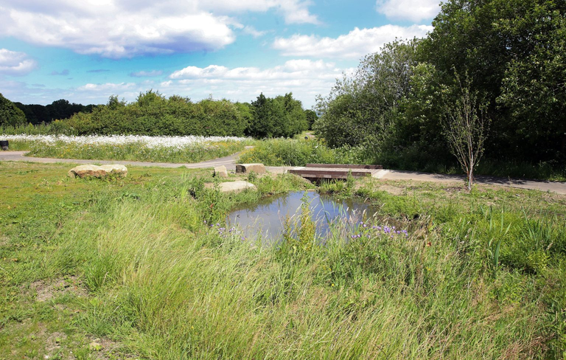
Urban Cooling
  Green roofs and walls
  Parks
  Individual trees
  Urban forests
  Water features

Slide 10
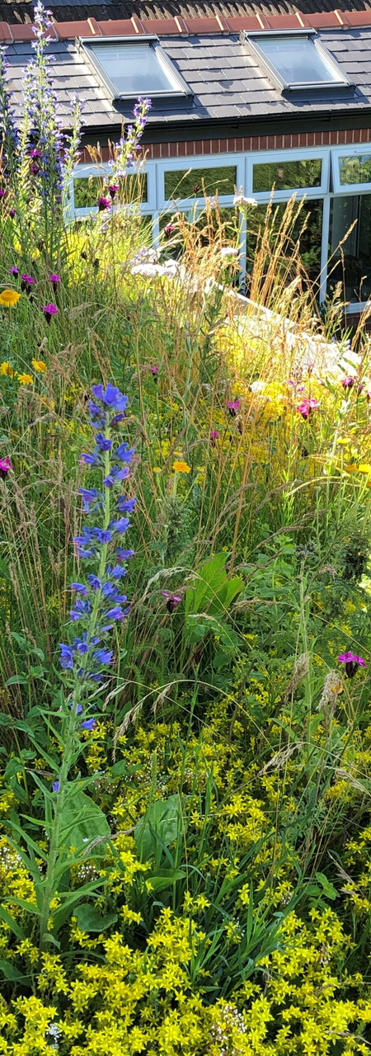
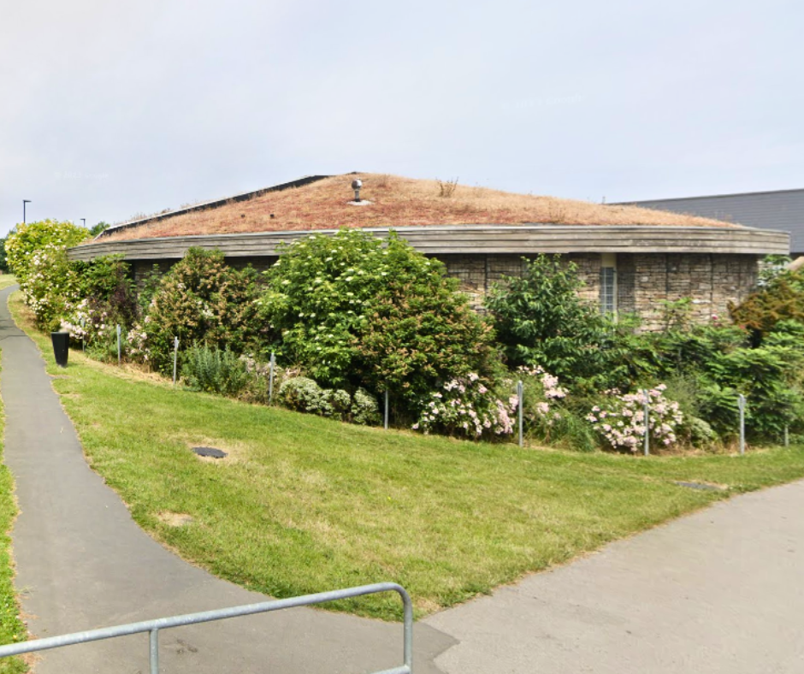
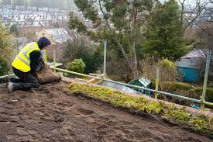
Case Study - Green Estate Green Roofs
  The Green Estate have developed, produced and installed green roof products over the years
  Insulate and cool buildings
  Slow and reduce volume of water entering drains
  Create attractive and biodiverse habitats

Slide 11
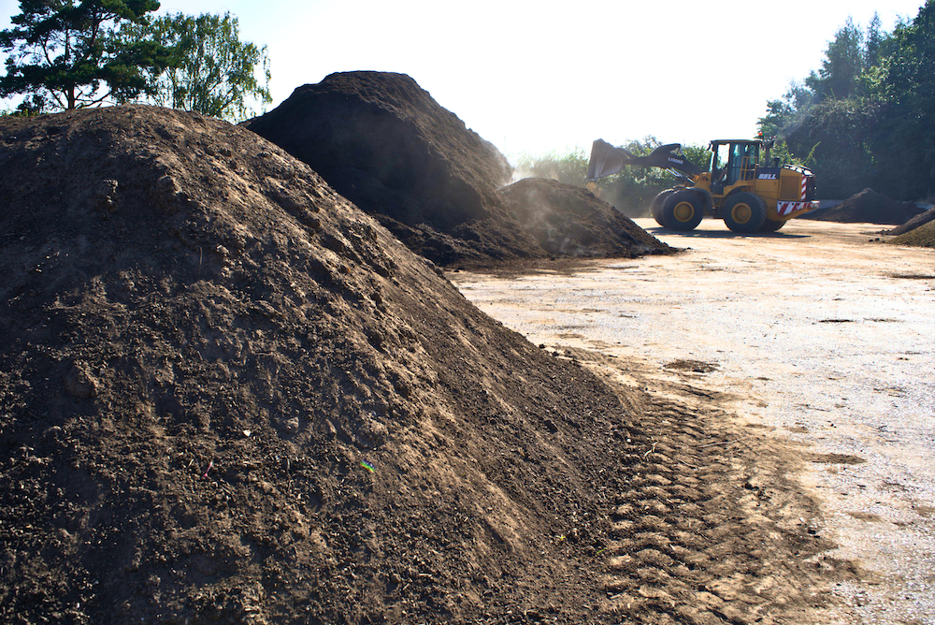
Soils & Food Growing
  Degraded soil is less able to retain water
  Food growing can improve root systems and ensure more water can be retained and absorbed
  Co-benefits of improved health and wellbeing for people

Slide 12
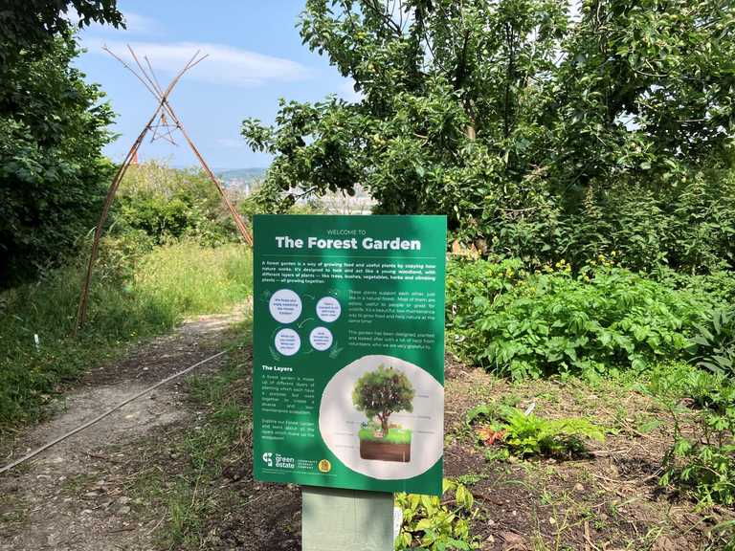
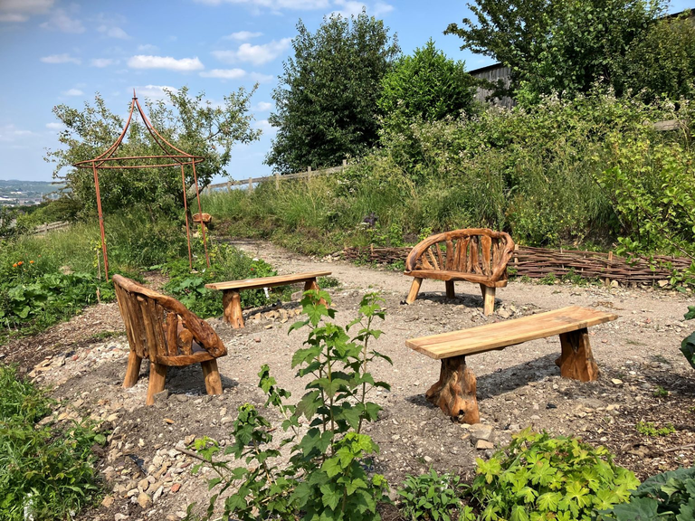
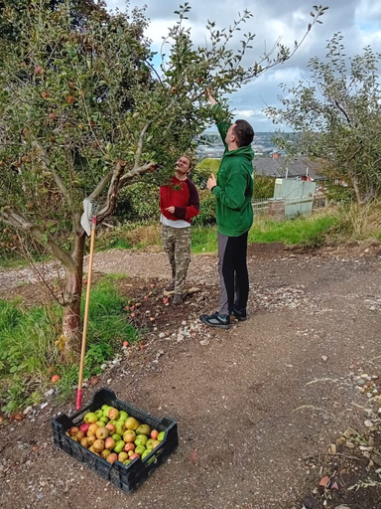
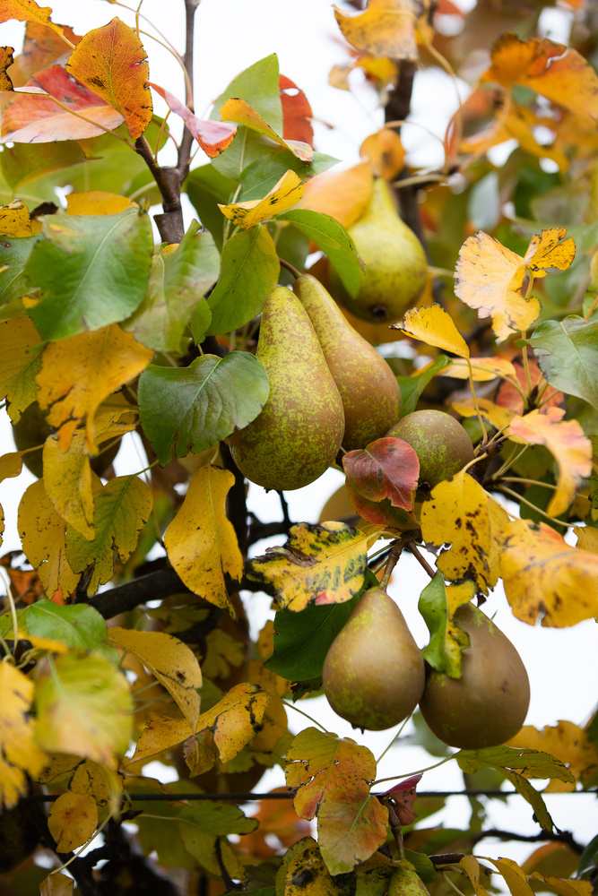
Case Study - Green Estate Forest Garden
  Our forest garden echos the natural ecosystem found in a woodland environment with different layers of plants
  Low maintenance
  Fruit trees and edible hedging
  Improved soils
  Volunteer-led project

Slide 13
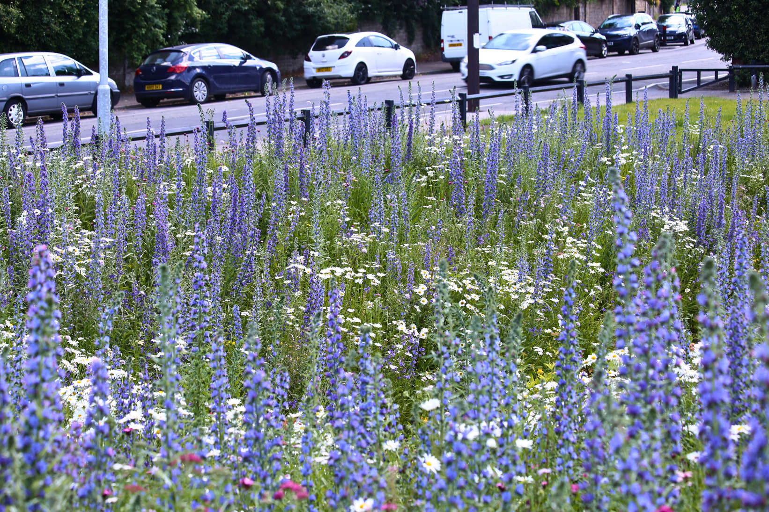
Diverse Planting
  Strengthens ecosystem resilience
  The plants complex, deep roots stabilise the soil and allow water infiltration
  Co-benefits: sequesters carbon and improves health and wellbeing

Slide 14
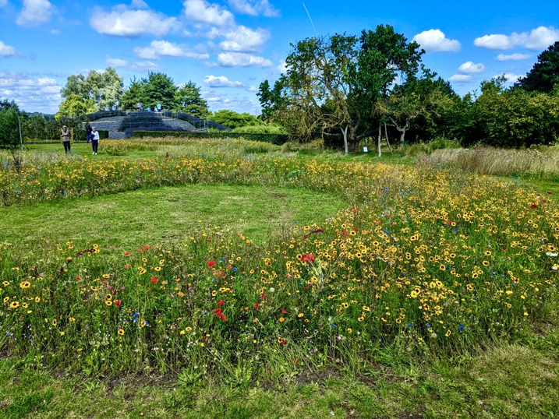
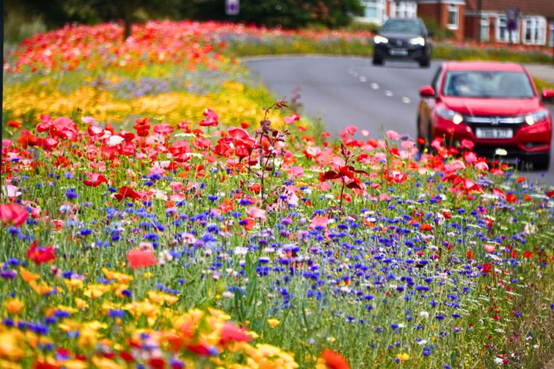
Case Study - Pictorial Meadows
  The Green Estate (in collaboration with the University of Sheffield) have been developing urban meadow mixes for 20+ years
  High-impact meadow seeds mixes that benefit both people and pollinators

Slide 15
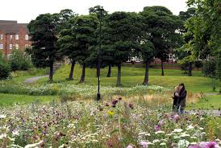
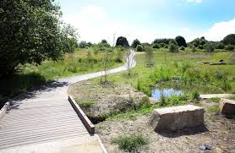
Green Space Managament - cross cutting
  Water management
  Cooling
  Improving soils
  Biodiversity enhancement
  Health and social benefits

Slide 16
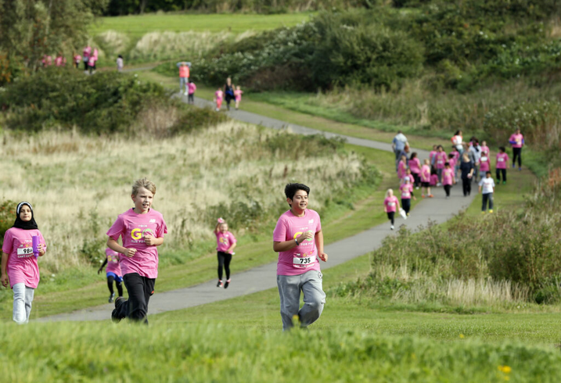
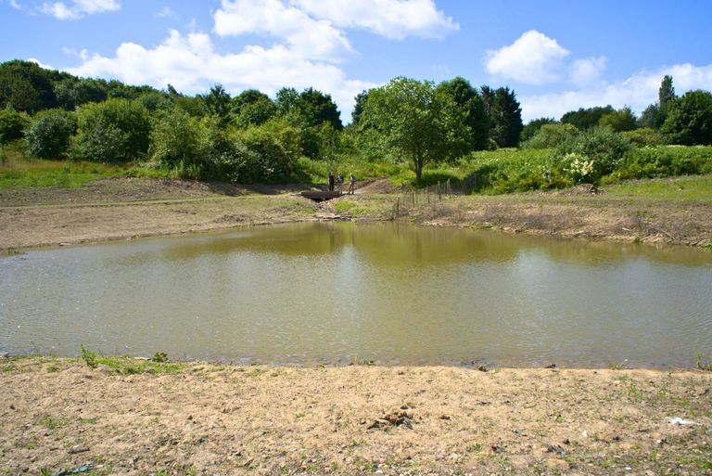
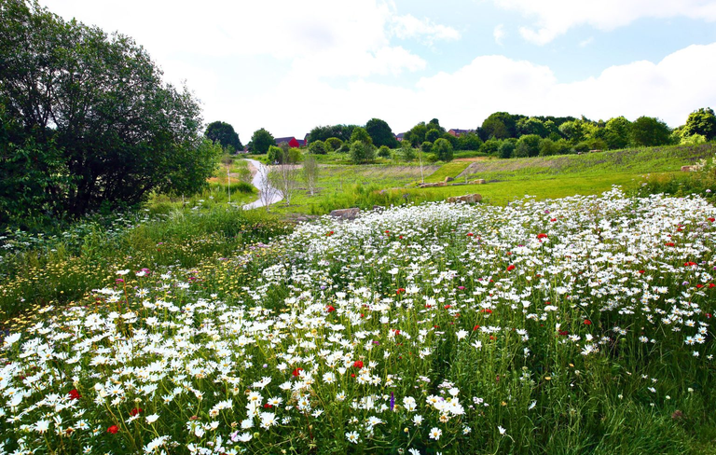
Case Study - Manor Fields Park
  Implemented and looked after by The Green Estate since 2003
  First major SUDs scheme of its kind in the UK
  The SUDs reduce water flow from Kirkbridge Dyke during heavy rainfall
  Lots of community events like park run
  Green Flag Award Winners for 11 years

Slide 17
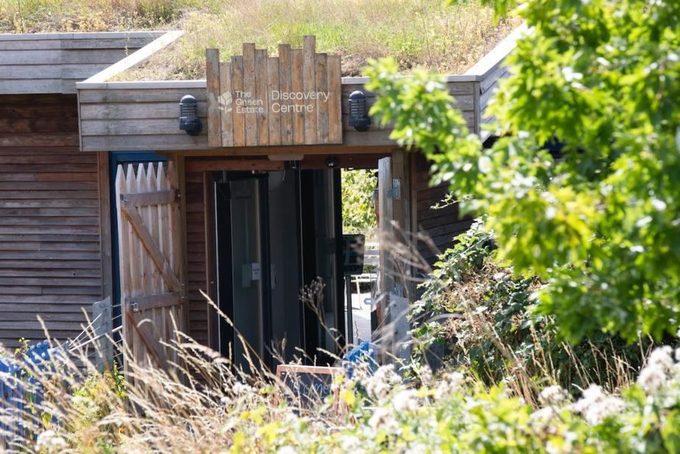
Green Estate & Adapt-Ed
  Many years of experience delivering nature-based solutions, those profits invest in our community and educational work
  Utilise that expertise to educate the next generation
  Collaboration with Sheffield Hallam
  Come to our site for Geography and Science not just history!
  Next CPD session - what do you want to know more about?

Slide 18
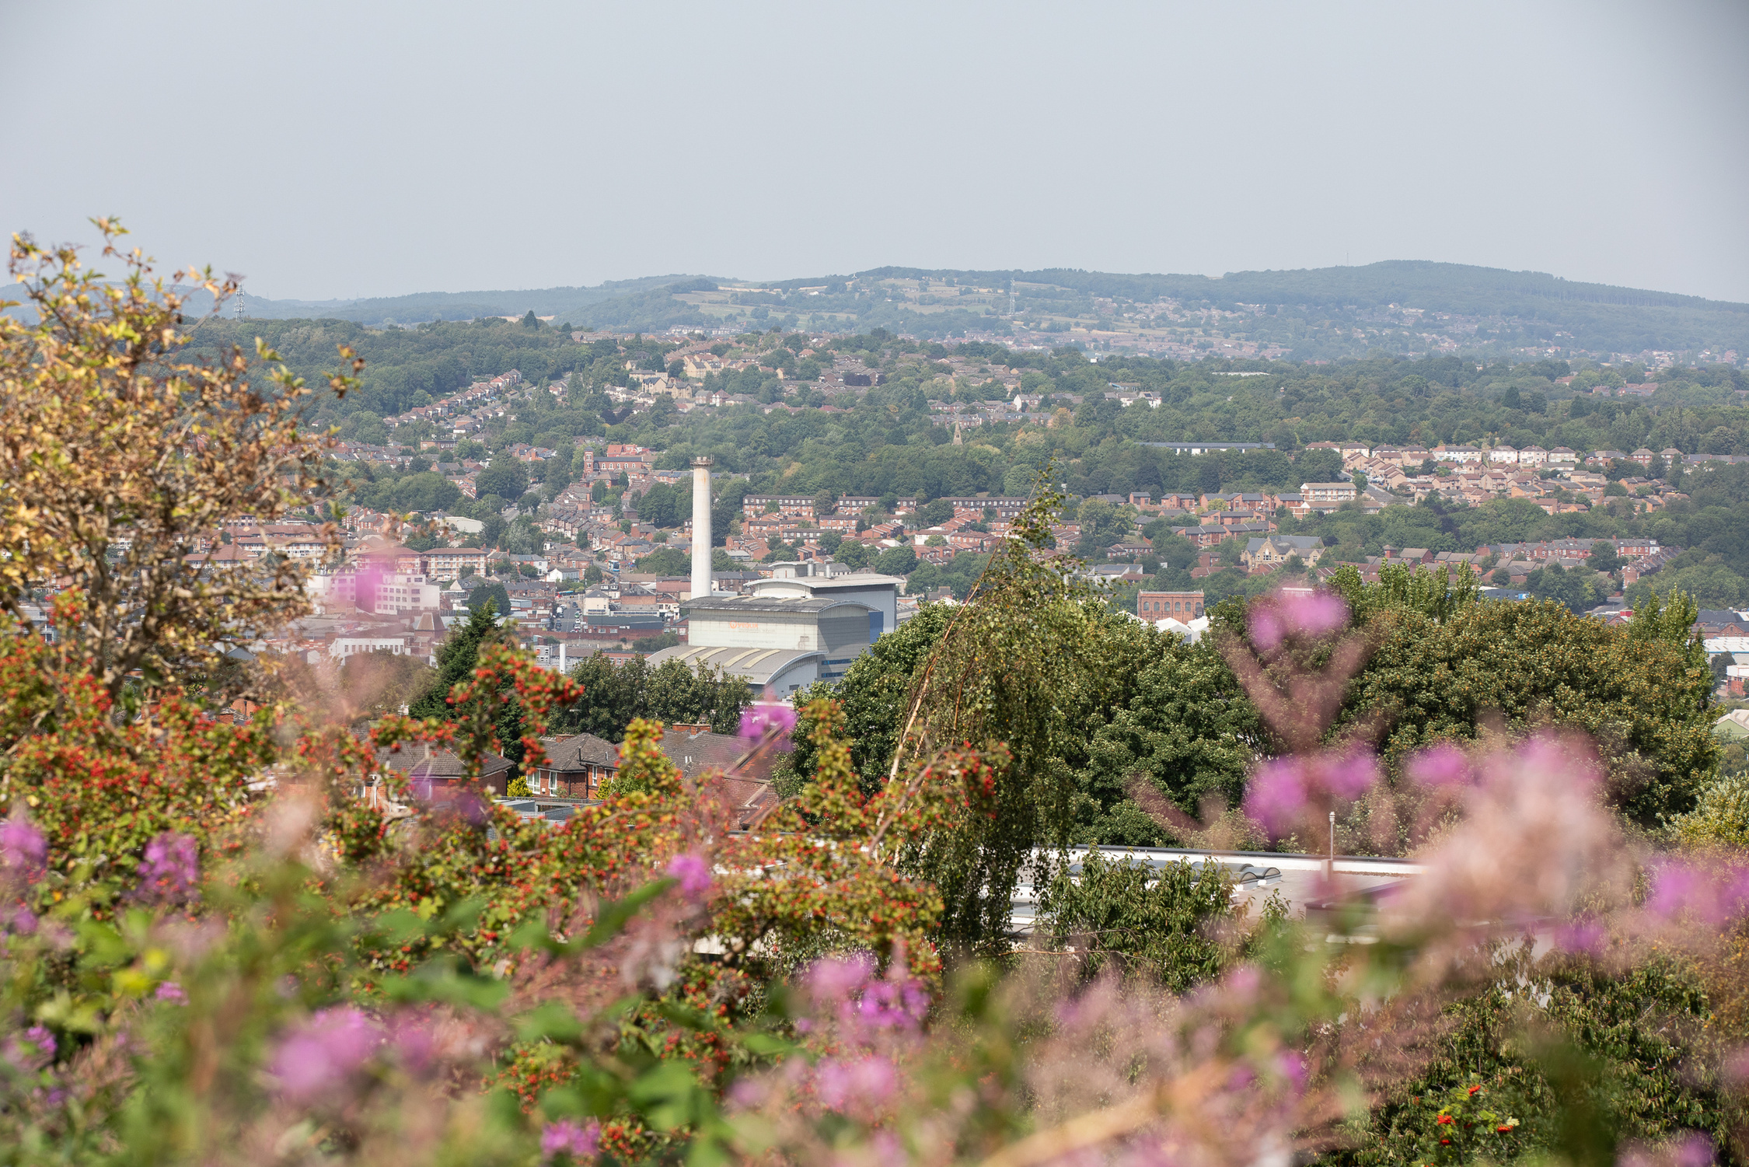
Thank you - any questions?

