Slide 1
Adapt-Ed CPD training 23rd April 2026 Introduction to climate adaptation
Laurie Kooben
PhD student
Centre for Regional Economic and Social Research (CRESR)

Slide 2
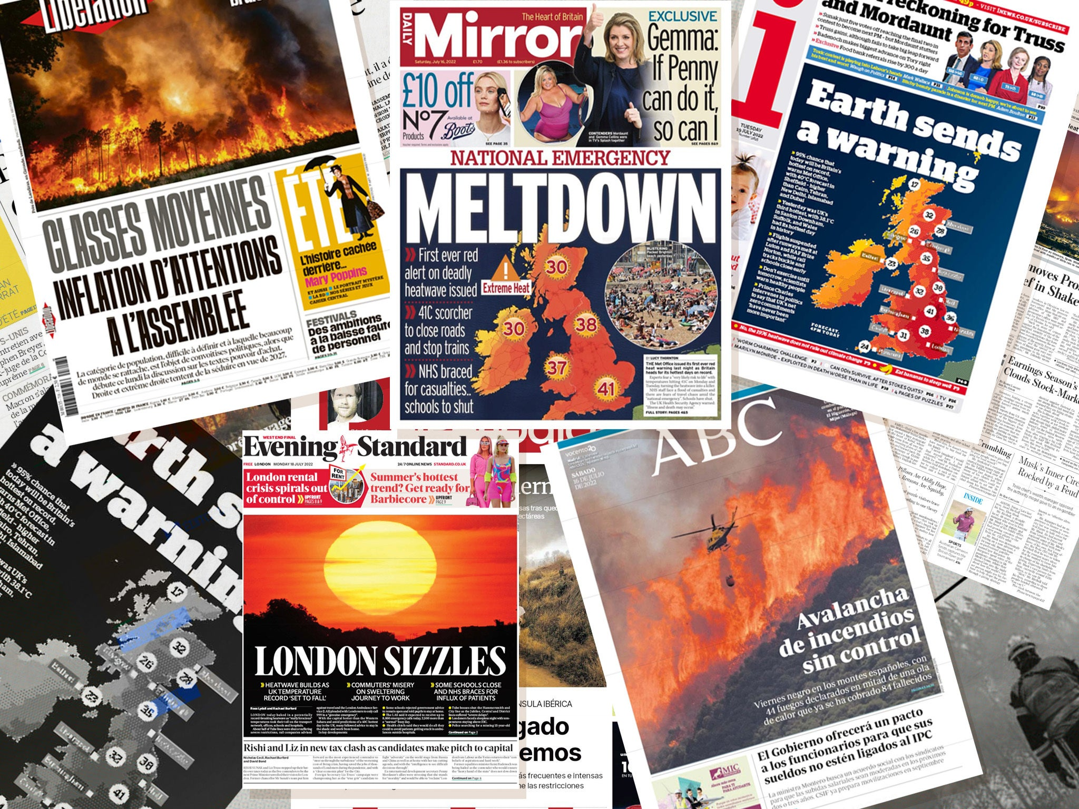

Slide 3
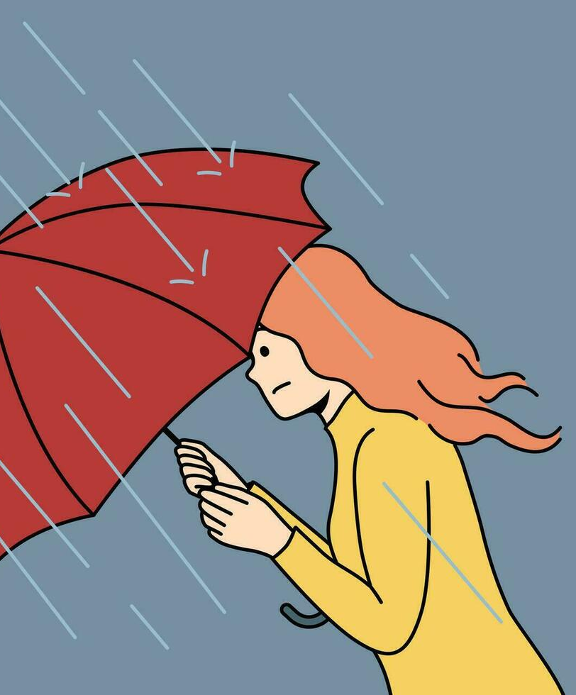

warmer
wetter
winters
hotter
drier
summers

Slide 4

What is climate adaptation?
mitigation
adaptation
avoiding the unmanageable
managing the unavoidable
‘Quadruple’ injustices of climate impact:
Those least responsible for causing climate change...
... live in places where climate change will be most disruptive
... are less likely to have the means to personally adapt to change
... will pay disproportionally towards policy responses
... and have less voice in the process of shaping policy responses

Slide 5



Inequality and adaptation
Social – housing tenure, power relations, social networks
Personal –
age, disability, job, education, income, behavioural
Vulnerability
Environmental –
built environment, physical geography, ecology

Slide 6
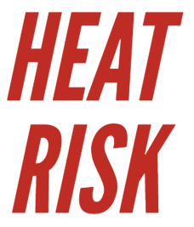

Why schools are important in adapting to climate
Student concentration best between 20-22°C
Absences more likely during heatwaves and flood events
Vulnerabilities are exacerbated during extreme weather
Staff face no maximum legal working temperature
Opportunities for practical learning from small-scale solutions

Slide 7




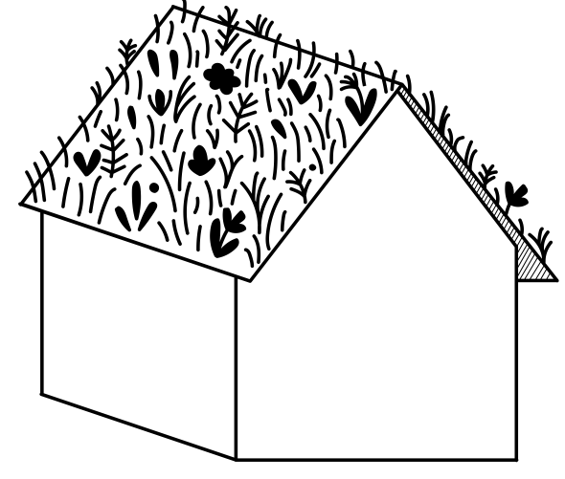


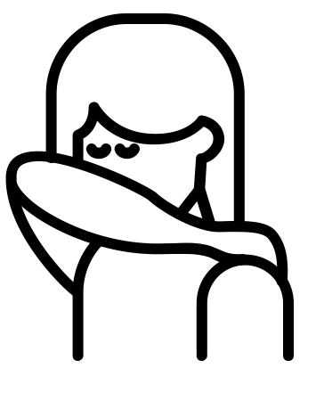


How can schools adapt? – medium / long term
Insulation
Green roof
Ventilation
Air con
Shade
BUIDLING DESIGN
Heat Plan
Vulnerabilities
Scheduling
Uniform
Hydration
POLICY / OPERATIONAL

Slide 8

How can schools adapt? – short term
UK Health and Security Agency (UKHSA) provides practical advice including how to spot signs of heat stress, heat exhaustion and heatstroke.
https://www.gov.uk/guidance/looking-after-children-and-those-in-early-years-settings-before-and-during-hot-weather-teachers-and-other-educational-professionals

Slide 9
Discussion
Opportunities for...
... schools to adapt to climate impacts
... place-based learning

