Slide 1

Climate Change Education Pedagogy

Slide 2
The English national curriculum
‘Sustainability’ and ‘Climate change’ very limited in the national curriculum
Limited to geography and science, and some of D&T
Seen as a scientific phenomenon with little reference to anthropogenic causes

Slide 3
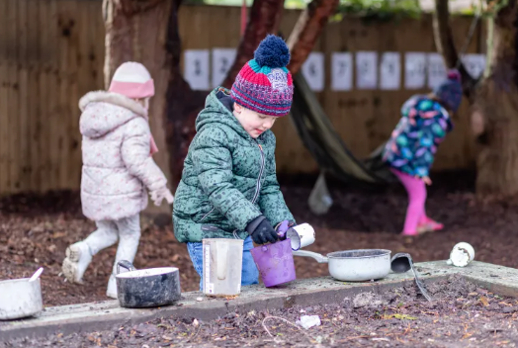
Climate Change and Sustainability
Children born in 2020 will experience a two-to-seven-fold increase in extreme climate (particularly heatwaves) compared to people born in 1960 (UNESCO)
Young people say they are frightened about their future (one study stated as high as 75%, UNESCO)
Getting the message and support right is important from a young age
Early Years Stronger Practice Hub

Slide 4




DfE Policy Paper - 2022
Sustainability and climate change strategy - GOV.UK
Sustainability and climate change: a strategy for the education and children’s services systems
“By 2025, education settings will have designated sustainability leads and a climate action plan.”
“A climate action plan should typically cover the following four areas:
Decarbonisation - calculating and taking actions to reduce carbon emissions
Adaptation and Resilience - taking actions to reduce the risk of flooding and overheating
Biodiversity - e.g. engaging with the National Education Nature Park
Climate Education and Green Skills and Careers - ensuring education provided gives comprehensive teaching about climate change, and teaching staff feel supported to offer this”
Notes:
We have taken each of these areas and come up with some suggested actions. We will deliver a 1 minute intro and then give you 5 minutes to choose some actions for each area.

Slide 5
Study 1 – Taking Action on Climate Change and Sustainability Case Studies from Education Settings Lee Jowett
Study 2 - Primary Teachers' Perceptions of Climate Change Education Dr Stuart Bevins, Joelle Halliday, Lee Jowett, Vicki Pountney, Hongjuan Zhu
Study 3 – Investigating Teachers’ Use of Information about Cutting Edge Research Lee Jowett, Joelle Halliday, Andy Bullough, Prof Emily Perry and Dr Josephine Booth
Research publications – Climate Action in South Yorkshire

Slide 6
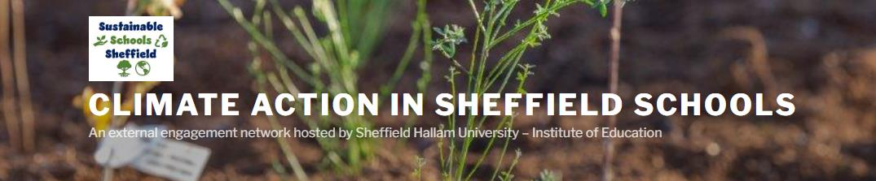
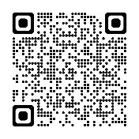
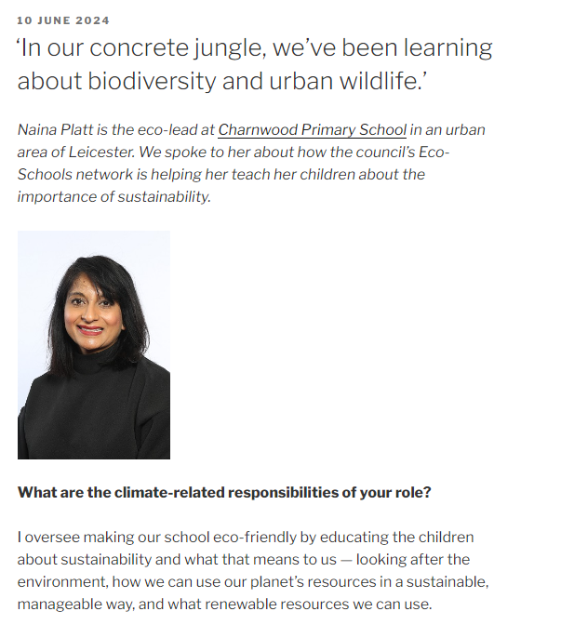
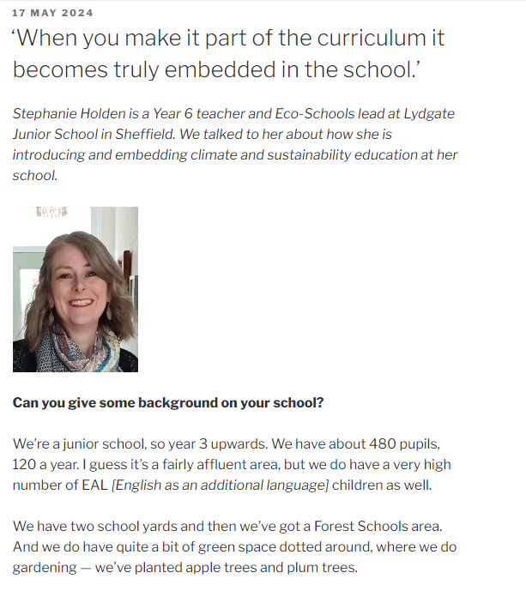
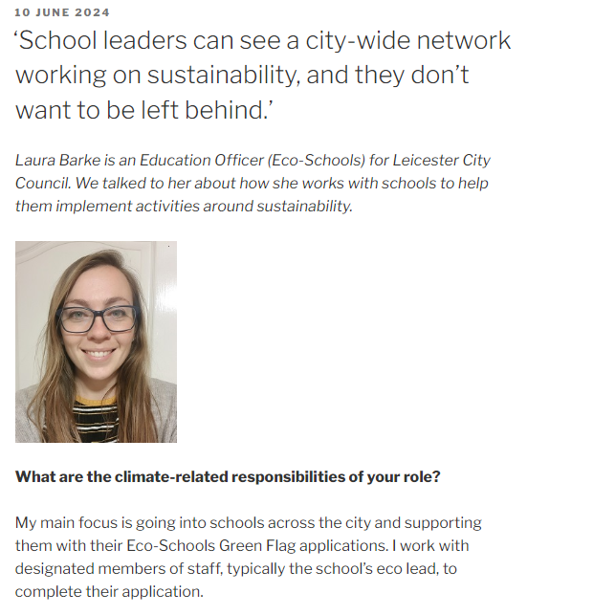
https://research.shu.ac.uk/sustainability

Slide 7
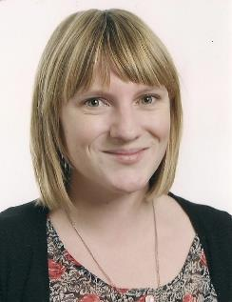

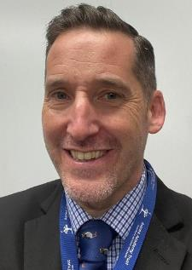
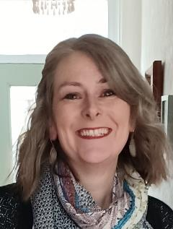
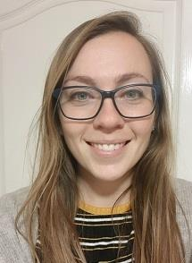
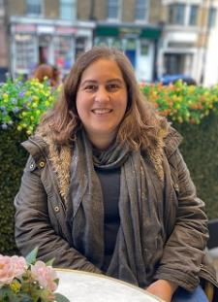
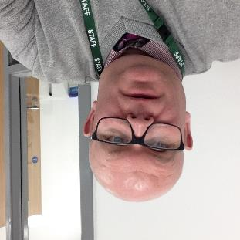
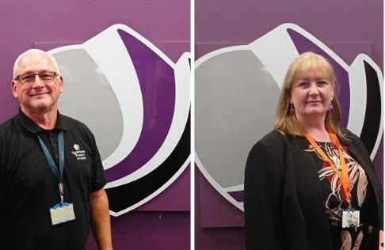
Challenges and barriers
The strategy isn’t mandatory
Inconsistent approaches between settings
Piecemeal content – driven by individuals
Time and space in the curriculum
Resources and funding
Training and CPD
Some of the case study participants

Slide 8
Challenges
Curriculum - Little direct indication of where climate issues fit
Practice – school context and pedagogy, teacher knowledge and confidence
Resources – availability and trustworthiness is an issue

Slide 9
Enablers
School approach to curriculum - whole school approaches, teacher autonomy and creativity
Teachers' knowledge and confidence - infusing into NC subjects, sharing ideas and resources via CPD
Children's interest and experiences - Linking to children's curiosity about the news, local events, relevant starting points

Slide 10
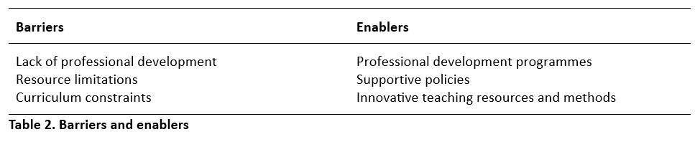

Using Cutting Edge Climate Research
Literature review
Link to report

Slide 11
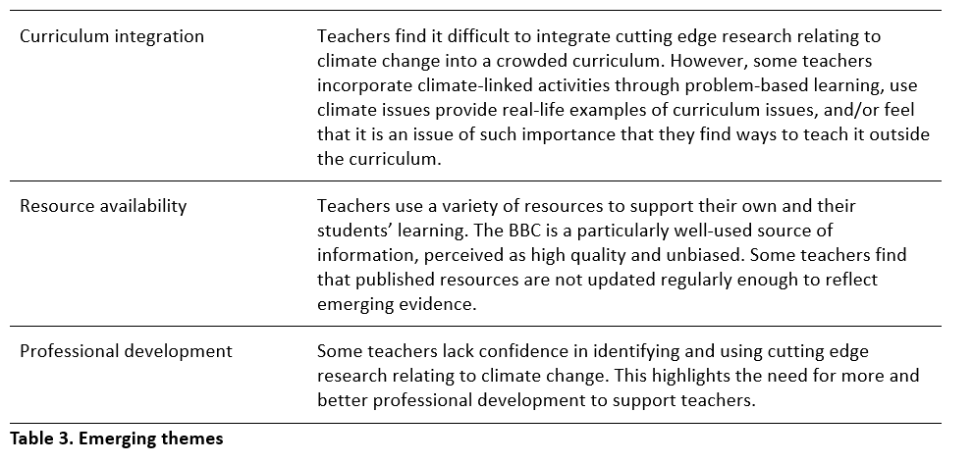
Using Cutting Edge Climate Research
Emerging themes from interviews

Slide 12


Why Measure Climate Education?
Student attitudes towards the environment are notoriously difficult to measure (Manoli et al., 2007)
Adults’ pro-environmental attitudes and behaviours are created in childhood, mainly due to their experience of nature (Chawla and Cushing, 2007; Hinds and Sparks, 2008).
When adult environmentalists were interviewed about their reasons for protecting the environment they frequently mention two reasons: positive experiences in childhood and the influence of role models (Chawla, 1999; Palmer et al., 1999).

Slide 13
How Do We Measure Climate Education Impact?
Changes in knowledge? (Monroe et al. (2017)
Changes in academic performance? Bartosh et al. (2006), Mayer-Smith et al (2009), Ofsted (2009)
Changes in attitudes and behaviour? Jelle Boeve-de Pauw and Peter (2013), Coertjens et al.(2010)

Slide 14
Research informed Climate Education (RICE): A framework for teaching and learning
What do they know:
Family, local community & school
What they do:
engaging in climate action outside of school
Green careers:
Connecting with those who are taking action on climate change
Climate knowledge:
Value and build ‘be sceptical’ (e.g. greenwashing)
How they think:
Ensuring climate action is part of everyday life
Based on the Science Capital Teaching approach
Notes:
Lee

Slide 15
Research Informed Climate Education (RICE): A framework for teaching and learning
Extending: beyond the taught curriculum
Greenwashing
Climate literacy: building knowledge in a sequenced order
Equality and social justice
Eco-anxiety: acknowledging and targeting
Personalising and localising: solutions focused
Valuing: recognising and acknowledging experiences
Creating Agency – creating actions
Outdoor Learning – learning in and with nature
Knowing people – in climate ‘green’ roles
Climate Consumption: Where do they get their information?
Based on the Science Capital Teaching approach
Notes:
Lee

Slide 16
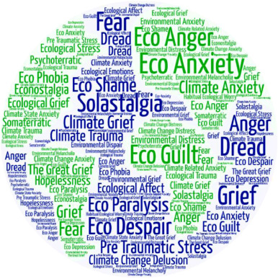
How do we tackle the climate crisis without causing more harm in young people?
Eco-anxiety: acknowledging and targeting
Valuing: recognising and acknowledging experiences
Eco-anxiety is the distress caused by climate change where people are becoming anxious about their future
Indigenous peoples, children and young people, and those connected to the natural world are most impacted by eco-anxiety (Coffey et al, 2021)

Slide 17
How do we tackle the climate crisis without causing more harm in young people?
Eco-anxiety: acknowledging and targeting
Valuing: recognising and acknowledging experiences
Young people are concerned about the climate (59% very or extremely)
Many rated government responses to climate change negatively and feeling betrayed
Climate and anxiety are correlated with perceived inadequate government responses (Pihkala et al., 2021)
Speak with concerned hope (Prof Sylvia Knight, RMetS) What Is Climate Literacy And Why Do Pupils Need It?

Slide 18
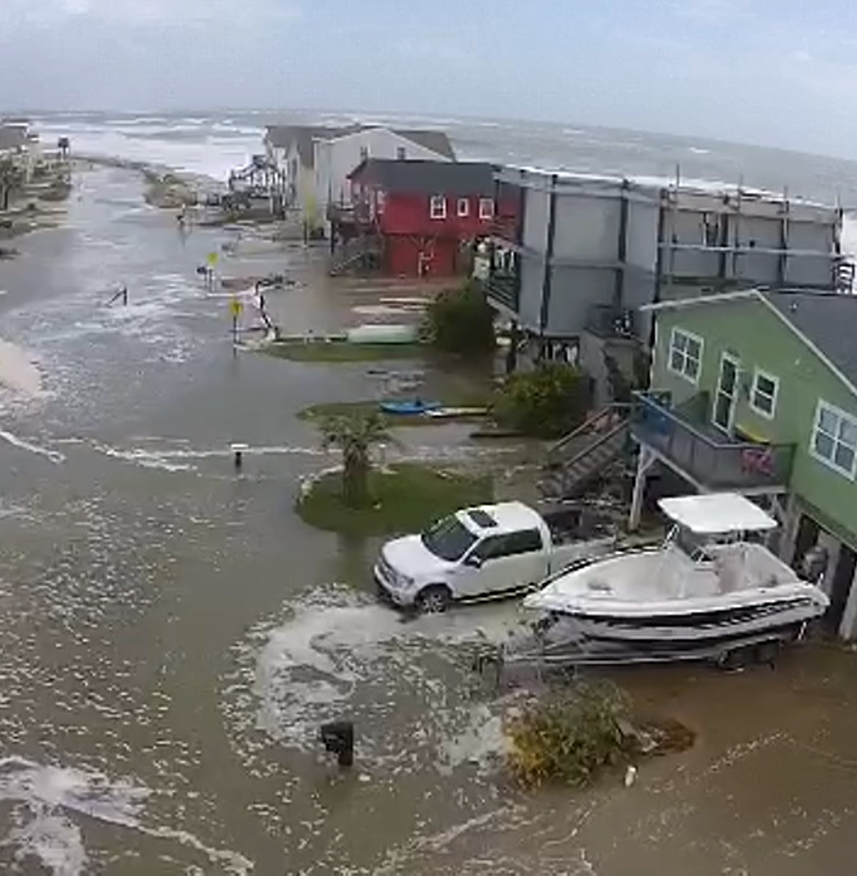
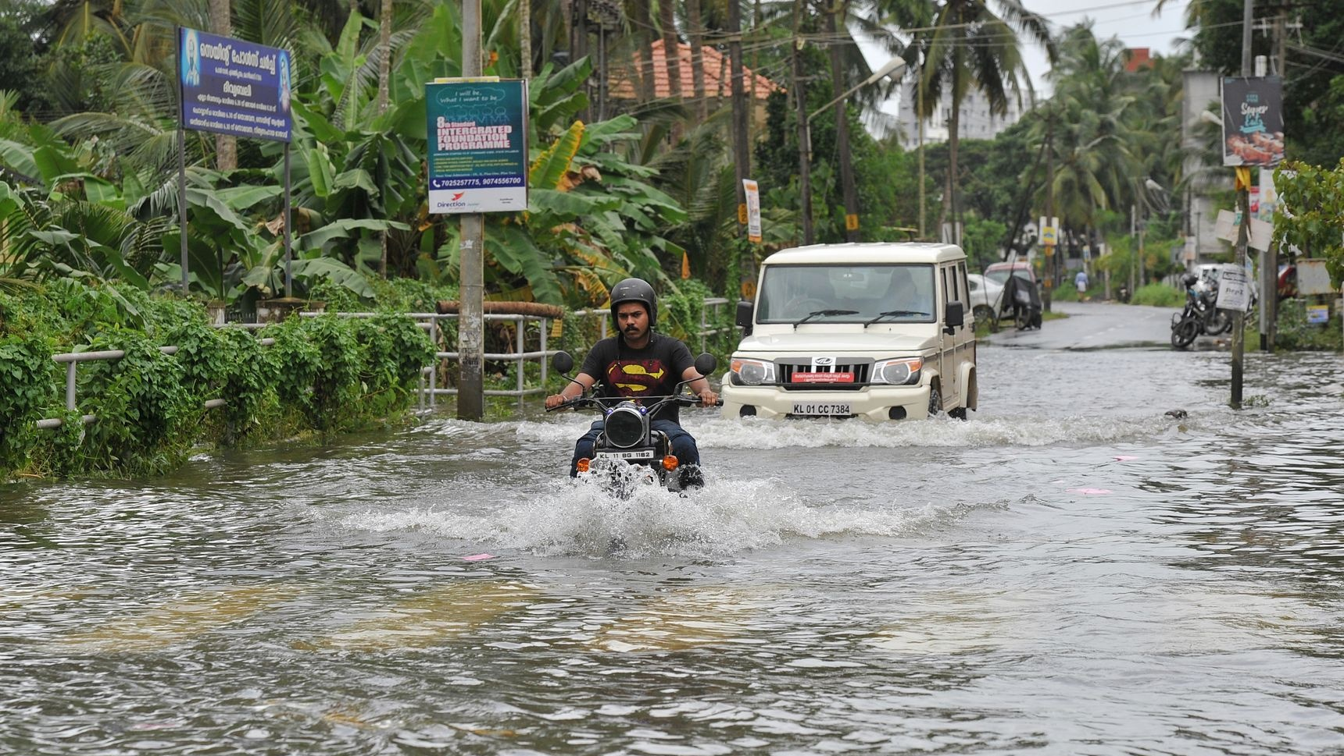
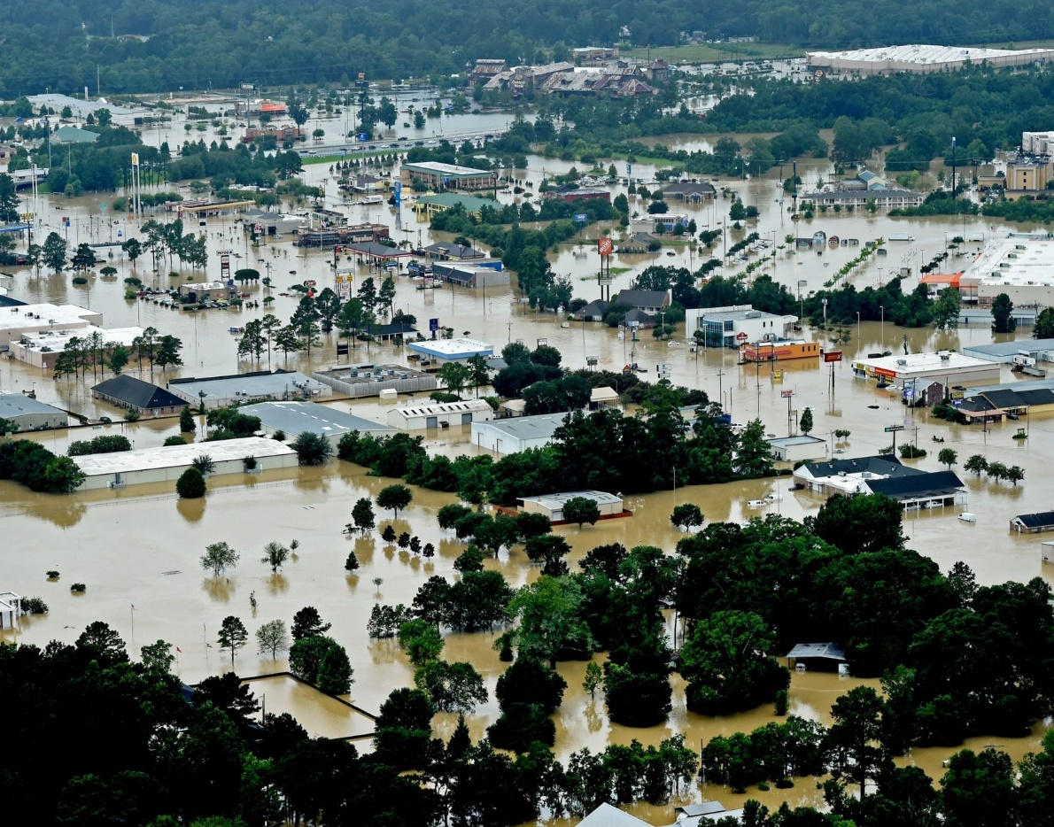

Slide 19
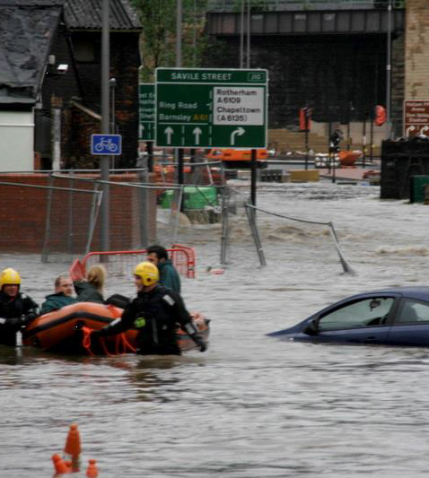
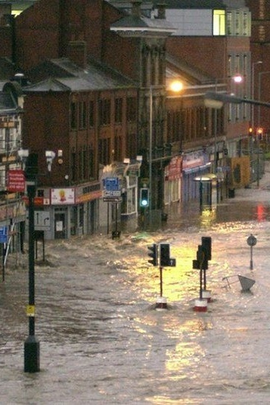
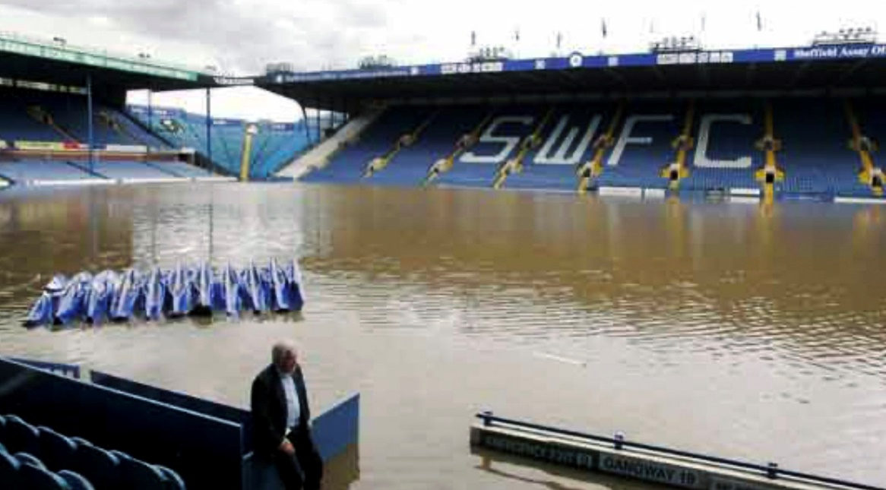
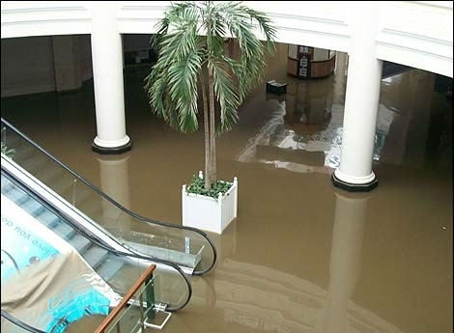
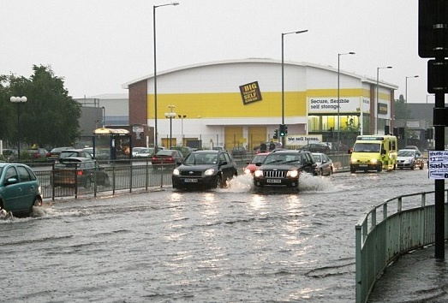
Local flooding in Sheffield

Slide 20
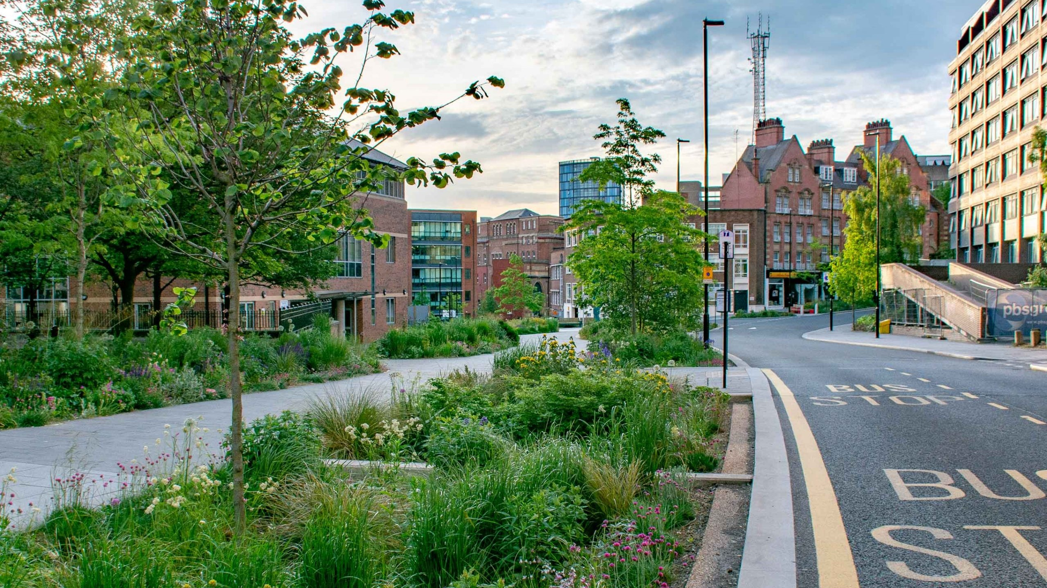

Slide 21
Personalising and Localising
Personalising and localising: solutions focused
Building knowledge of students’ interests, aspirations, local communities and past experiences
Using examples and settings which are familiar and local to students as ‘hooks’ into content (Godec et al., 2017)
What is in the local area? What exists to adapt or mitigate climate change?

Slide 22
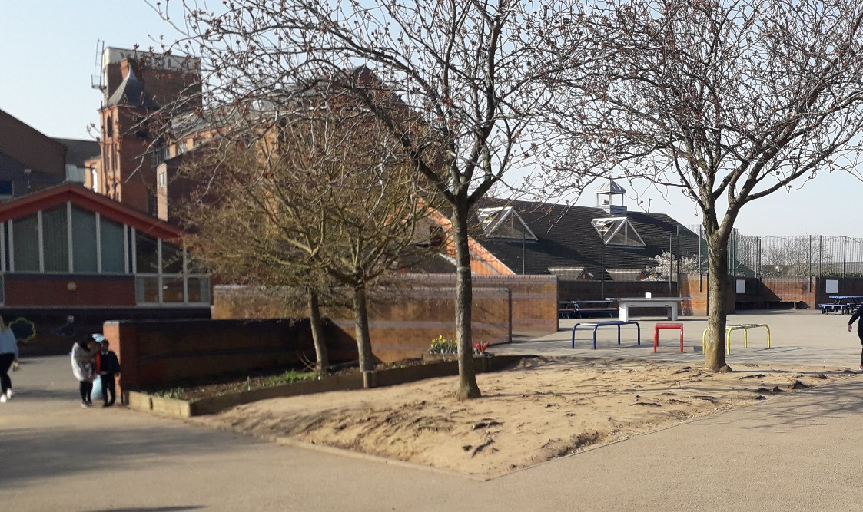
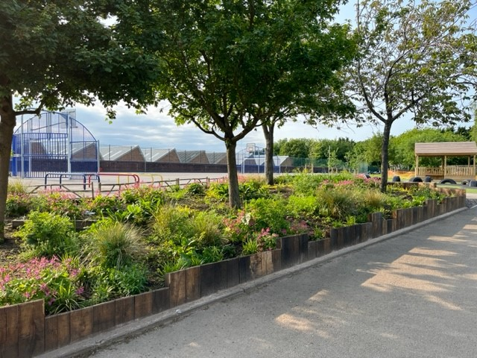
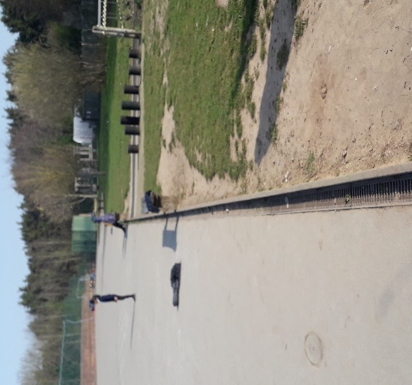
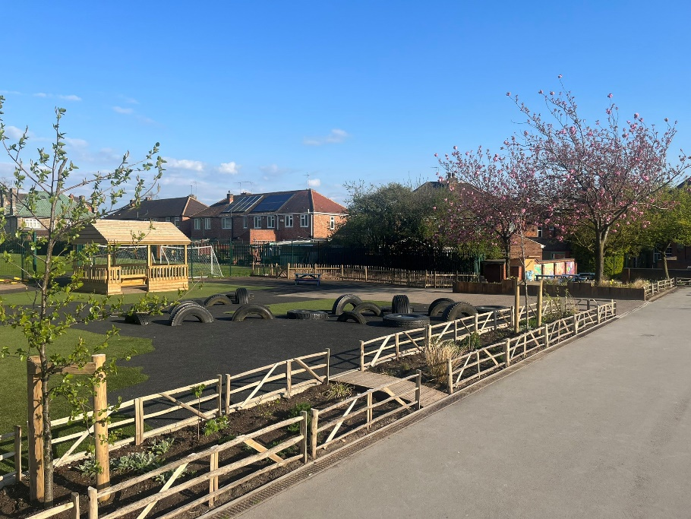

Slide 23
Equality and Social Justice
Equality and social justice
Climate justice is an approach to climate action that focuses on the unequal impacts of climate change on marginalised or otherwise vulnerable populations (Global Witness, 2023)
Climate change is impacting the most vulnerable regions of the world (IPCC, 2024)
Those with the lowest income are most vulnerable (e.g. increased energy bills, food costs)

Slide 24
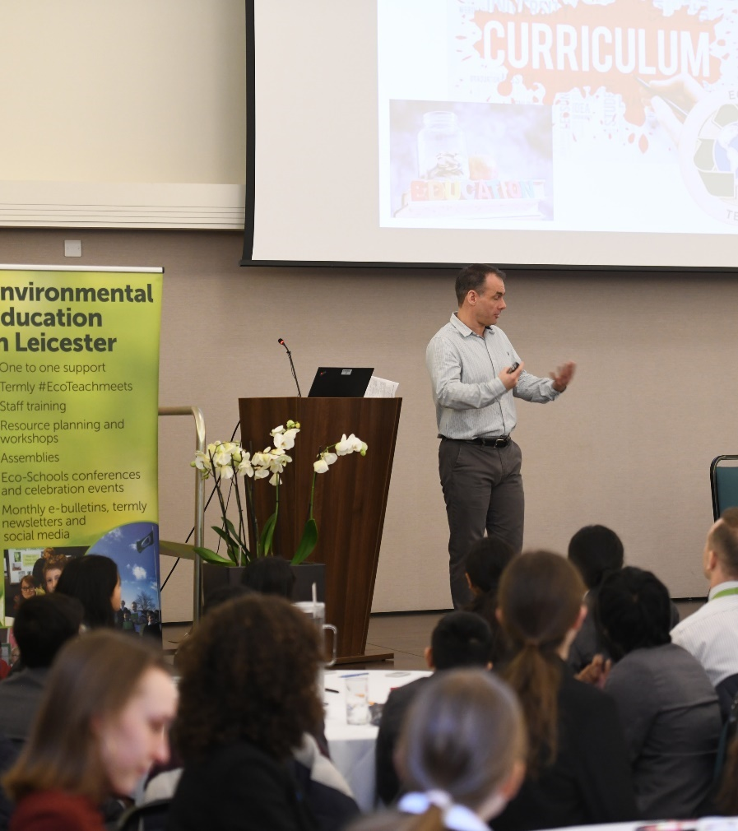
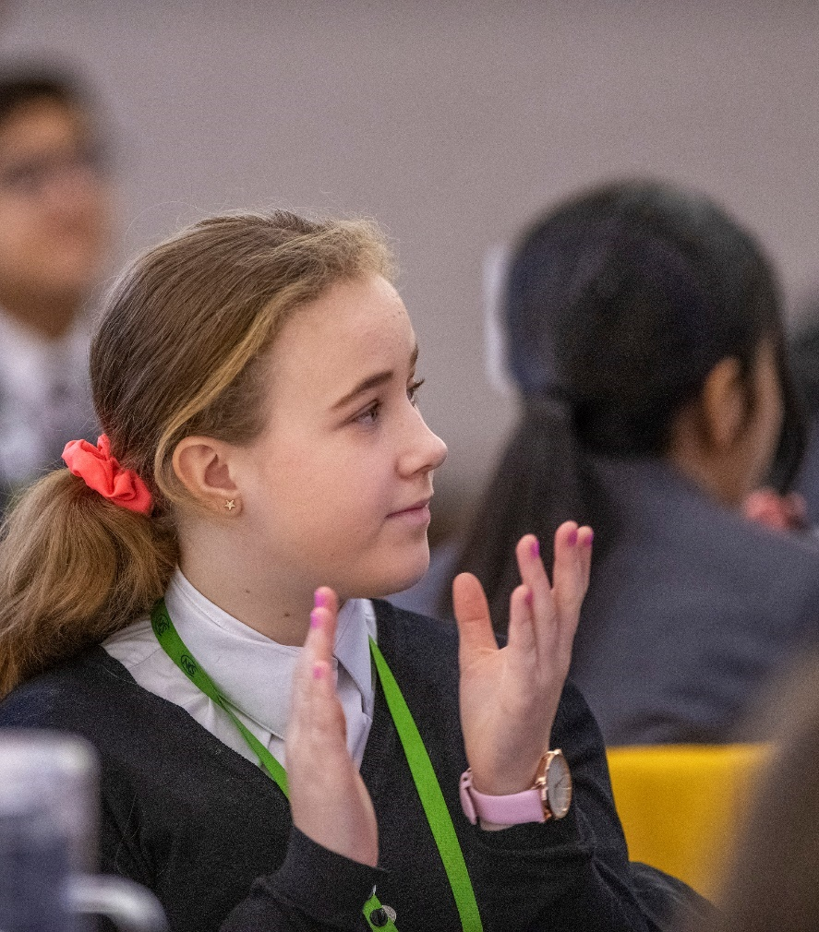
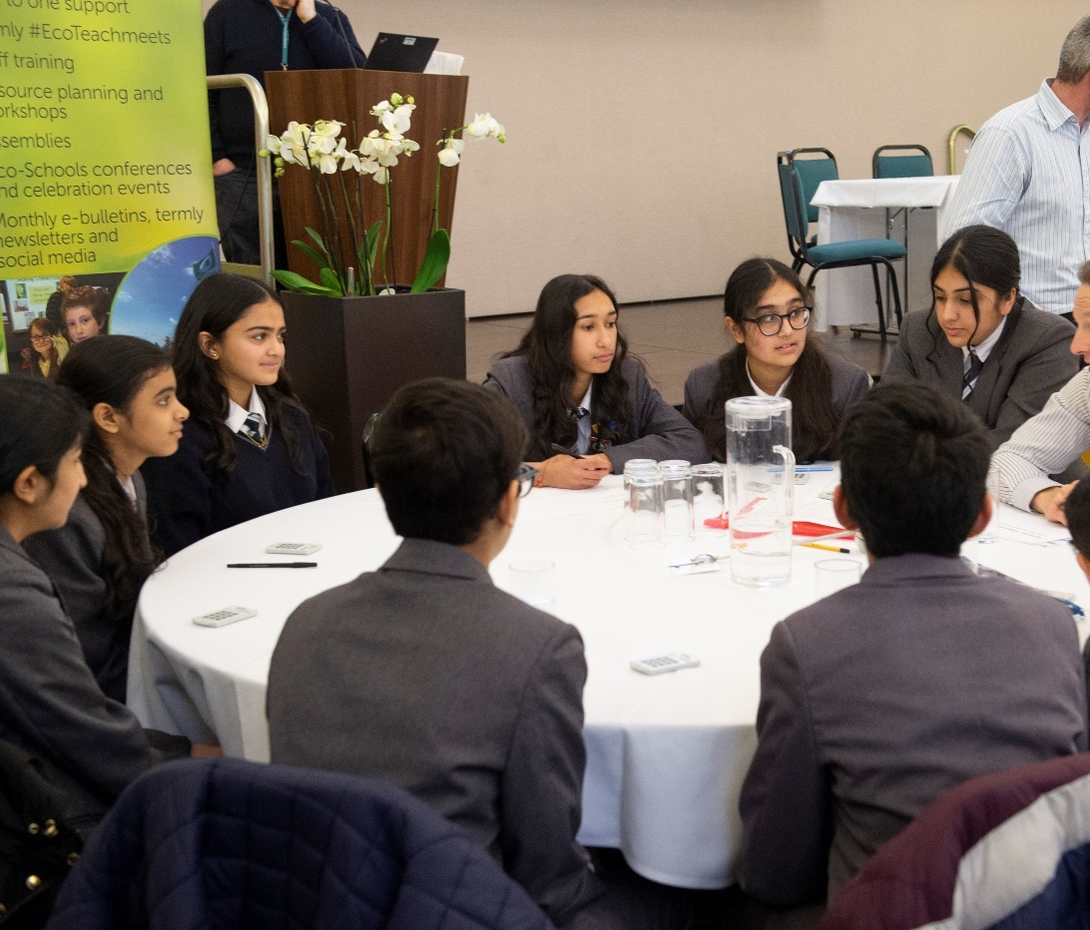
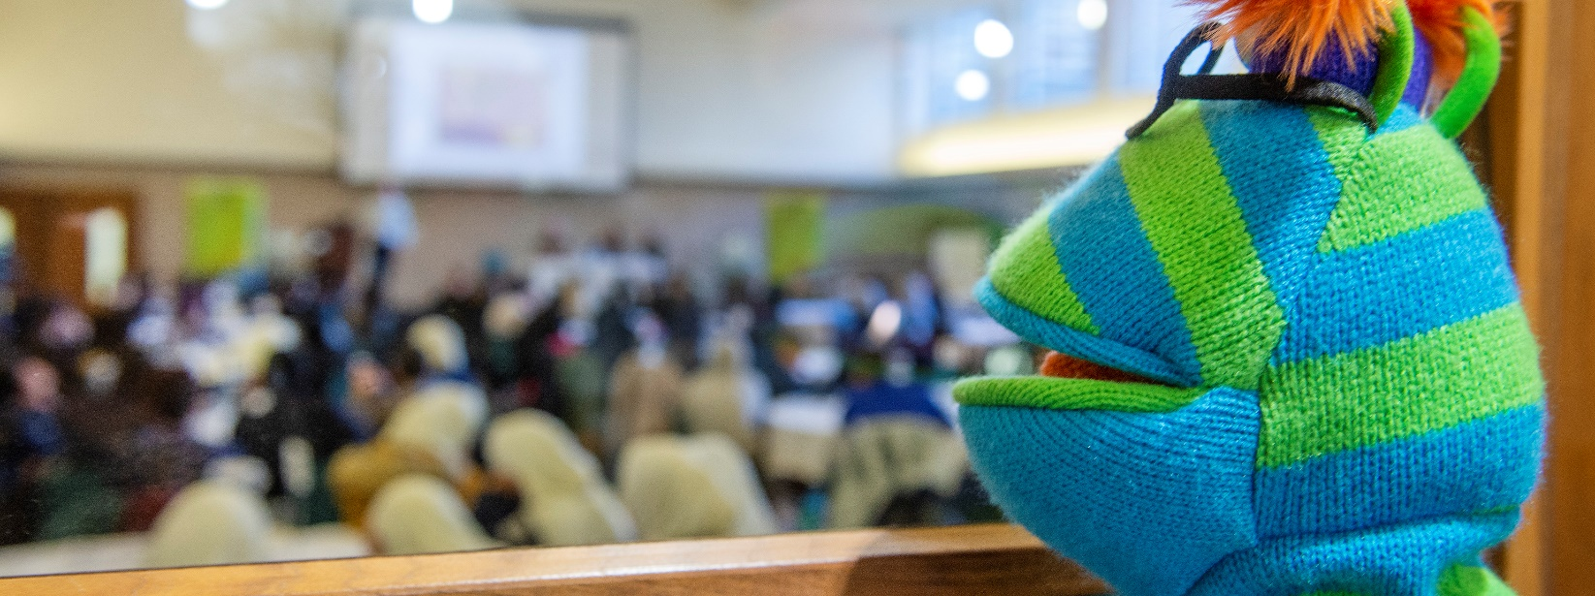
Young people in decision making at the council

Slide 25
Climate literacy
Climate literacy: building knowledge in a sequenced order
Developing the knowledge of climate change – causes and effects
Understanding adaptation and mitigation
Climate justice

Slide 26
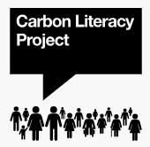

Primarily adult focussed course, but child version available
Adult and child version available
Equivalent to a day’s worth of learning
External accredited course and individuals
Run by a facilitator, train the trainer
In person or online
Build knowledge, values and social learning
Individual and group action pledges
3 hours of training
Based on the IPCC graphs
Run by a facilitator, train the trainer
In person or online
Develop a ‘Fresk’ linking ideas
Time to reflect and take action

Slide 27
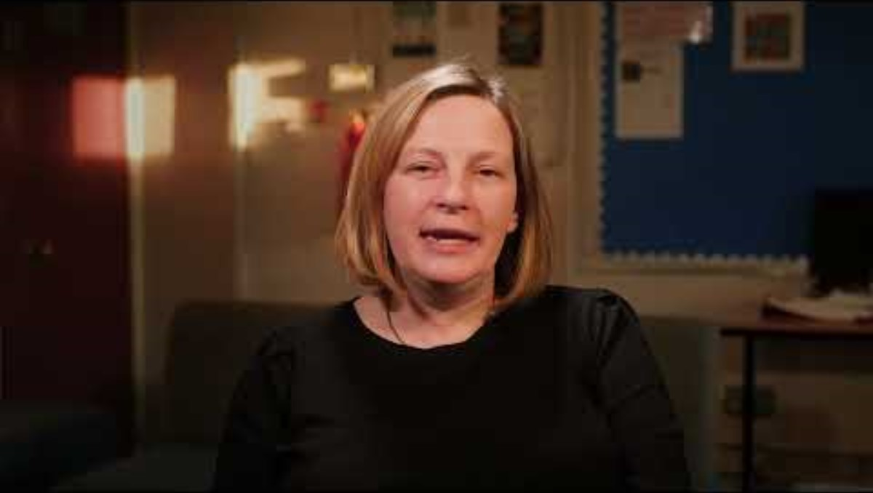

Slide 28
How do we cut through the greenwashing and misinformation, even disinformation?
Greenwashing – teaching scepticism?
Valuing: recognising and acknowledging experiences
Communication that misleads people regarding environmental performance/benefits by disclosing negative information and disseminating positive information about an organisation, service, or product (de Freitas Netto et al, 2020)
Phrase first used in 1986 by Jay Westervelt – targeted at the hospitality industry on promoting towel reuse
How do we train our young people to be sceptical and review claims?

Slide 29
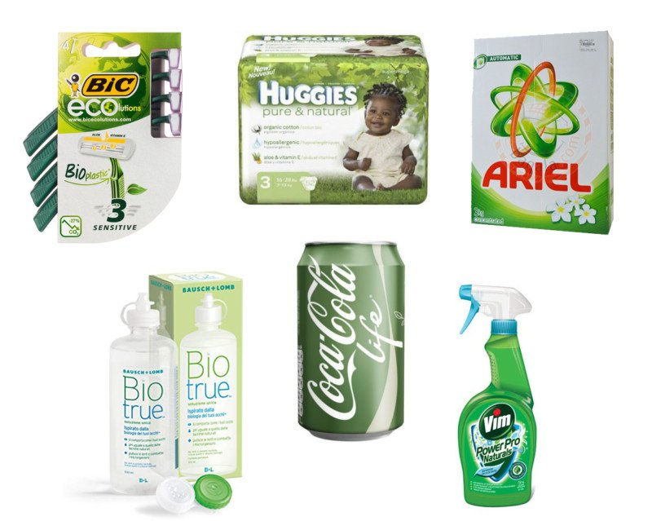
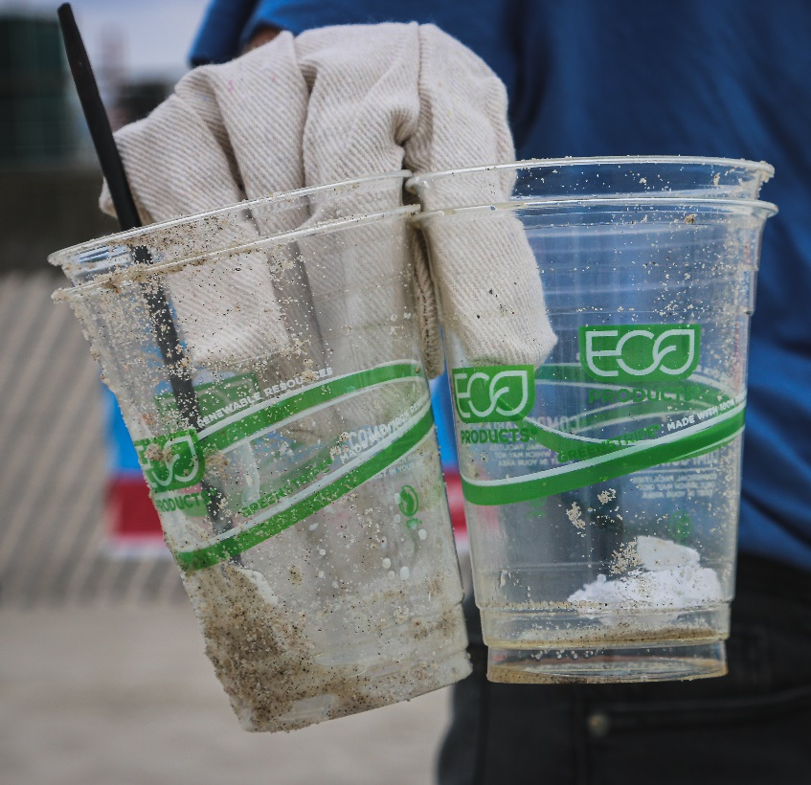
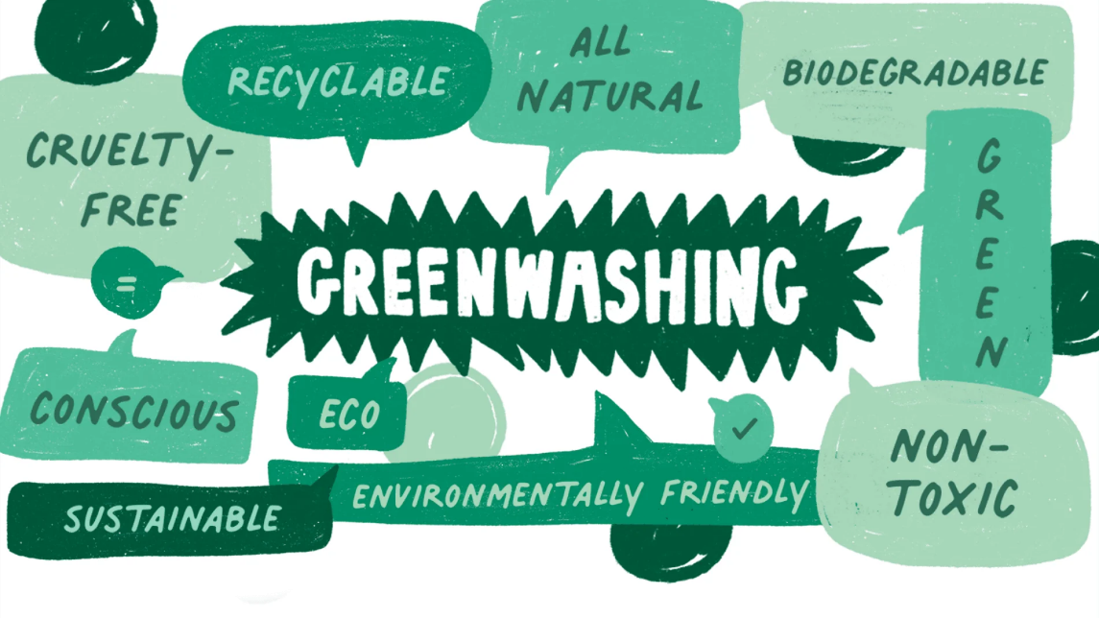

Slide 30
Creating agency and group actions
Creating Agency – creating action
Creating projects which enable change
Do we move from individual actions to group action?
How political can we be?

Slide 31
Can we be political?
Teaching about climate change, and the scientific facts and evidence behind this, does not constitute teaching about a political issue and schools do not need to present misinformation or unsubstantiated claims to provide balance.
However, in climate education there is relevant political and scientific debate about the best ways that climate change can be addressed – there are different views and opinions, and different solutions.
Debates on political and policy change need to be grounded in wider citizenship education on democracy and democratic values and topics should be handled in line with schools’ legal duties on political impartiality

Slide 32
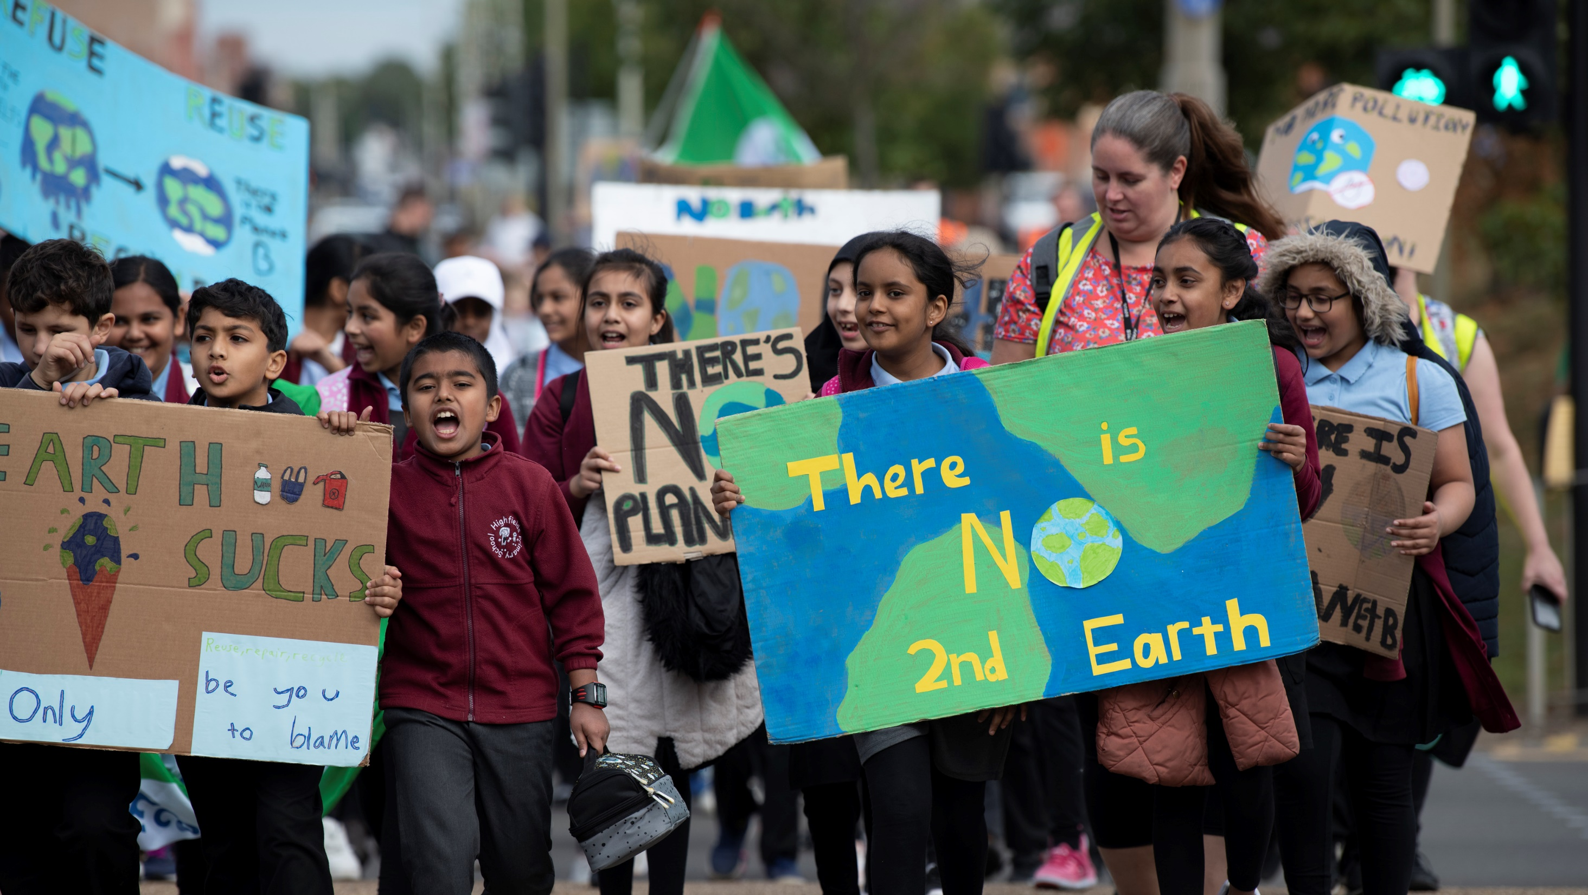

Slide 33
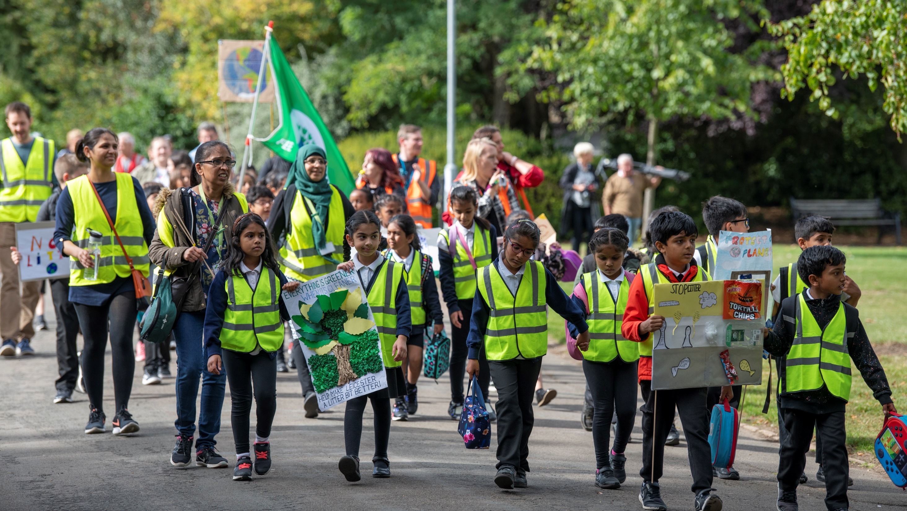

Slide 34
Research Informed Climate Education (RICE): A framework for teaching and learning
Extending: beyond the taught curriculum
Greenwashing
Climate literacy: building knowledge in a sequenced order
Equality and social justice
Eco-anxiety: acknowledging and targeting
Personalising and localising: solutions focused
Valuing: recognising and acknowledging experiences
Creating Agency – creating actions
Outdoor Learning – learning in and with nature
Knowing people – in climate ‘green’ roles
Climate Consumption: Where do they get their information?
Based on the Science Capital Teaching approach
Notes:
Lee

