Slide 1





Adapt-Ed – Climate Adaptation through Education
Wi-Fi
GreenEstateGuest
1234greenestateguest5678
Welcome
Help yourself to a drink and sign in

Slide 2
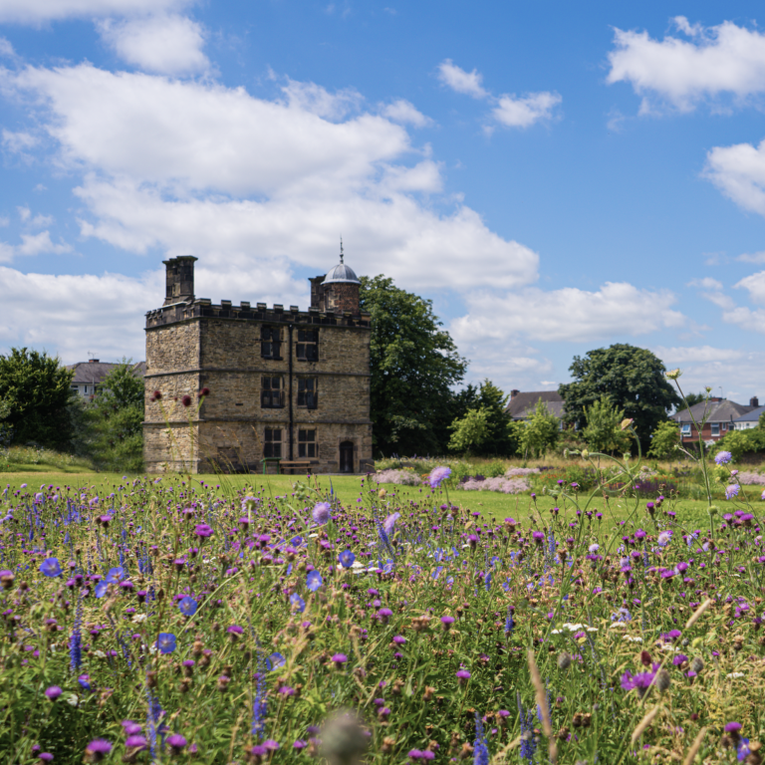
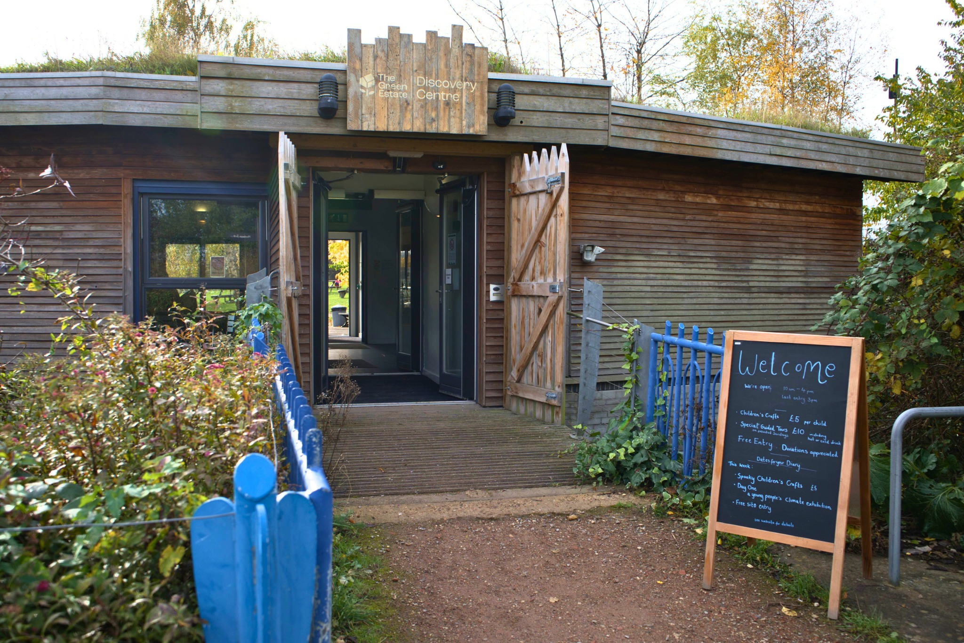

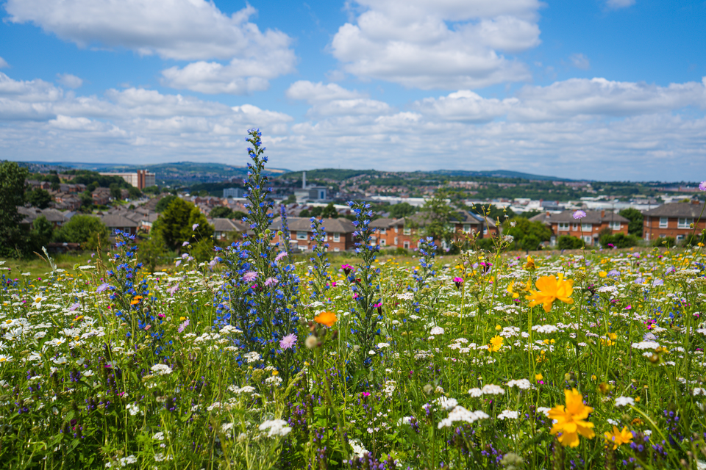

Slide 3




Housekeeping

Slide 4
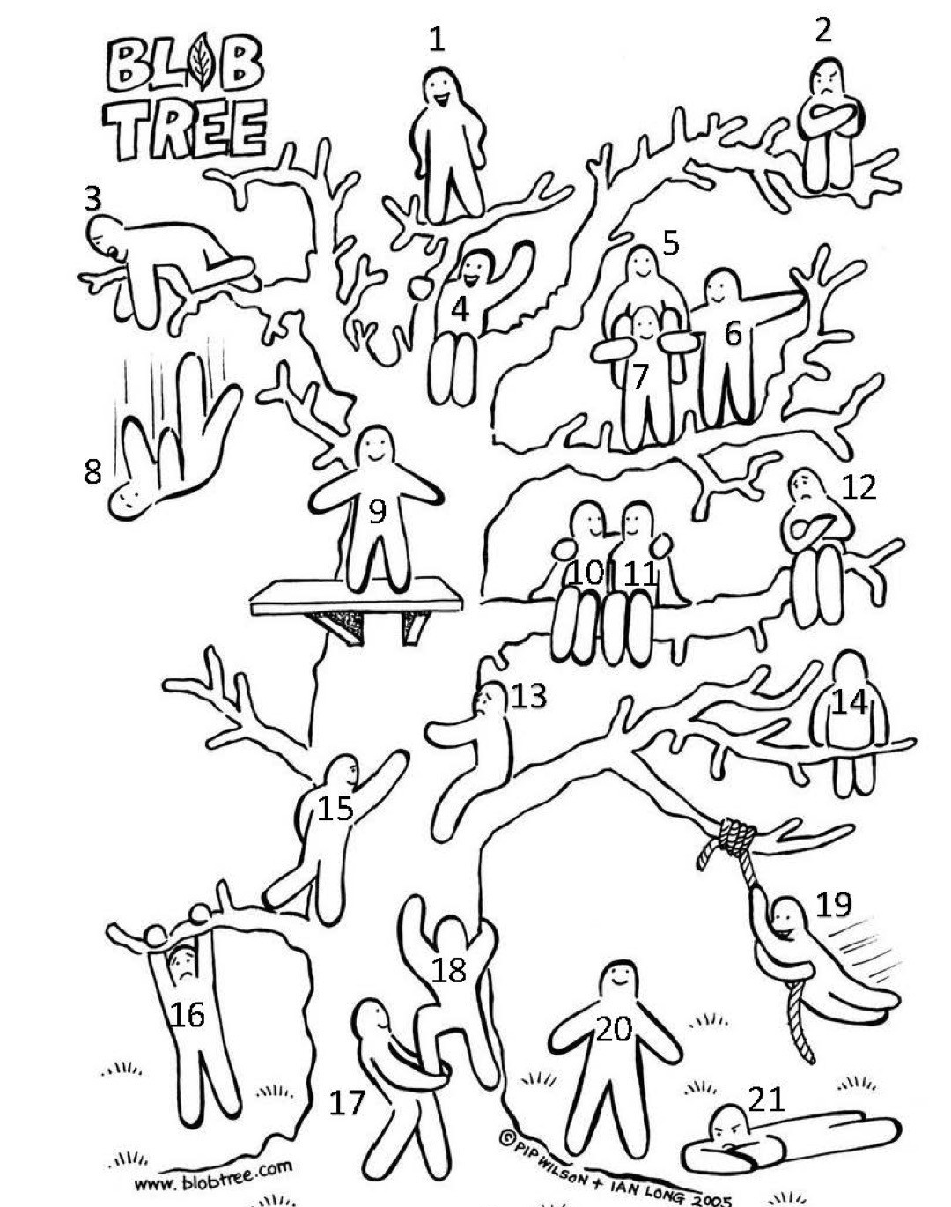
Introductions
Who are you?
What would you like from today and the programme?
How are you feeling today? Pick a number

Slide 5

Teacher and staff consent

Slide 6
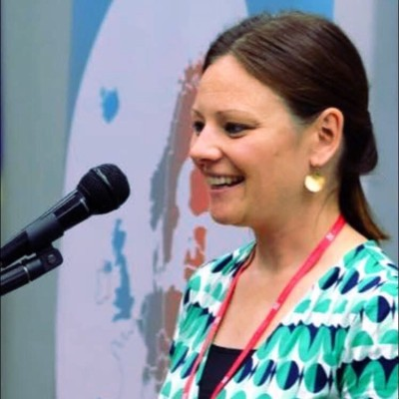
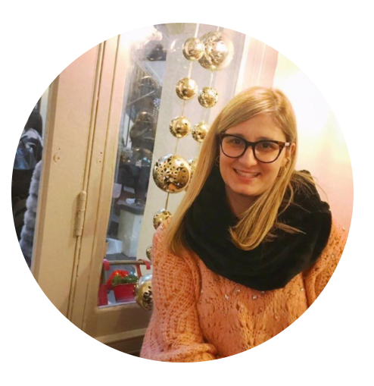
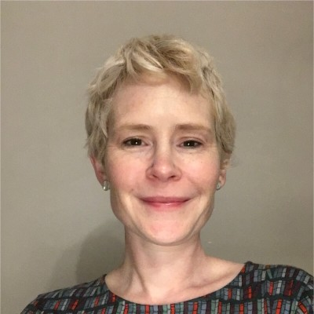

The Team
Alice Jones Hannah Wallace
Lee Jowett Laurie Kooben Professor Aimee Ambrose Dr Pangiota (Giota) Blouchou
Victoria Penman, Sheffield City Council Rob Cattrall, Let’s Go Zero
The Green Estate
Sheffield Hallam
Partners

Slide 7
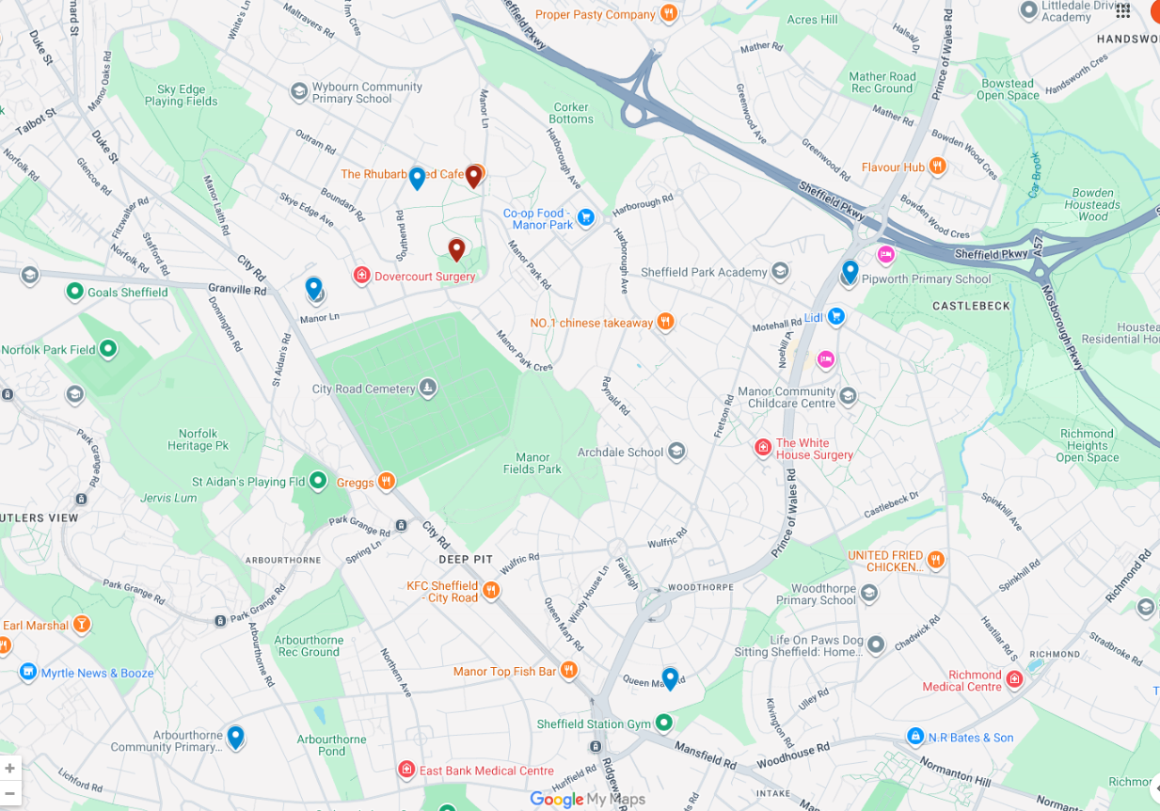
Emmaus Catholic and CoE Primary
Green Estate
Pipworth Primary
Manor Lodge Primary
Prince Edward Primary
Arbourthorne Primary
Google Maps

Slide 8
Plan for today
9.00-9.40 | Introductions and project outline
9.40-10.00am | Ice breaker and local climate risks
10.00-11.15am | Input 1: Climate Adaptation – Laurie Input 2: Nature-based Solutions – Alice & Hannah Input 3: Climate change pedagogy – Lee
11.15-11.30am | Break
11.30-12noon | Curriculum mapping – where are we at?
12.00-12.30pm | Ethics, data and reflection
12.30-1.15pm | Lunch
1.15-2.30pm | Action planning and curriculum development
2.30-3.10pm | Sharing and feedback, barriers and enablers
3.10-3.30pm | Next steps and feedback

Slide 9

Adapt-Ed – Climate Adaptation through Education
Funding administrator Maximising UK Adaptation to Climate Change (MACC) – flexible fund
Funded by UK-RI (NERC funding) and DEFRA
Co-designed by UK-RI, DEFRA, Met office and Climate Change Committee
Lead by Kings College London and Cardiff University

Slide 10

Built for Change
A Sheffield City Council programme supporting schools to respond to climate change
Helps schools adapt buildings and grounds to risks like heat and flooding while improving wellbeing
Supports carbon reduction and climate action planning, helping schools cut emissions and costs
A partnership-led initiative (incl. SHU) providing funding, expertise, and opportunities for young people to lead climate action
Provides CPD and curriculum support to embed climate education across teaching and learning
Built for Change mailing list

Slide 11
Adapt-Ed – Climate Adaptation through Education
Partnership: Sheffield Hallam University, The Green Estate, Sheffield City Council, Let’s Go Zero
Model combines:
Teacher CPD (3 days)
Curriculum delivery (2-3 activities)
Outdoor, place-based learning (2 days)
Grounded in local climate contexts and disadvantaged communities

Slide 12
Why this approach should work
Clear theory-of-change underpinning design and evaluation
Mixed-methods evaluation:
Validated quantitative scales (pre- and post-intervention)
Qualitative interviews, focus groups and observations
Built-in adaptive evaluation (mid-project review to refine delivery)
Produces transferable evidence, not just local case studies

Slide 13
Outcomes and value
Evidence for education-led climate adaptation
Impact at:
Pupil level
School planning and practice
Community engagement
Outputs for policy, publications and follow-on funding

Slide 14
LOGIC MODEL WOrKBOOK
Problem Statement
PROGRAM GOALS
Climate change is already disrupting education and this will get worse. The problem is poorly understood and not part of the curriculum. We need to educate, empower and support schools to provide comfortable, climate resilient environments and use this as a learning opportunity.
Support selected schools to understand and adapt to locally present climate risks through CPD, new curriculum resources and immersive outdoor learning.
INPUTS
ACTIVITIES
OUTPUTS
OUTCOMES
IMPACT
Funding, time, resources (i.e. venues, travel, buy out)
(G) Project governance incl. steering group, mid-way review, adaptive management
Curriculum resources/teaching materials
Better awareness of what GE does and expanded offer from GE
Greater environmental stewardship in community
Expertise (subject, research, evaluation, policy), University infrastructure
(A) 3x teacher CPD sessions, co-design curriculum content
Datasets and reports (evaluation)incl. case studies and recommendations
Proof of concept established (methods)
Community and school ownership of agenda
(A) Experiential, place-based, immersive, creative, outdoor learning activities
Showcases and events
Better knowledge of adaptation challenges and solutions
Climate literacy improved (teachers, students and parents)
Delivery partner (GE) and school participation
(R) Surveys, focus groups, observations, analysis, evaluation, case studies, impact monitoring
Presentations, briefings, publications
Closer, more effective partnership working SHU, GE, SCC, schools
Policy changed in response to evidence (school through to national)
Existing knowledge and frameworks (i.e.RICEF)
(D) Disseminate learning and findings (journals, conferences).
Activities with families – surveys etc.
Learning for other schools extracted and informing policy
Research and policy agenda established
Designed by ©WordLayouts.com

Slide 15
Adapt-Ed Education – Research questions
🧠 RQ1 - Teacher development
How does participation in Adapt-Ed CPD influence teachers’ knowledge, confidence, and capacity to integrate climate adaptation into the primary curriculum?
🌍 RQ2 - Pupil outcomes
How does participation in climate adaptation education influence pupils’ ecological worldview, connectedness to nature, and pro-environmental attitudes?
🏫 RQ3 - School implementation
How do schools embed climate adaptation into curriculum practice, climate action planning, and site-based adaptation measures?
🔧 RQ4 - Intervention effectiveness
What is the impact of a combined model of CPD, curriculum delivery, and immersive outdoor learning on climate adaptation education?
⚖️ RQ5 - Implementation processes
What are the key barriers and enablers experienced by teachers, pupils, and partners when delivering climate adaptation education?
📣 RQ6 - Scalability & transferability
What elements of the Adapt-Ed model are effective and transferable for wider adoption across the education sector?

Slide 16
Funding and Support available
Can cover 2 teachers per school to attend CPD sessions (April, May and September/October) £150 per teacher per day
Green Estate – visit days (covered)
Travel to Green Estate – can be contributed towards if needed
Celebration event £200 per school
Raise an invoice to us at Sheffield Hallam
Email to follow

Slide 17
What climate impacts have you and your students experienced, noticed or talked about in school (in curriculum or anecdotally) What action are you already taking in school (if any)?

Slide 18
Inputs (25 mins each)
Climate Adaptation (and mitigation) - Laurie
Nature based solutions – Alice and Hannah
Climate Change pedagogy – Lee

Slide 19
Break

Slide 20
Curriculum mapping
What already appears in your curriculum plans?
Are there any tweaks or opportunities?
Are you starting to think what new opportunities might come up in the new curriculum?

Slide 21
Future Curriculum Changes
The Curriculum and Assessment Review (November 2025) names climate and sustainability as one of five key applied knowledge areas for the new curriculum
Digital literacy, financial literacy, media literacy, oracy
New curriculum published spring 2027
First teaching September 2028
The approach is embedding across subjects, not a standalone topic.

Slide 22
Future Curriculum Changes
Science
Scientific principles underpinning climate change
Evaluating evidence and spotting misinformation
Earlier sequencing of climate content across KS1 and KS2
Greenhouse effect, ecosystems, human impact on habitats
Geography
Most established home for climate content at primary
Explicit climate woven across physical, human and applied geography
Earlier and more detailed engagement than the current curriculum
Weather vs climate, land use change, local and global environmental impact

Slide 23
Future Curriculum Changes
Citizenship (new, compulsory from Year 1)
Biggest structural change for primary
Climate gets a guaranteed curriculum slot from age 5 for the first time
Framed around informed, active participation in society
Why we recycle, community green spaces, understanding environmental news
Design and Technology
Sustainability embedded into material choices and design decisions
Green economy and future careers angle introduced
Sustainable packaging, food miles, designing with environmental impact in mind

Slide 24
Future Curriculum Changes
The Gaps
No statutory requirement across the whole curriculum
English and maths largely untouched
Climate justice and action-oriented approaches barely mentioned
Risk of patchy delivery without strong CPD support for teachers

Slide 25
Ethics, data and evaluation
Full ethical approval through SHU's Research Ethics Committee before any data collection begins
All delivery staff hold enhanced DBS checks; school and SHU safeguarding protocols followed throughout
Informed consent from parents/carers; child assent obtained using age-appropriate information sheets
Climate anxiety risk acknowledged: all activities are solution-focused and staff briefed on recognising distress with clear referral pathways
Data anonymised, stored securely on SHU servers, accessible only to the research team
No identifiable data published; all findings presented in aggregate
Full GDPR compliance throughout
Project assessed as low ethical risk but managed with robust safeguarding and governance frameworks

Slide 26
Ethics, data and evaluation
Pre and post surveys using a validated tool: Two Major Environmental Values scale (2-MEV) and some general questions (start and end of project)
Focus groups with pupils, teachers and Green Estate staff
Parent surveys capturing wider family engagement and impact at celebration events
Non-participant observations of classroom and Green Estate-based activities
Teacher reflections gathered through CPD sessions
All data feeds into a logic chain evaluation tracking inputs, activities, outputs and outcomes
Indeemo – data capture (shared with funder)

Slide 27
Reflections and discussions Thoughts so far...

Slide 28
Lunch

Slide 29
Delivery model for activities
2 delivery days at Green Estate – either loosely or directly linked to topics you are planning in school
At least 2 activities in school related to climate adaptation
A celebration event in school
What would be useful to support this?

Slide 30
School action planning

Slide 31
Sharing and feedback

Slide 32
Barriers and enablers Commitments and next steps

Slide 33
Next Steps
Distribute parent consent form (and collect in)
Then, complete the pre-survey with pupils
We can visit to complete these in school or do via Teams
Confirm dates with Green Estate visits back in school
Consider your themes and topic further with ideas for the next CPD session
20 May 9am-3.30pm
Look out for an email with further information
Anything else?

Slide 34


Sustainable Schools South Yorkshire
Website and blogs
Termly meetings – face to face
Monthly eBulletins
Opportunities to engage in research and knowledge exchange projects
research.shu.ac.uk/sustainability
Sustainable Schools South Yorkshire Mailing list

Slide 35
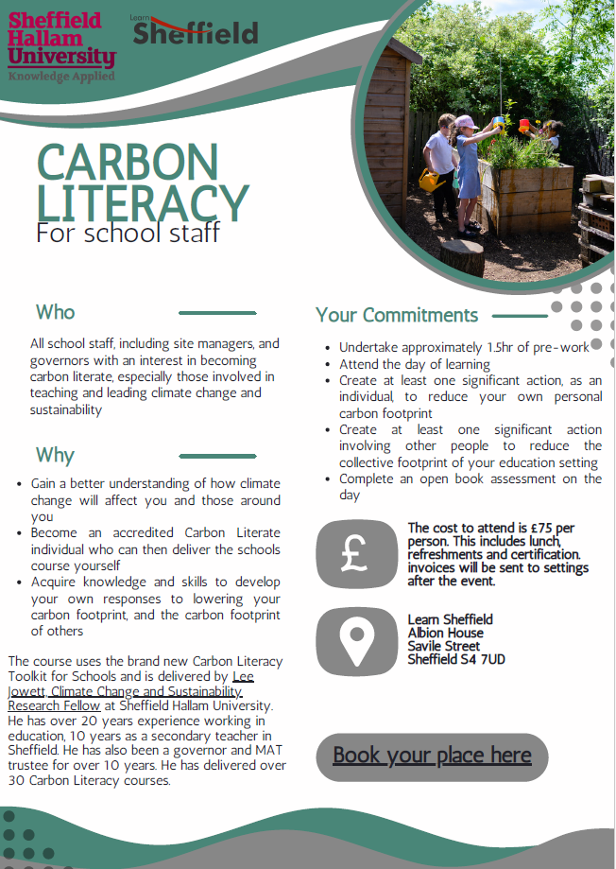

Carbon Literacy
A full-day accredited training helping school staff understand climate change and take action
Builds knowledge, confidence, and practical strategies to reduce carbon in schools and personal practice
Leads to Carbon Literacy certification, including commitments to individual and collective action
£75 per person or can be run in school as a bespoke rate
Friday 26 June 2026
Carbon Literacy for School Staff Tickets

Slide 36


Expressions of Interest Tomorrow’s Climate Scientists
Support pupils (Y1–Y6) to run real, hands-on science investigations
Build confidence in teaching climate change & biodiversity through practice
Work alongside a matched STEM professional (researcher or academic)
Flexible, curriculum-linked investigations shaped to your school context
Funded CPD, classroom resources, and ongoing project support
Celebrate pupil learning and gain support to apply for a £3,000 Royal Society grant
Register interest - Programme starts Sept 2026

Slide 37
Commitments and your next steps
1 short term action
1 pre-delivery action
Anything you need from us?

Slide 38
Thank you 🌍

