Slide 1
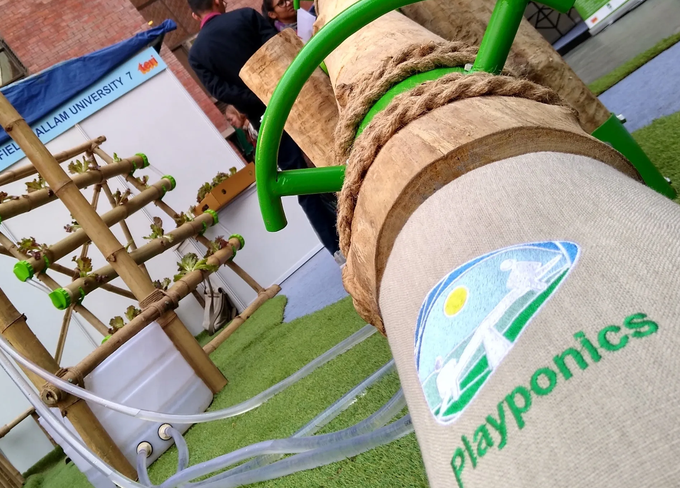

PLAYPONICS
Sheffield Hallam University and Lightmain Company Limited

Slide 2
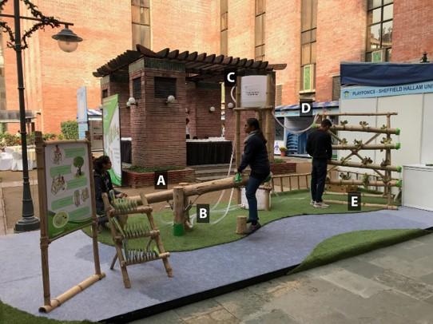
The Concept
“Rather than just being informed about the environment and the wider world, children will be supported in both understanding and experiencing (it)” (Rickinson et al, 2004)

Slide 3
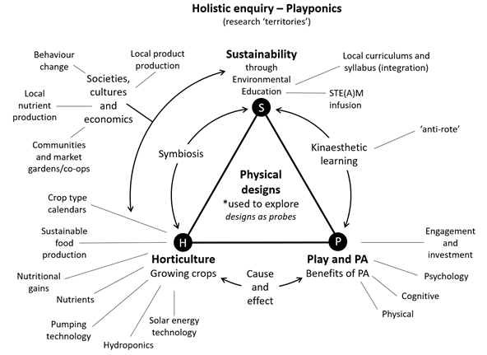

Slide 4
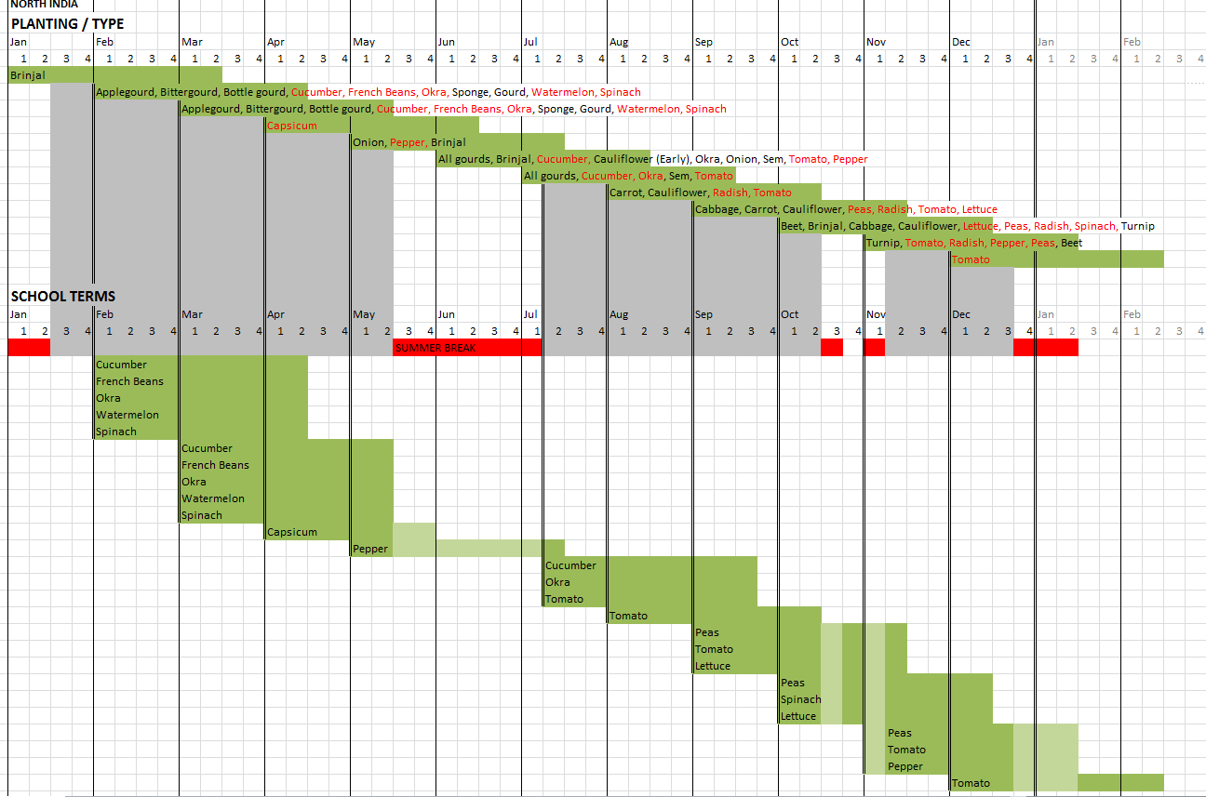
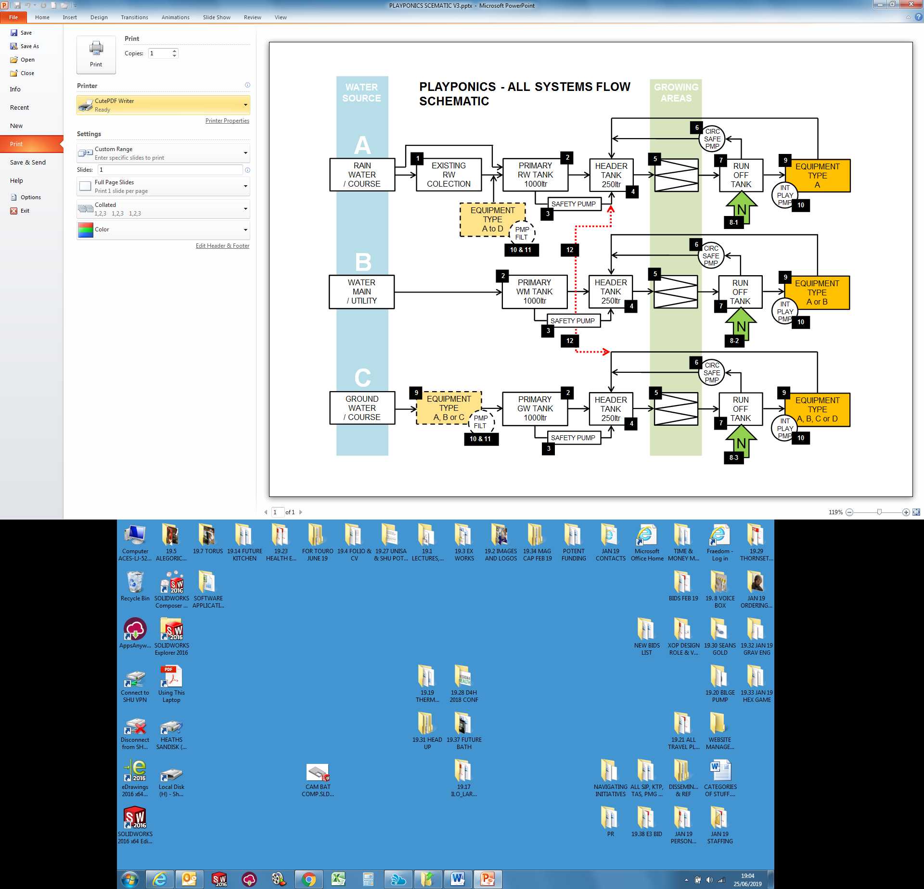
Local crop growing and care calendars
Localised enabling technologies and systems

Slide 5
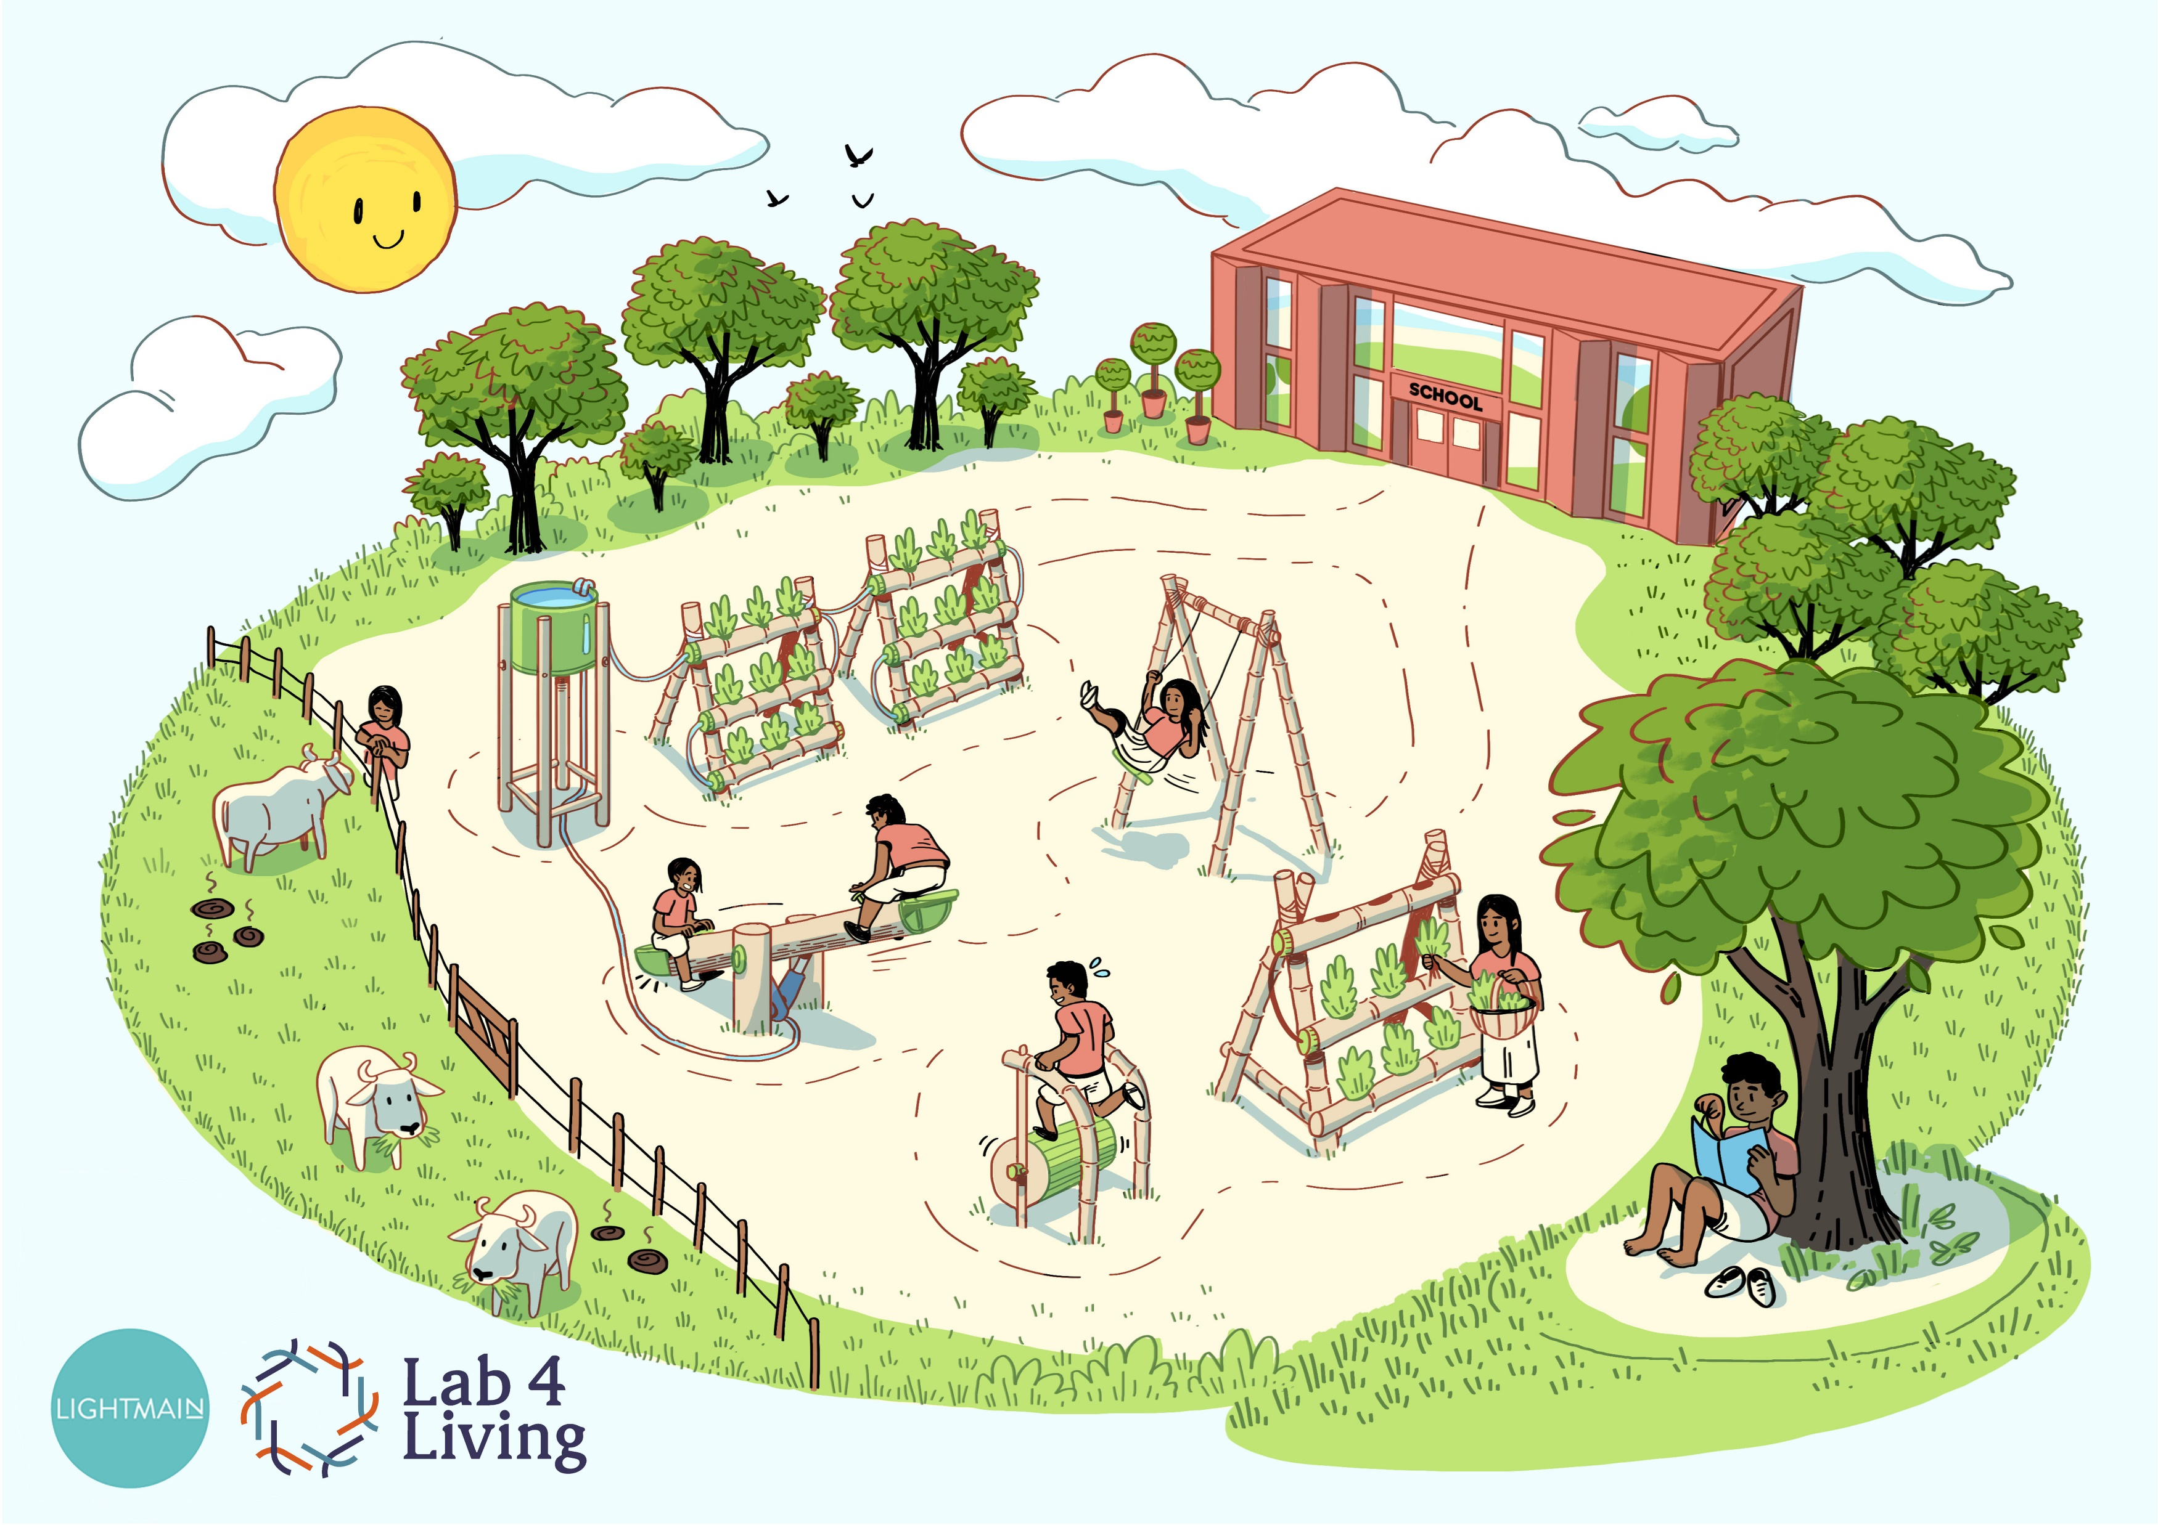
THANK YOU!

