Slide 1


Royal Society Pilot Partnership Programme – joint training session Lee Jowett, Climate Change and Sustainability Fellow l.Jowett@shu.ac.uk / @leejowett Joelle Halliday, Research Associate Joelle.Halliday@outlook.com

Slide 2





Housekeeping
Facilities
Fire alarm
Wi-Fi access
Refreshments
Photography
Notes:
Toilets near Hallam View
Fire alarm – not expecting a fire drill, if it goes off – meet outside Charles Street
Wifi – access Sky Wifi – the Cloud
Refreshments through out the day and lunch at 12noon, if anyone is fasting – we have prayer rooms on campus
Photos being taken during the day – let me know if you’re not happy to be included

Slide 3
What we’ll be covering
Introductions
The Royal Society and their programme
Pilot Partnership programme aims
Time commitments
Who are the academic researchers?
Funding and resources
Practical enquiries
Questions and next steps

Slide 4
Plan for the day
9.30am | Housekeeping and aims
9.45am | Introductions
10.05am | Core content of the programme and
10.45am | Working collaboratively
11.05am | Break
11.15am | Subject knowledge building
12 noon | Lunch
1.00pm | Practical activities and enquiry planning
2.50pm | Next steps and questions
3.00pm | Finish
Notes:
Reminder – can put questions in the chat

Slide 5


Who’s involved in the project?
Lee Jowett
Climate Change and Sustainability Research Fellow
Project Lead
Joelle Halliday
Research Associate

Slide 6
Introductions
Introduce yourself on your table
Who you are, role and your interests
Something in your professional life which gives you a buzz
Something in your personal life which gives you a buzz
We’ll ask you to introduce someone on your table to the room
Notes:
Science based and rationale

Slide 7

The Royal Society
The Royal Society is a Fellowship of many of the world’s most eminent scientists and is the oldest scientific academy in continuous existence
Develop and lead innovation and research in science education
Provide resources and programmes to engage teachers and children in science
One of their flagship programmes is the Partnership Grants Scheme
Notes:
Science based and rationale

Slide 8
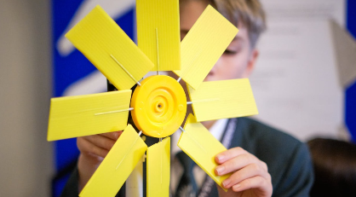
The Royal Society Partnership Grants
Partnership Grants scheme funds UK schools and colleges up to £3,000
Working in partnership with STEM professionals from academia or industry
To run an investigative STEM project
Open to all levels of education supporting students aged between 5 – 18
Tomorrow's climate scientists is an extension to the Partnership Grants specifically researching into climate change and biodiversity
Notes:
Science based and rationale

Slide 9
The Challenge
The same schools, from the same areas apply for funding year after year
It’s a challenge to apply for funding or find a STEM partner
Increase engagement with other schools through a pilot of matching schools on smaller scale projects and activities
Notes:
Science based and rationale

Slide 10
Aims of the programme
Enable productive and sustainable collaborative relationships between STEM professionals, teachers and pupils.
Increase agency, motivation, skills and enjoyment of STEM subjects for teachers and pupils, through investigative learning, contextualised in climate change and biodiversity.
Notes:
Working scientifically and rationale
Opportunity for children and teachers
Working with a scientist and understanding how they work (not just images)
How this will help your school (EEF primary science report)

Slide 11
Aims of the programme
Increase STEM professionals’ knowledge and understanding of effective working with schools, such as appropriate pedagogies in primary STEM teaching.
Increase pupils’ understanding of STEM subjects, including their relevance to their everyday lives, future careers, and potential to tackle climate challenges.
Increase teachers’ and STEM professionals’ understanding and knowledge of Royal Society Partnership Grants, enabling successful future applications.
Notes:
Working scientifically and rationale
Opportunity for children and teachers
Working with a scientist and understanding how they work (not just images)
How this will help your school (EEF primary science report)

Slide 12
Timeline
Training – virtual and face-to-face (October 2025)
In school and virtual delivery (Nov 2025 – Feb 2026)
Training on applying for further funding (Jan/Feb 2026)
Check in with your mentor (January 2026)
If successful – start your extended project (Autumn 2026)
Apply for further funding £3k (exact deadline TBC)
Notes:
Working scientifically and rationale
Opportunity for children and teachers
Working with a scientist and understanding how they work (not just images)
How this will help your school (EEF primary science report)

Slide 13
Time commitments
Face to face training (today!) at Sheffield Hallam University
5 school activities
3 face to face sessions
2 virtual sessions
Notes:
(Lee and Joelle) and school teachers
Big-up the programme, funding and opportunity – researchers and the end game

Slide 14
Time commitments – what it looks like
5 school activities (as agreed between teacher and researcher)
Face to face - Meet your researcher – what they do and research. Introduction to the project
Virtual – Communicating research – students present, researcher asks questions and ideas
Face to face – Undertaking Primary Research – in school activity
Virtual – Communicating your learning – students present, researcher asks questions and ideas
Face to face – Findings and Celebration
Notes:
(Lee and Joelle) and school teachers
Big-up the programme, funding and opportunity – researchers and the end game

Slide 15
Funding and support available
£300 to cover supply costs for school staff
Up to £75 for travel costs for researchers (for the project)
Schools will need to invoice us (information to follow on email)
SHU staff – can claim via Core HR (project cost P121)
Non-SHU Staff – submit claim form to Lee (info on email)
Materials and science resources provided on loan (or consumable)
Towards the end of the project, opportunity to apply for £3000 to extend project or research something completely different

Slide 16
The Science of Climate Change, Sustainability and Biodiversity loss

Slide 17
Key terms and ideas
Card sort activity

Slide 18
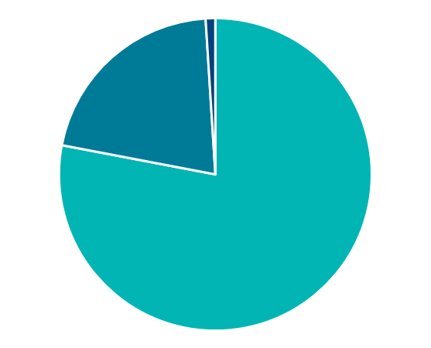
The composition of the atmosphere
Argon (Ar)
Trace Gases
Carbon Dioxide (CO₂)
Nitrous Oxide (N₂O)
Oxygen
(O₂)
Methane (CH₄)
Ozone (O₃)
Hydrogen (H₂)
Helium (He)
Nitrogen
(N₂)
Neon (Ne)
Krypton (Kr)
Xenon (Xe)
+ water vapour
Notes:
Composition of the Atmosphere
Before we take a closer look at the greenhouse effect, let’s just remind ourselves about the composition of the Earth’s atmosphere.
It’s about 78% nitrogen, 21% oxygen, and 1% argon.
However, in addition to these main constituents, there are also a number of what we call “trace gases” – these are gases present at very low concentrations – collectively they account for less than 0.1% of the atmosphere. However – while they are present at very low concentrations – the effect they exert is far from tiny, where some of these gases are what we call greenhouse gases (shown in bold on the slide).
It’s also important to note that these proportions are based on a “dry” atmosphere – and of course there’s also water vapour present… where water vapour is also a greenhouse gas.
FOR INFO: water content of the atmosphere varies in space and time based on temperature – typically in range 0.2-4% (0.2% would be very cold air – e.g. at the poles, 4% would be warm tropical air).

Slide 19
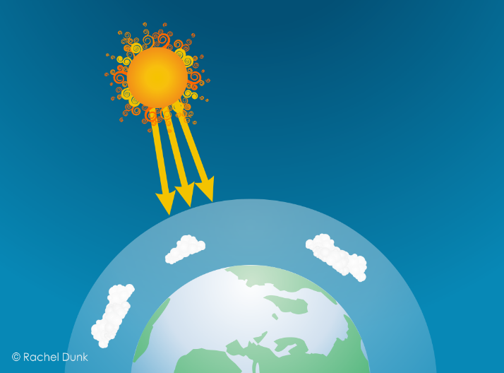
The Greenhouse Effect (1/7)
Energy from the Sun is transmitted through space to the Earth
(mainly visible light)
Notes:
The Greenhouse Effect – Scientific Explanation - 1/7
So now let’s consider the Greenhouse Effect.
We start with the Sun – which is basically a giant nuclear fusion reactor that is kicking out an enormous amount of energy. That energy is transmitted through space to the Earth - mainly as visible light – that is short wavelength radiation in the visible part of the electromagnetic spectrum.

Slide 20

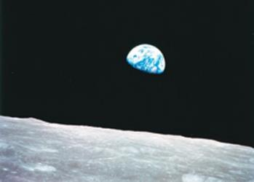
The Greenhouse Effect (2/7)
Some of this energy is reflected back into space from clouds and the Earth's surface.
This is why we can see the Earth from space!
Notes:
The Greenhouse Effect – Scientific Explanation - 2/7
Some of this energy is reflected straight back to space. How much solar radiation is reflected depends on the Earths albedo – how reflective or shiny the Earth is – where a significant portion of the Earth’s albedo is due to clouds.
This reflection of solar radiation is why the Earth - our blue marble - is visible from space, where the photograph shown here is the famous NASA Earthrise picture, taken by Bill Anders on December 24th 1968 as Apollo 8 entered lunar orbit.
IMAGE CREDIT:
Earthrise: NASA/Bill Anders. Earthrise (photo of the Earth taken from Apollo 8 in 1968). Photograph is in the public domain as it was solely created by NASA (NASA material is not protected by copyright unless noted). Available here: https://commons.wikimedia.org/wiki/File:NASA-Apollo8-Dec24-Earthrise.jpg

Slide 21
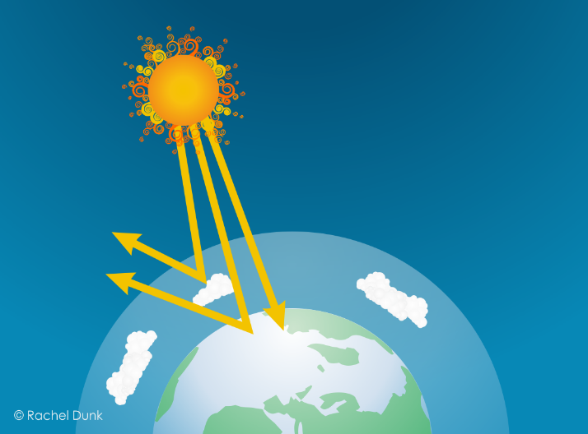
The Greenhouse Effect (3/7)
The energy that isn’t reflected passes through the atmosphere and is absorbed by the Earth’s surface.
This is because the Earth’s atmosphere is largely transparent to visible light.
Notes:
The Greenhouse Effect – Scientific Explanation - 3/7
The solar radiation that isn’t reflected back to space passes through the atmosphere and is absorbed by the Earth’s surface.
This is because the Earth’s atmosphere is largely transparent to visible light.

Slide 22

The Greenhouse Effect (4/7)
The Earth warms up and emits infrared radiation.
The atmosphere is NOT transparent to infrared radiation…due to the “excitability” of the greenhouse gases…
Notes:
The Greenhouse Effect – Scientific Explanation - 4/7
This heat’s the Earth’s surface. Any heated object emits electromagnetic radiation – where the Earth emits in the infrared part of the spectrum - this is longer wavelength and lower energy radiation than the incoming visible light from the Sun.
While the atmosphere is what we call “transparent” to visible light it is not transparent to infrared.
That is because of the excitability of the greenhouse gases, which can absorb infrared radiation.

Slide 23

The Greenhouse Effect (5/7)
…so while some infrared radiation will escape to space, most is absorbed by the greenhouse gases…
Notes:
The Greenhouse Effect – Scientific Explanation - 5/7
So while some infrared radiation escapes directly to space through the atmospheric “window” (this is gaps in the absorbance of the atmosphere) - most is absorbed by the greenhouse gases.

Slide 24
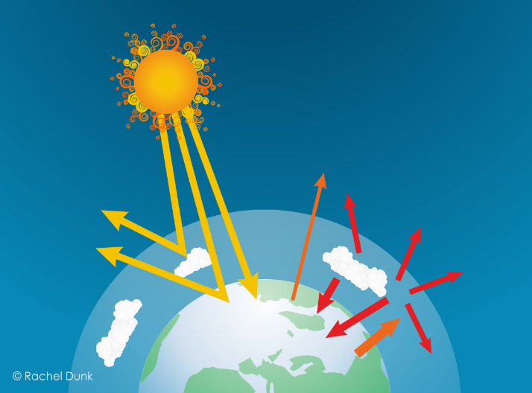
The Greenhouse Effect (6/7)
…they then emit even longer wavelength lower energy infrared radiation in all directions.
This traps heat, warming the Earth and the lower atmosphere.
Notes:
The Greenhouse Effect – Scientific Explanation - 6/7
The greenhouse gases then emit even longer wavelength lower energy radiation in all directions – so some escapes to space but some is re-absorbed by the Earth’s surface and the lower atmosphere.
This effectively traps heat, warming the Earth – where this process will continue – and the system will continue to warm up - until the total amount of energy escaping from the top of the atmosphere is equal to the amount that came in from the Sun.

Slide 25
The Greenhouse Effect (7/7)
The natural Greenhouse Effect is a good thing.
Without it, the Earth would be about -18°C.
The problem is that human activities are enhancing this effect by adding more greenhouse gases to the atmosphere.
Notes:
The Greenhouse Effect – Scientific Explanation - 7/7
The Greenhouse Effect is a natural process – and a very good thing. Without it the Earth’s average temperature would be around minus 18°C – liquid water would not exist and life as we know it would not have evolved.
However, for the past 250 years or so, human activities have been increasing the concentrations of greenhouse gases in the atmosphere – thereby enhancing the Greenhouse Effect - further warming the Earth – and leading to the climate change that we are now experiencing.

Slide 26
Human influences on climate
There are two main factors within the sphere of human influence that control Earth’s T:
The amount of solar radiation that is reflected or absorbed
The concentration of greenhouse gases (GHGs) in the atmosphere
If we change albedo (how reflective Earth is) we should expect the Earth’s T to change
If we change the concentration of GHGs we should expect the Earth’s T to change
More reflective = cooling
Less reflective = warming
Add GHGs = warming
Remove GHGs = cooling
Notes:
Human influences on climate 1/1 (OPTIONAL – HIDE if you don’t want to use)
ANIMATED SLIDE
CLICK: From an understanding of the basic physics of the greenhouse effect we can see that there are two key factors within the sphere of human influence that control the Earth’s temperature.
CLICK: Firstly, if we change how reflective the Earth is we should expect the Earth’s temperature to change.
CLICK: More reflective (e.g. deforestation) would be cooling. Less reflective (e.g. melting ice caps, black carbon (soot) on snow) would be warming.
CLICK: Secondly (and dominantly) if we change the concentration of GHGs in the atmosphere we should expect the Earth’s temperature to change.
CLICK: Adding GHGs would be warming. Removing GHGs would be cooling.

Slide 27


The Greenhouse Effect (blanket analogy)
The natural Greenhouse Effect is a good thing.
Without it, the Earth would be about -18°C.
The problem is that human activities are enhancing this effect by adding more greenhouse gases to the atmosphere.
Notes:
The Greenhouse Effect - Blanket Analogy 1/1 (UNHIDE to use)

Slide 28


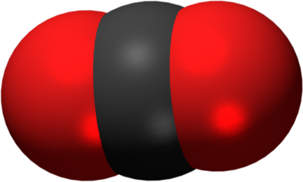
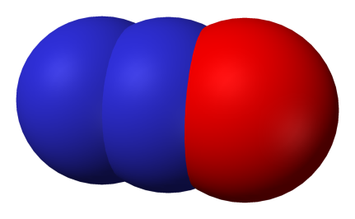
The greenhouse gases
carbon dioxide
CO₂
methane
CH₄
nitrous oxide
N₂O
F gases
(various)
1
28
265
10s-10,000s
mass x GWP → common currency of carbon dioxide equivalents (CO₂e)
Notes:
Introduce the GHGs and Global Warming Potentials (GWPs).
Now we’re going to focus on the greenhouse gases that our (human) activities are adding to the atmosphere.
The main greenhouse gases are carbon dioxide, methane, nitrous oxide and fluorinated gases (F-gases).
Not all GHGs are equal – some are more potent than others. The numbers below each gas are their Global Warming Potentials (GWPs) - a measure of the gases ability to trap heat in the atmosphere compared to carbon dioxide on a weight for weight basis. For any greenhouse gas we can then multiply the mass emitted by the GWP to express the emissions as CO2 equivalents.
For example, emitting 1 tonne of methane has the same warming effect as emitting 28 tonnes of carbon dioxide (it is 28 times more potent!).
Likewise, emitting one tonne of nitrous oxide has the same warming effect as emitting 265 tonnes of carbon dioxide.
If we look at the F-gases – which is a family of different compounds, they are 10s to 1000s of times more potent than carbon dioxide.
NOTE: Be careful NOT to mention any sources of the GHGs here – as this is covered in the game!
For information – the F-gases shown are:
CF4 (PFC-14, carbon tetrafluoride) = 6,630
SF6 (sulfur hexafluoride) = 23,500
NOTE: Global Warming Potentials presented here are the 100-year values from the Intergovernmental Panel on Climate Change Assessment Report 5 (IPCC AR5) - see Trainer Guide for further information. These are the GWPs that have been identified as those the Parties to the Convention should use for reporting their commitments under the Paris Agreement. https://unfccc.int/process-and-meetings/transparency-and-reporting/methods-for-climate-change-transparency/common-metrics

Slide 29
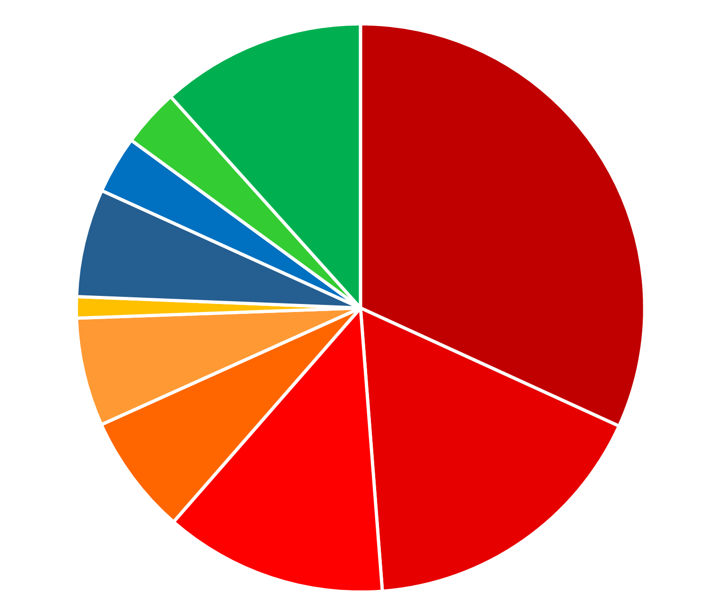
GHG emissions by sector (2019)
Agriculture
5,795 MtCO₂e (12%)
Electricity & Heat
15,835 MtCO₂e (32%)
LUCF
1,642 MtCO₂e (3%)
Energy accounts for 76%
of global GHG emissions
Waste
1,630 MtCO₂e (3%)
Industrial Processes
3,056 MtCO₂e (6%)
Other Fuel
602 MtCO₂e (1%)
Buildings
3,065 MtCO₂e (6%)
Fugitive
3,402 MtCO₂e (7%)
Transportation
8,435 MtCO₂e (17%)
Manufacturing
& Construction
6,297 MtCO₂e (13%)
Notes:
OPTIONAL SUMMARY 1/3 - Breakdown of emissions by sector (all gases expressed as CO₂e)
This pie-chart provides a breakdown of emissions by sector. All the “hot” colours (yellow-red) represent energy related emissions – so we can see our use of energy accounts for nearly three-quarters of global GHG emissions.
Data Source: The data presented here is the 2019 Global (World) emissions (including Land Use Change and excluding Bunker Fuels) from the World Resources Institute CAIT Climate Data set – Historical Emissions – Country GHG Emissions dataset. Available via Climate Watch (climatewatchdata.org).
NOTE: Buildings = energy use in buildings; Fugitive = methane emissions during fossil fuel extraction & transport; Manufacturing & Construction = energy use in manufacturing & construction.

Slide 30
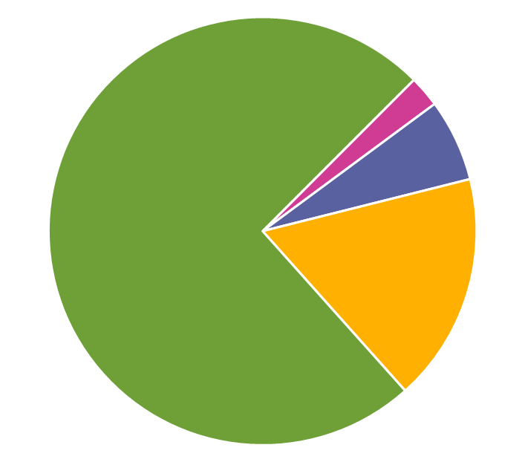
GHG emissions by gas (2019)
CO₂ accounts for 74%
of global GHG emissions
F-gases
1,177 MtCO₂e
(2%)
CO₂
36,874 MtCO₂e
(74%)
N₂O
3,097 MtCO₂e
(6%)
CH₄
8,610 MtCO₂e
(17%)
carbon dioxide
methane
nitrous oxide
F-gases
Notes:
OPTIONAL SUMMARY 2/3 - Breakdown of emissions by gas
This pie chart shows a breakdown of global emissions by gas – with emissions of each gas presented as carbon dioxide equivalents. We can see that the dominant anthropogenic greenhouse gas is carbon dioxide, which accounts for nearly three-quarters of total emissions.
Data Source: The data presented here is the 2019 Global (World) emissions (including Land Use Change and excluding Bunker Fuels) from the World Resources Institute CAIT Climate Data set – Historical Emissions – Country GHG Emissions dataset. Available via Climate Watch (climatewatchdata.org).

Slide 31
Research Informed Climate Education (RICE)

Slide 32

Research informed Climate Education (RICE): A framework for teaching and learning
What do they know:
Family, local community & school
What they do:
engaging in climate action outside of school
Green careers:
Connecting with those who are taking action on climate change
Climate knowledge:
Value and build ‘be sceptical’ (e.g. greenwashing)
How they think:
Ensuring climate action is part of everyday life
Based on the Science Capital Teaching approach
Notes:
Lee

Slide 33
Research Informed Climate Education (RICE): A framework for teaching and learning
Extending: beyond the taught curriculum
Greenwashing
Climate literacy: building knowledge in a sequenced order
Equality and social justice
Eco-anxiety: acknowledging and targeting
Personalising and localising: solutions focused
Valuing: recognising and acknowledging experiences
Creating Agency – creating actions
Knowing people – in climate ‘green’ roles
Climate Consumption: Where do they get their information?
Based on the Science Capital Teaching approach

Slide 34
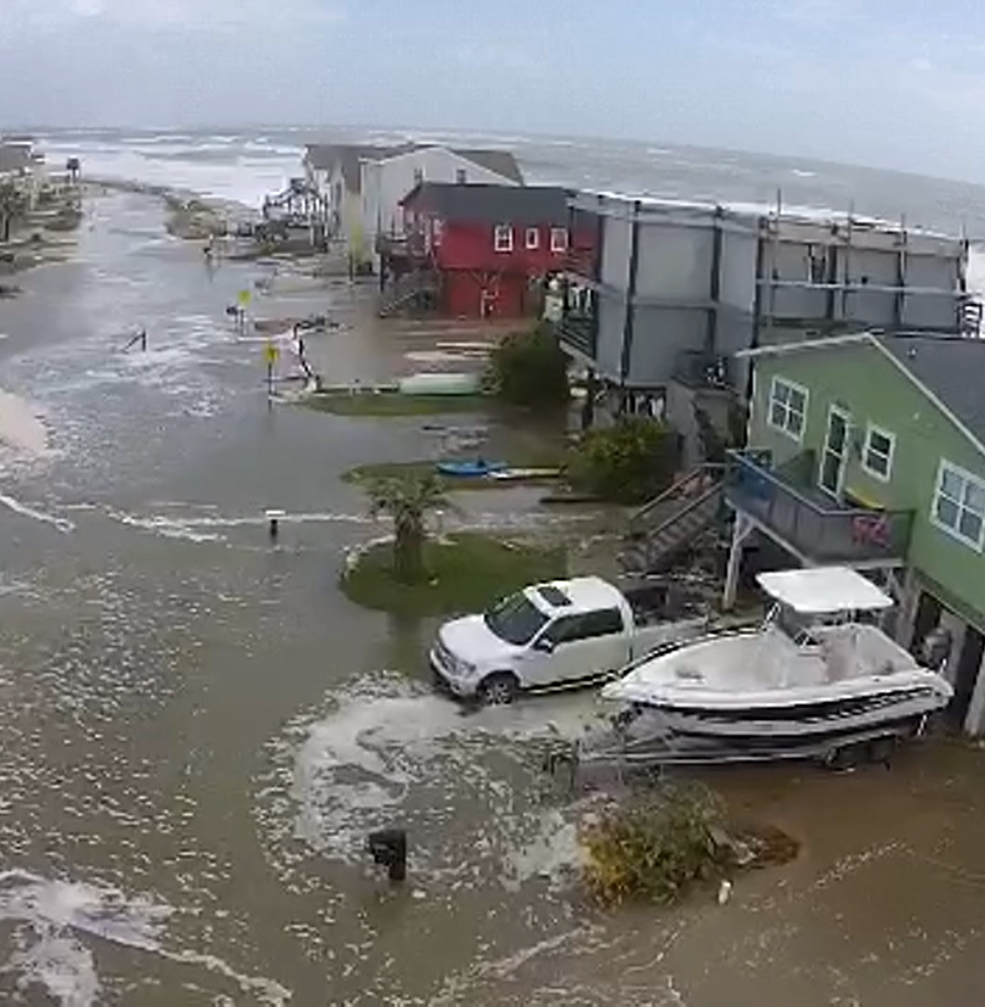
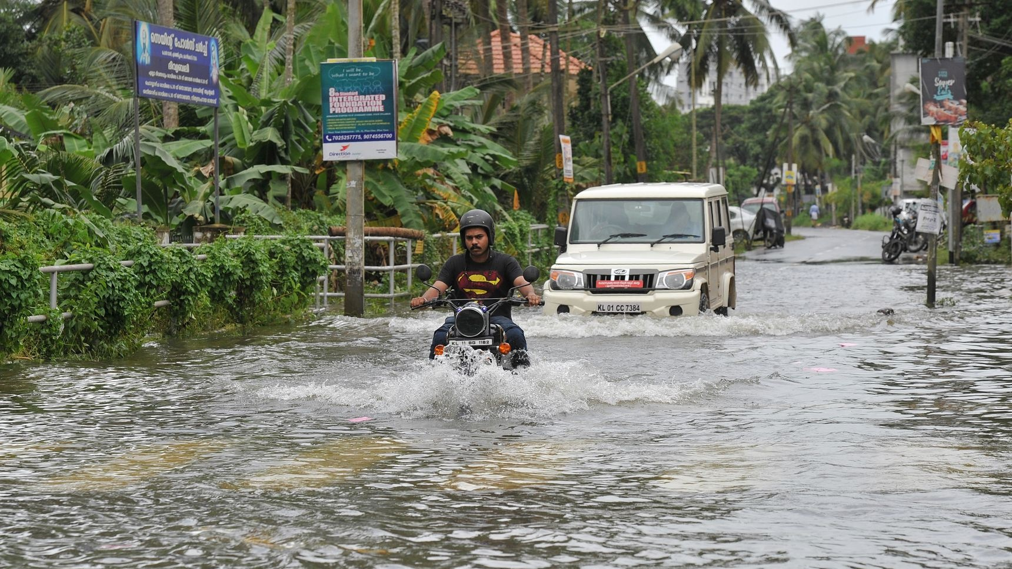
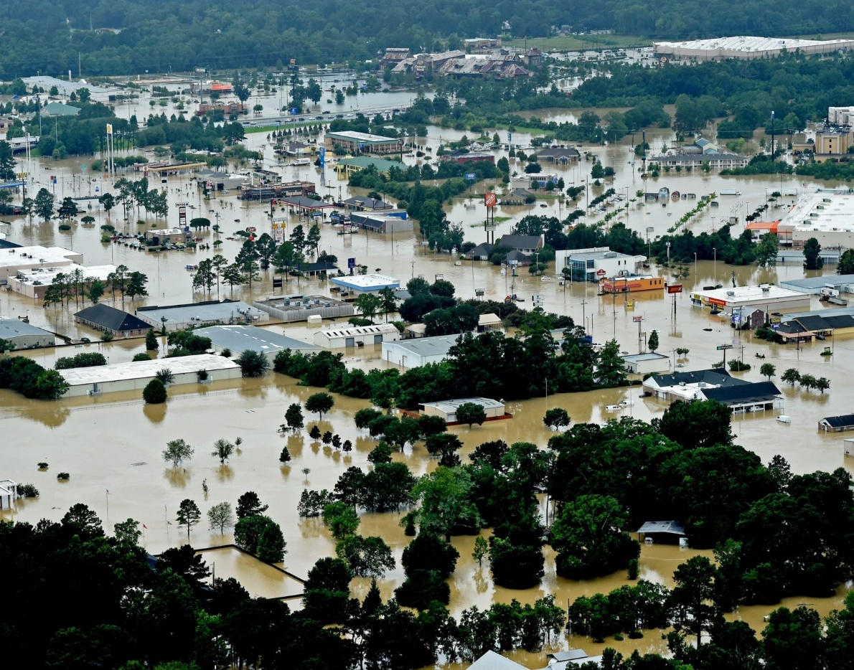

Slide 35
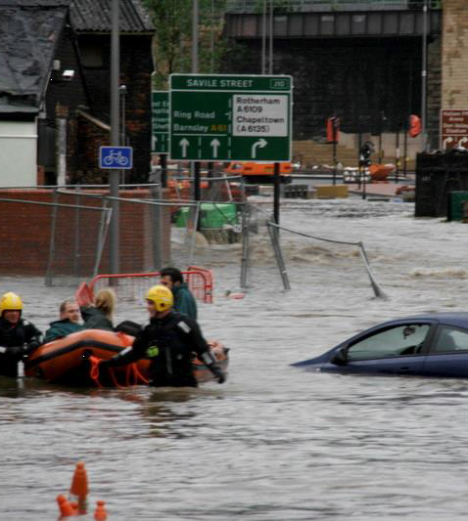
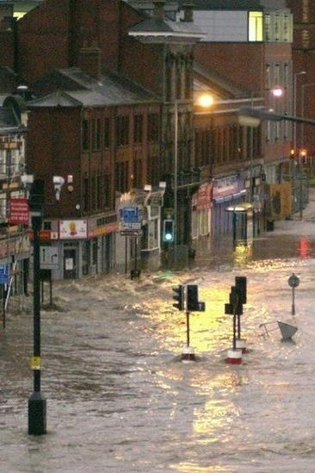
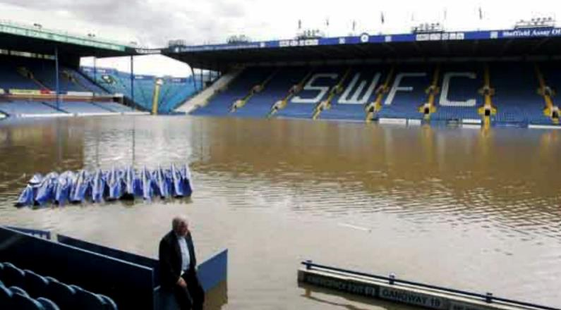
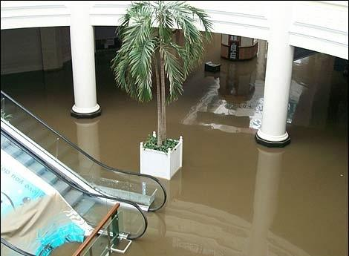
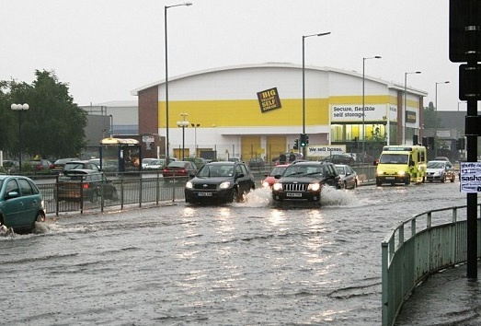

Local flooding in Sheffield

Slide 36
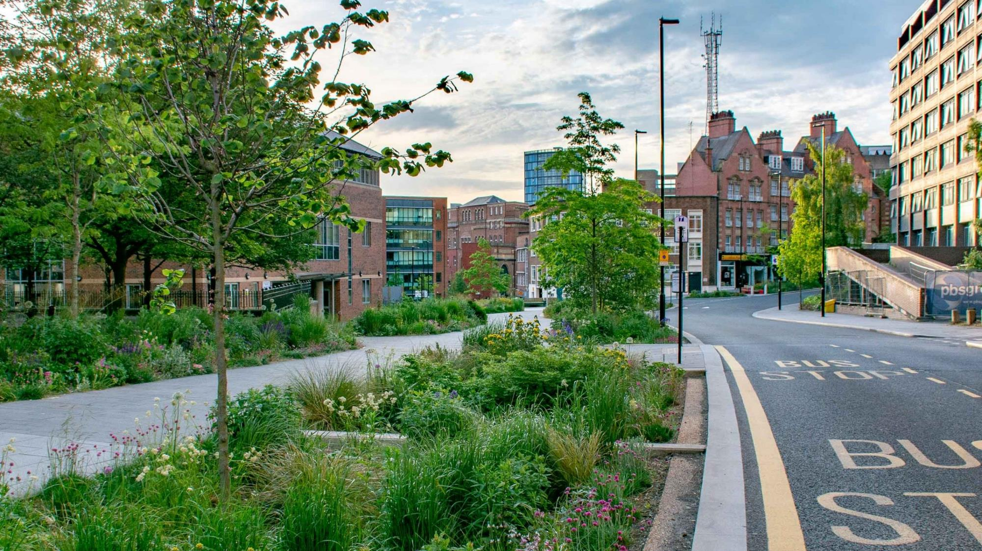

Slide 37
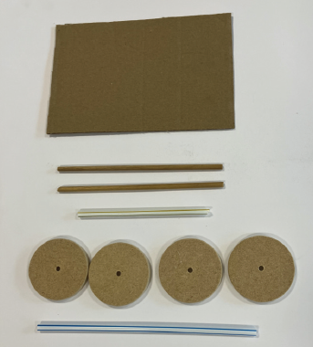
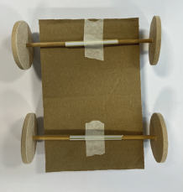
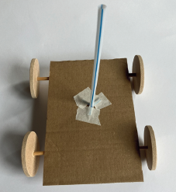
Land yacht Challenge
You will need:
1 hard board
2 dowels
4 wheels
2 straws
Masking tape
2 sheets of card and scissors
Something to waft the air

Slide 38
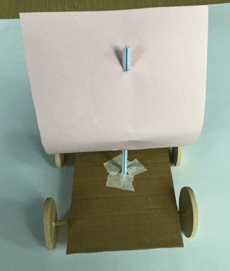
Land yacht Challenge
You will need:
1 hard board
2 dowels
4 wheels
2 straws
Masking tape
2 sheets of card and scissors
Something to waft the air

Slide 39
Primary Science and Enquiry Learning

Slide 40








A high-quality science education provides the foundations for understanding the world
scientific knowledge and concepts across biology, chemistry, and physics;
the nature, processes, methods, and skills of science to answer scientific questions;
and the application and implications of science in the wider world, presently and in the future.
Notes:
11.30

Slide 41
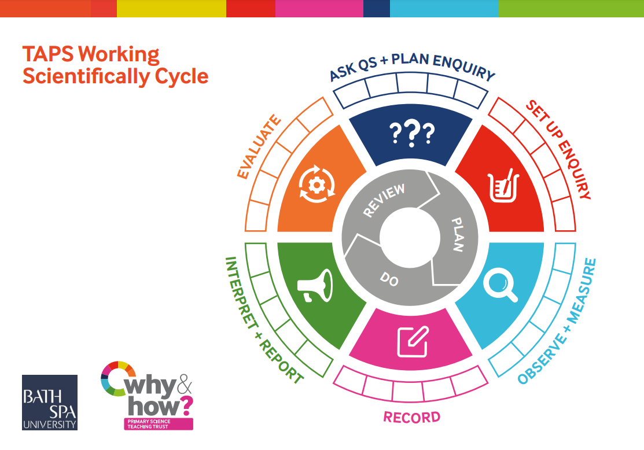

Slide 42

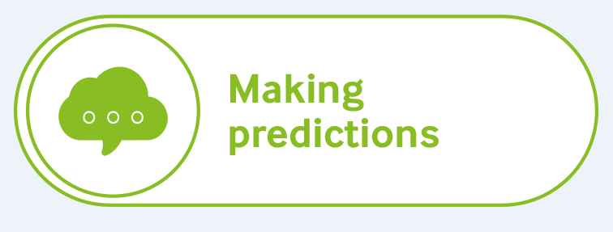
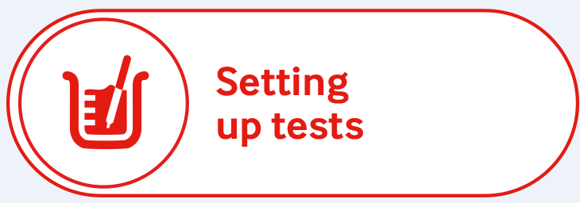
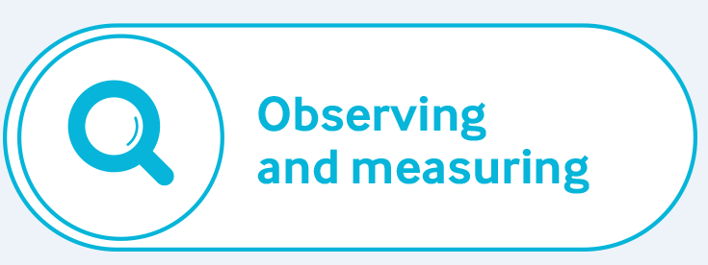
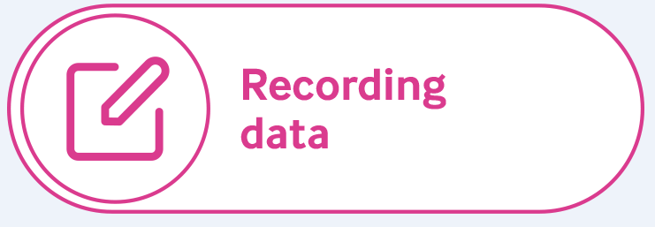
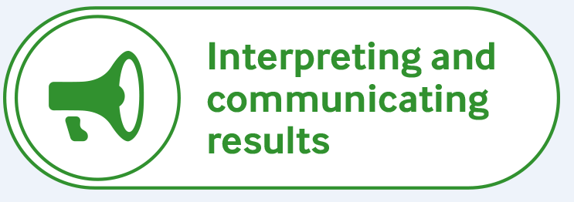

Science enquiry skills
Using the symbols as clues can you name the enquiry skills?

Slide 43
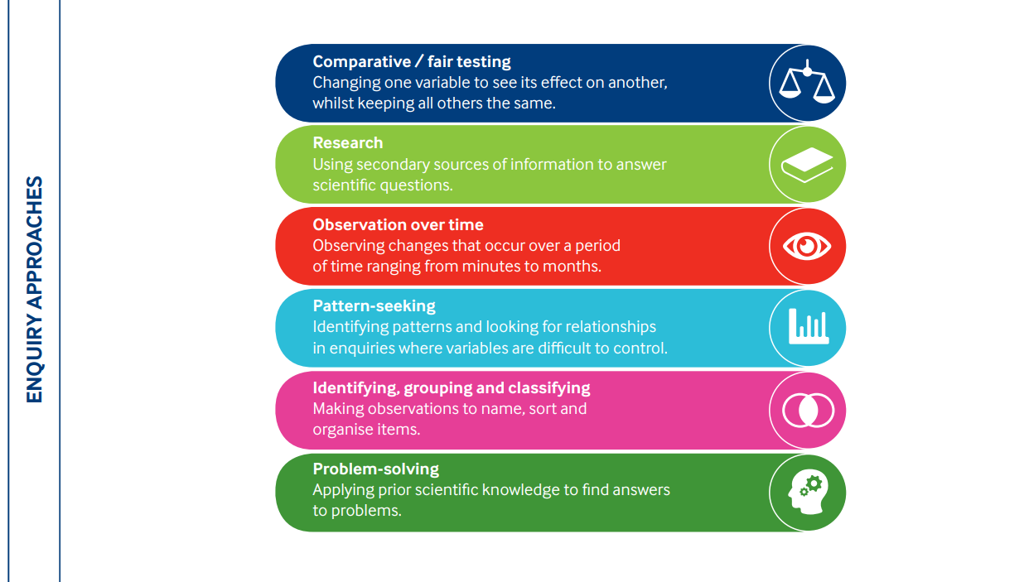
Enquiry Approaches – Finding answers to questions

Slide 44



EEF: Improving Primary Science (2023)
Guide pupils to work scientifically
Explicitly teach the knowledge and skills to work scientifically, guiding pupils to apply this in practice, with opportunities for discussion and reflection.
Relate new learning to relevant real-world contexts
Consider real world contexts.
Engage with science concepts supported by virtual models
Notes:
Six practical recommendations, underpinned by high quality evidence, about how to make meaningful improvements to primary science teaching.
It is designed to help practitioners build on their existing expertise with a view to supporting them to close the attainment gap and cultivate positive pupil attitudes towards science.

Slide 45
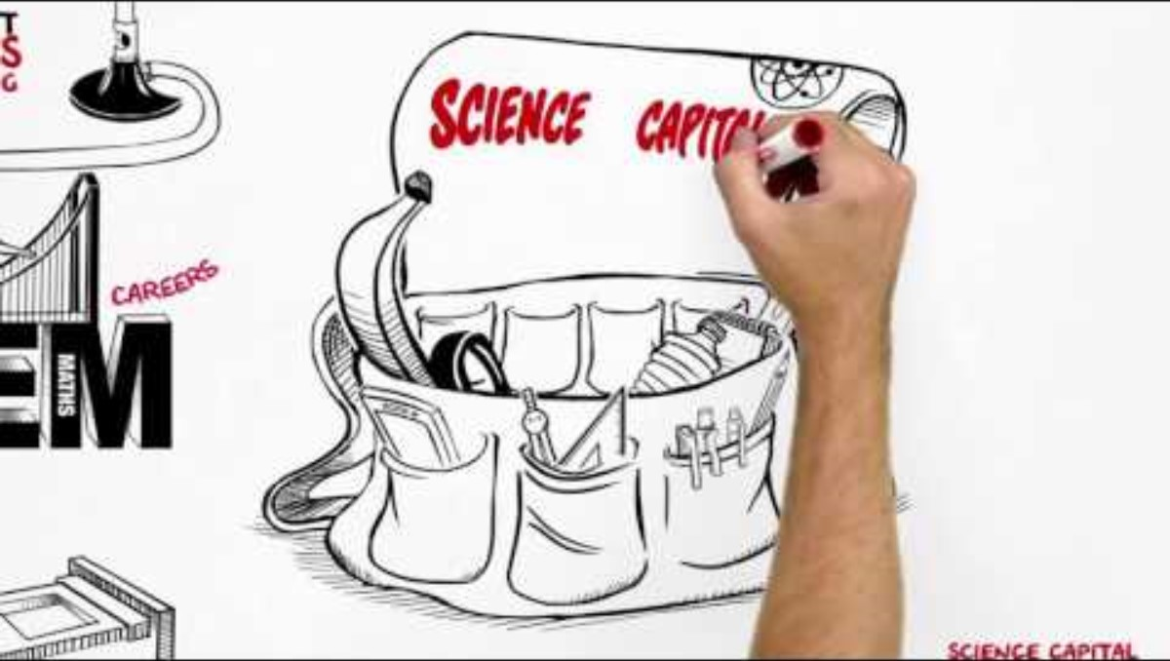
Science Capital
Notes:
Short video on Science Capital

Slide 46
Who the researchers are
Academics (researchers, lecturers and undergraduate/postgraduate PhD students) from Sheffield Hallam University and the University of Sheffield
Broad range of subjects – not just STEM related
Social science – behaviour change
Arts and humanities
Documentary film making
Notes:
(Lee and Joelle) and school teachers
Big-up the programme, funding and opportunity – researchers and the end game

Slide 47

Climate Ambassadors programme
Our researchers are going through the Climate Ambassador programme (similar to STEM Ambassadors)
Information provided by Ruth Green Climate Ambassadors Hub Manager University of Leeds, Yorkshire and Humber

Slide 48

Available dates
Wednesday 21 January 2026
Thursday 12 March 2026

Slide 49

Lunch
Back by 1.00pm
£8 voucher to spend

Slide 50
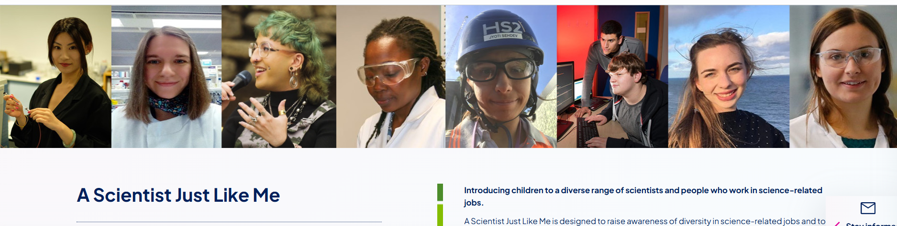
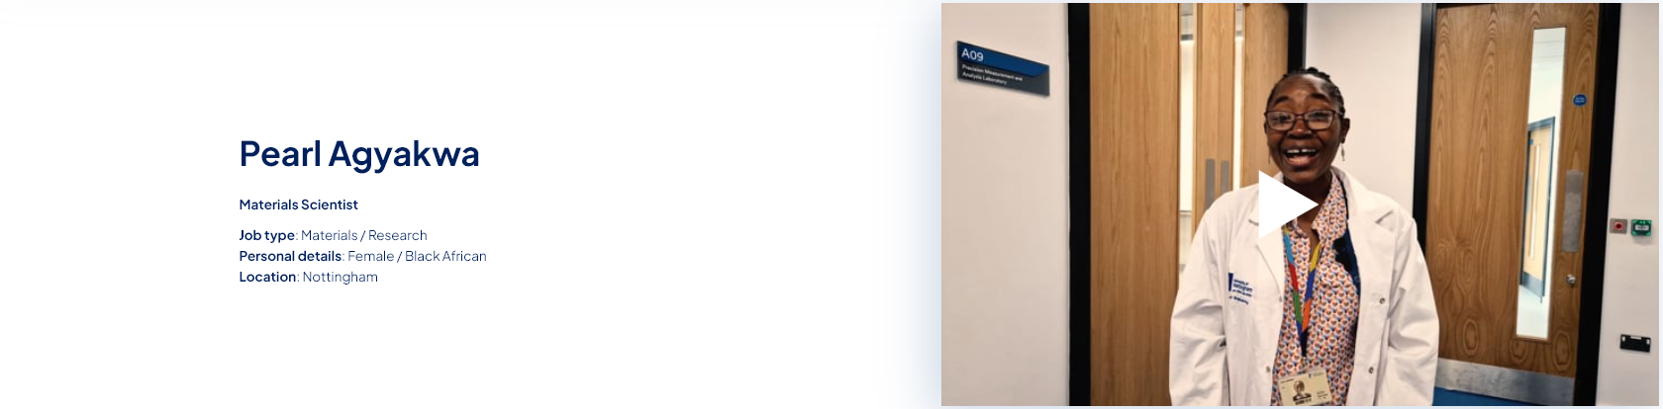
How ca you share your work with pupils?
https://pstt.org.uk/unique-resources/a-scientist-just-like-me/
Notes:
A Scientist Just Like Me is designed to raise awareness of diversity in science-related jobs and to provide illustrated examples of a wide range of science-based careers. It consists of a series of short slideshows, each one ‘telling the story’ of a particular scientist or person working in a science-related job.
The slideshows are intended to be used as discussion prompts, guided by a teacher. They can be used in different ways and for different purposes, for example:
to show children an example of someone from a particular ethnic background working in a science job
to challenge gender stereotypes about science jobs
as part of a science topic that relates to the work of the scientist
as stand-alone fifteen-minute discussion activities
with a small group or the whole class, or in a whole school assembly
ACTIVITY:
What does Pearl do to engage her audience
Describes her day
Shows examples
Uses real life examples
speaks in uncomplicated language

Slide 51
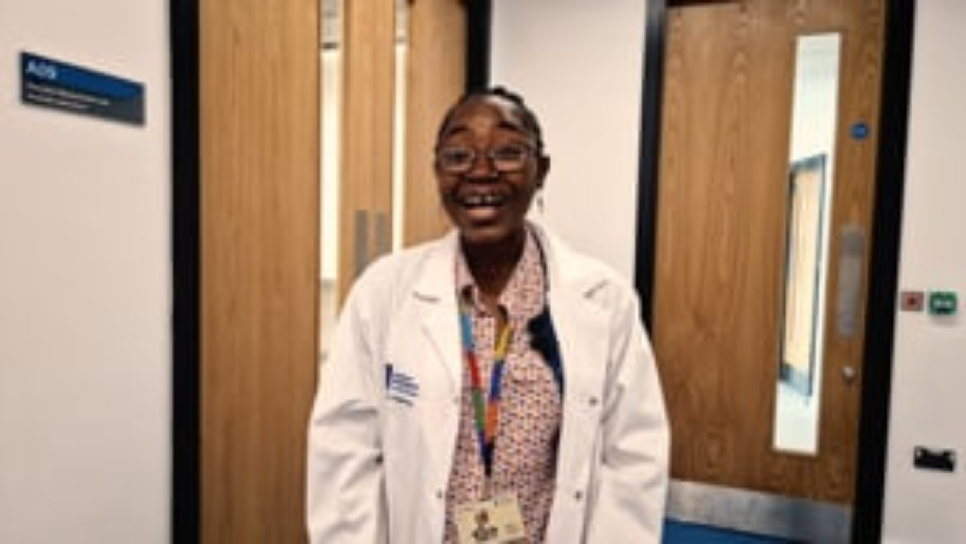

Slide 52
Sharing your work with children
Less is more
Ensure that your presentation takes cognitive load into account. Only essential information on slides.
Plot a journey
Chunk your presentation into small sections with pit stops to check understanding and time for questions.
Thinking out loud
Talk out loud to model your thinking if you are demonstrating a task or skill.
Modelling
Gradual release response – I do – we do- you do.

Slide 53
How are we going to work together?
Whiteboard....

Slide 54




STEM Cup stack challenge
You will need:
•1 piece of string each
•1 rubber band (per team)
•1 pair scissors (per team)
•Cups for stacking
Each set of cups can be organised to spell a word.
Stack the cups so that the word can be read across the base of the stack.
You must not touch the cups!

Slide 55
Project topics
These are a framework of ideas and activities
We don’t want to tell you what to do
You don’t need to stick to these – but they give you most of the content for the work as a pair with your children
Don’t reinvent the wheel – ask us if something is missing

Slide 56

Project topics
Air quality – indoors (CO₂) and outdoors (lichen)
Energy efficiency – insulation and using IR cameras
Energy production – solar energy production
Biodiversity – trail cameras and investigating school nature
Sustainable drainage (SuDS) – school survey, modelling flooding and reducing the flow

Slide 57


Slide 58
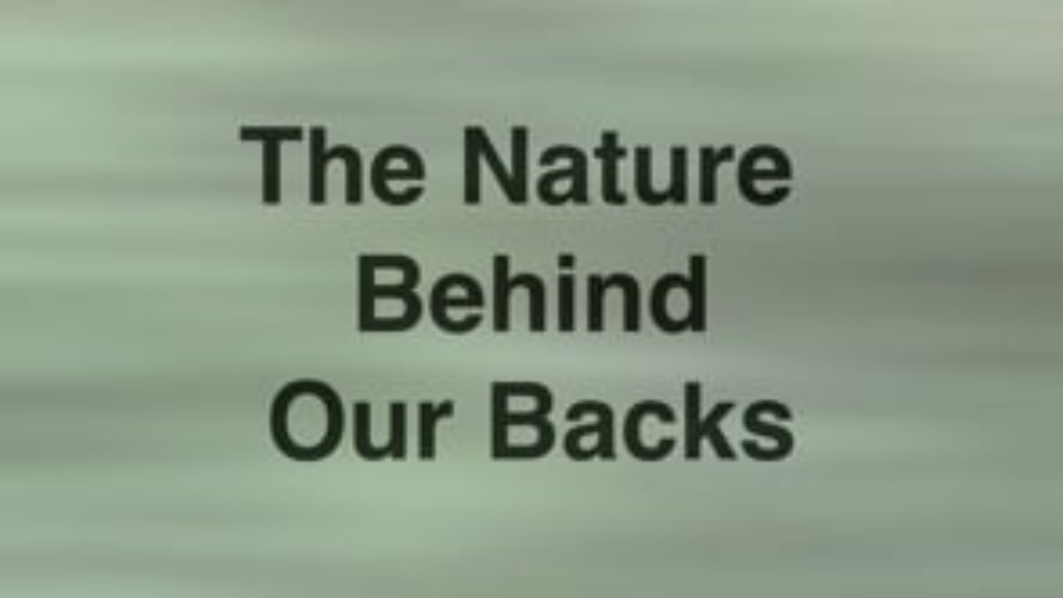

Slide 59
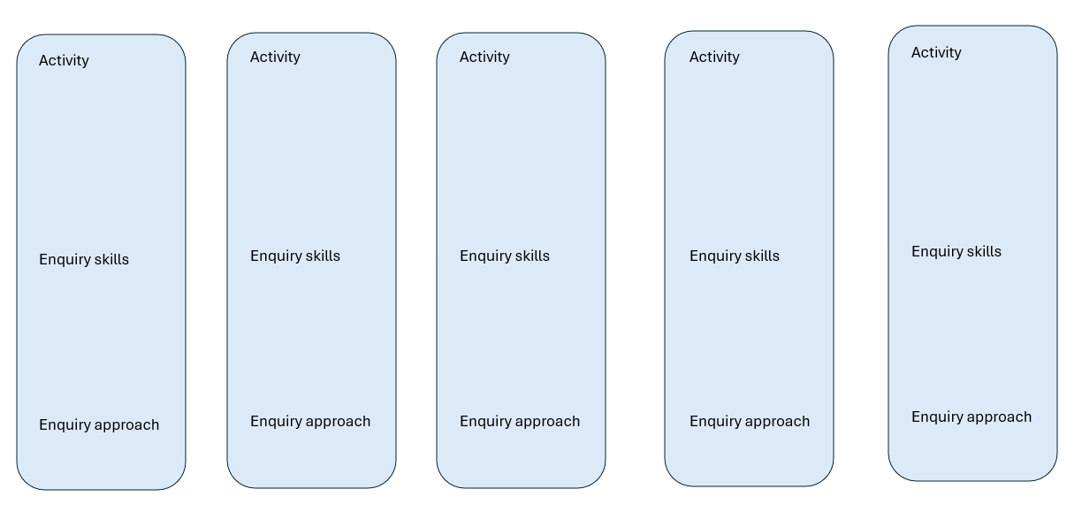
Project planning
Notes:
(Lee and Joelle) and school teachers
Big-up the programme, funding and opportunity – researchers and the end game

Slide 60
Tomorrow
This term
What Next ?
Summer term
Autumn term

Slide 61
Next steps
Speak to your partner and agree topic and create a draft plan – share this with Lee/Joelle
Get in touch (with plenty of time ☺) when you need equipment
Speak to us if you have any problems

Slide 62
Any questions?

