Slide 1

An online CPD-accredited course designed for teachers and Sustainability Leads

Slide 2
Why choose this course?
Clear & Practical: Find manageable starting points for sustainability that make a lasting impact.
Flexible Learning: Work at your own pace for just £52, with lifetime access.
Whole-School Approach: Engage leadership, staff, learners, and families.
Grounded in Permaculture Principles: Focus on caring for the Earth, people, and the future.

Slide 3
The course covers the Department for Education’s five Climate Action Areas
1) Climate education
2) Green skills and careers
3) Education estate and digital infrastructure
4) Operations and supply chains
5) International
Plus...
6) Creating your Climate Action Plan

Slide 4
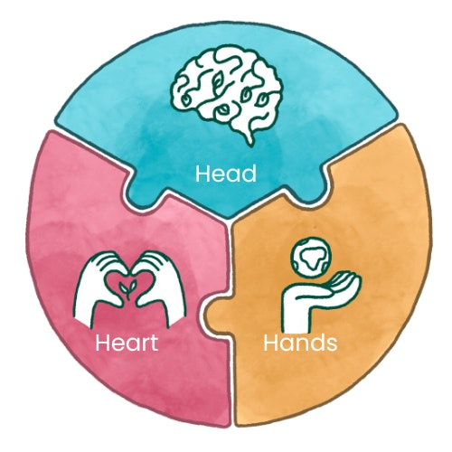
The structure of the course
Head: Develop the intellectual knowledge and understanding you need to tackle climate change effectively.
Heart: Learn how to inspire and engage your whole school community in a meaningful way.
Hands: Find useful lessons, links and activities to optimise learning and action for your students and school community.

Slide 5
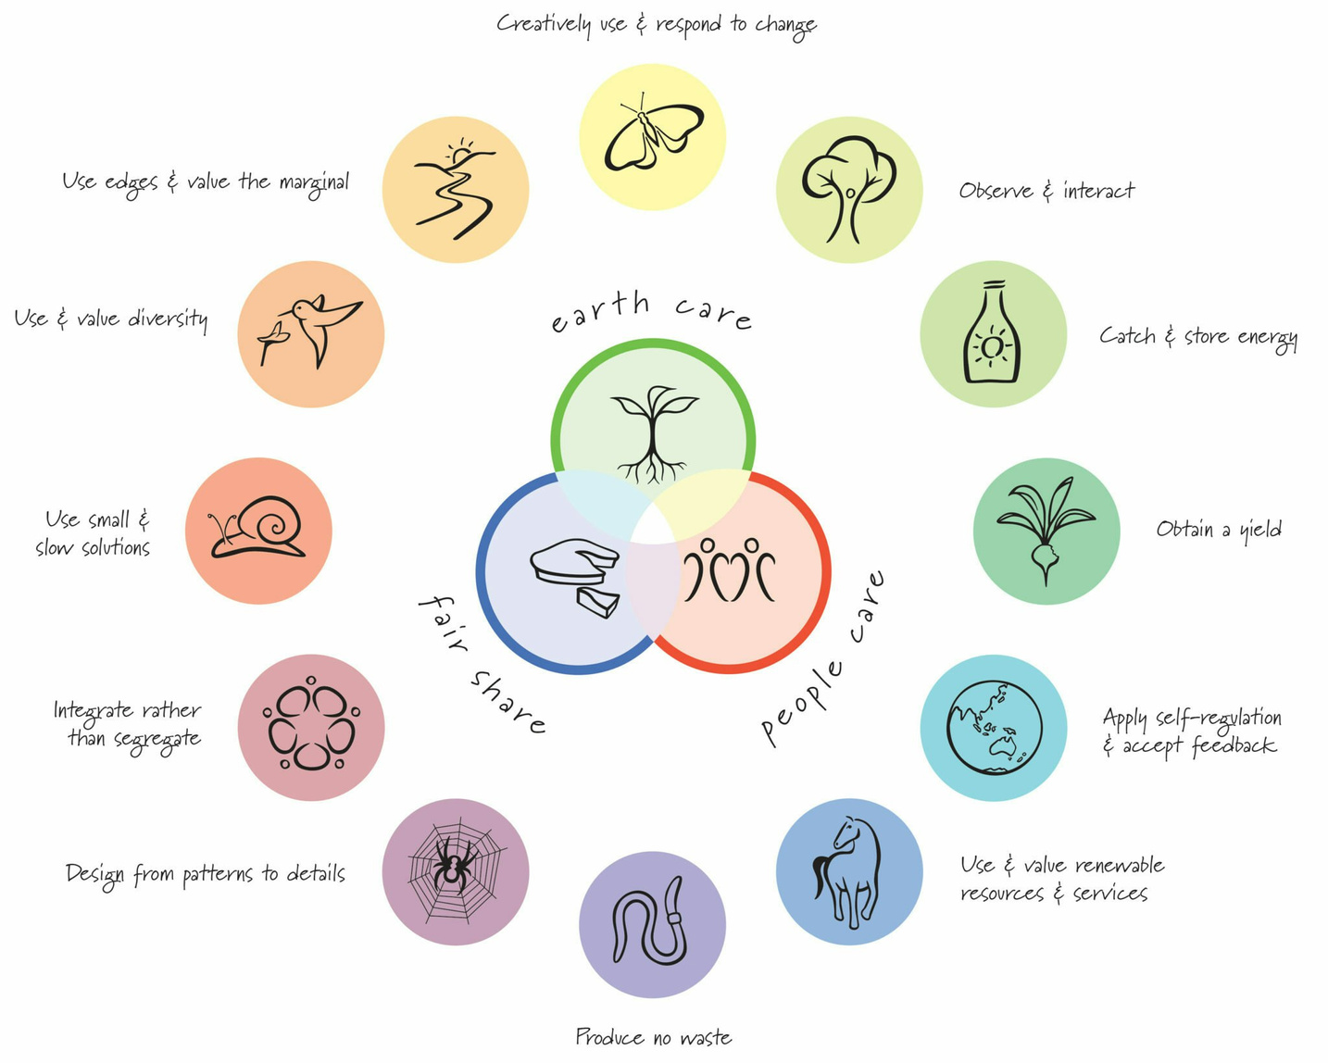
What is permaculture?
A holistic approach that helps you to understand and design your system well, consider your resources and reduce waste.
It uses a systems thinking approach to designing regenerative change.

Slide 6
School(ground) design using the SADIMET framework
How to (re)design the school (grounds) involving the whole school community.
How to implement a unique design, based on ethical choices, observations, site information and hands on tools.
Education estate and digital infrastructure

Slide 7

SADIMET framework
Survey
Analysis
Tweak
Design
Implementation
Evaluation
Maintenance

Slide 8
We need a core design team who coordinate the process, do most of the activities and make the final decisions.
The core team could be:
    School Council
    Eco Club members
    Dedicated to a class (possibly K2)
Guides throughout the design process:
    Permaculture ethics: Earth Care, People Care, Fair Share
    Vision statement: the core team’s vision about the designed area

Slide 9


Vision statement
Imagine how you want the school playground, classroom etc. to look, smell or feel like after the design process. Collect all the words, phrases, thoughts, feelings that come to your mind. Using these create your vision statement.
- How would you like it to make you and other people feel?
- What would people be able to do?
- What would you like to be able to see?
- What would you like to be able to hear?
Source: Education Nature Park

Slide 10
“We, as a school, want our grounds to be sustainable, natural, good for wildlife and filled with whimsy and magic.”
"We want a beautiful, inviting, colorful, and nature-friendly space with trees, a water source, and room for sports."

Slide 11
Ways of involving the whole school community
Launching Assembly - introducing the design team and their vision
Survey - gathering ideas and needs (students, teachers, parents)
Vote - prioritising, shortlisting the ideas
Drawing/writing/design competition
Info Wall/Comment Wall - means of communication
Display - showing the whole process
Assembly - presenting the final design for the school
Change making day - implementing ideas
Celebration

Slide 12

Survey
Observation. Getting to know our space, discovering what we have, what we know about the area. Gathering information, new ideas and needs.
Activities:
    Base Map
    Plant identification
    Soil test
    Client Interview (SLT)
    Survey (students, teachers, parents)
    PASTE

Slide 13
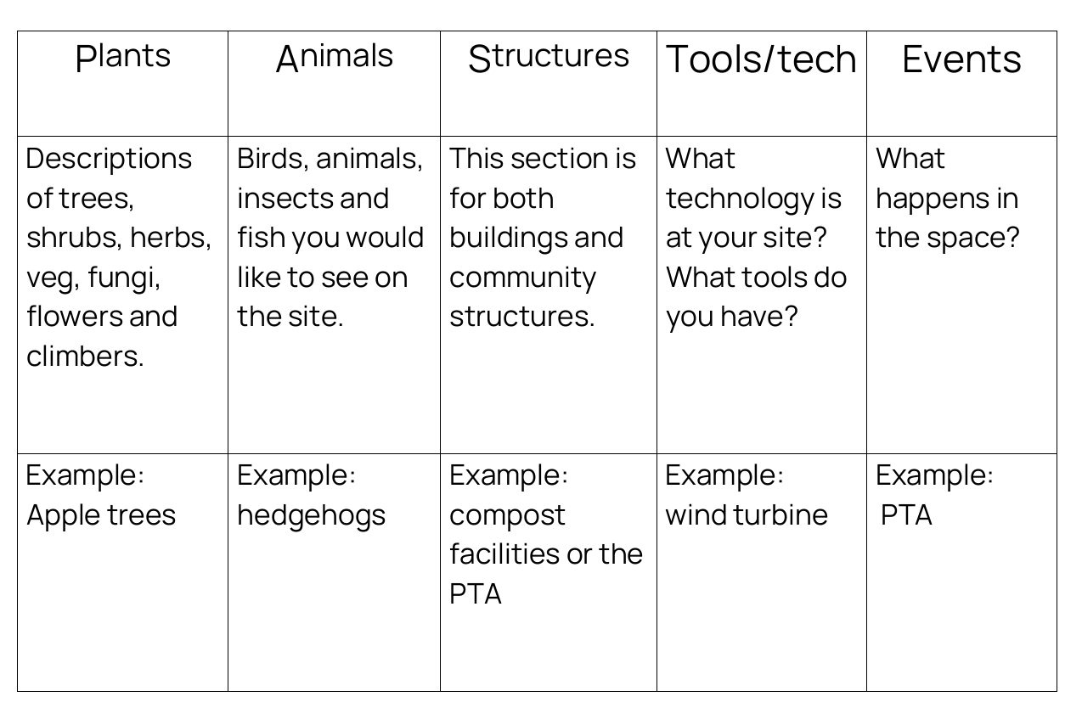
PASTE sheet

Slide 14

Analysis
Analysing the data collected at the survey period.
Activities:
    Analyzing the soil test
    Working with the Survey and interview answers (identifying the main ideas/needs)
    Sector Analysis

Slide 15

Design
Making decisions, creating the final design.
Activities:
    Drawing/design competition
    Having a look at the competition materials (picking ideas)
    Plant Cards
    Placing the final design ideas on the map

Slide 16
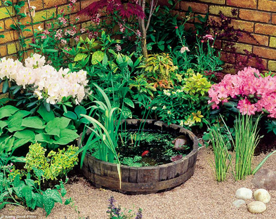
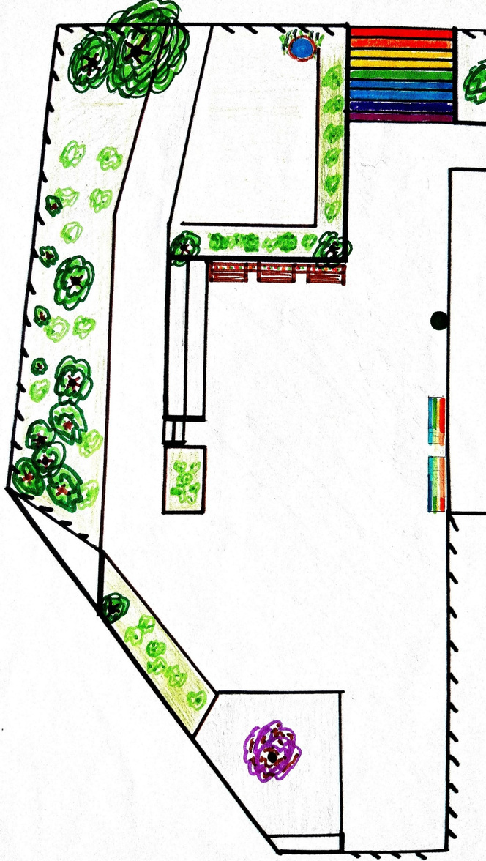
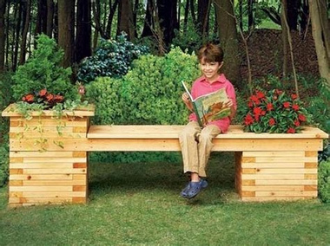
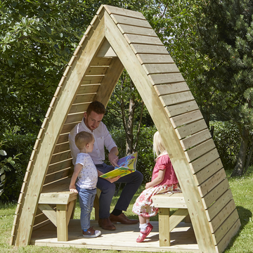
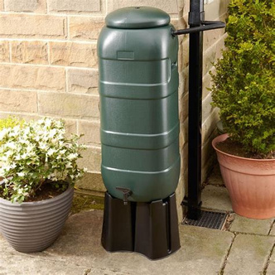
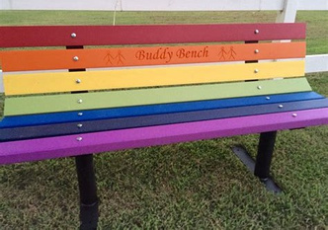
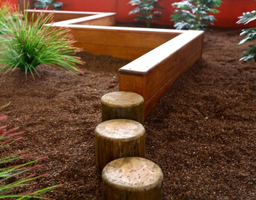
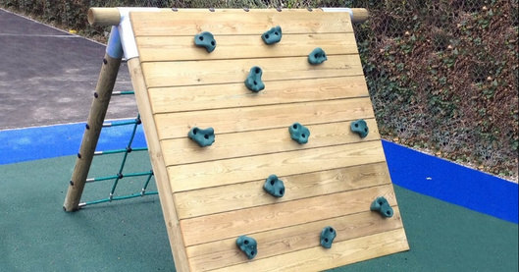
Rainbow stairs
Wildlife pond
Kitchen garden
Seating planters
Reading corner
Water butt
Nature fairy garden
(with bird feeders and bug hotel)
Herb garden
Play area
Benches

Slide 17
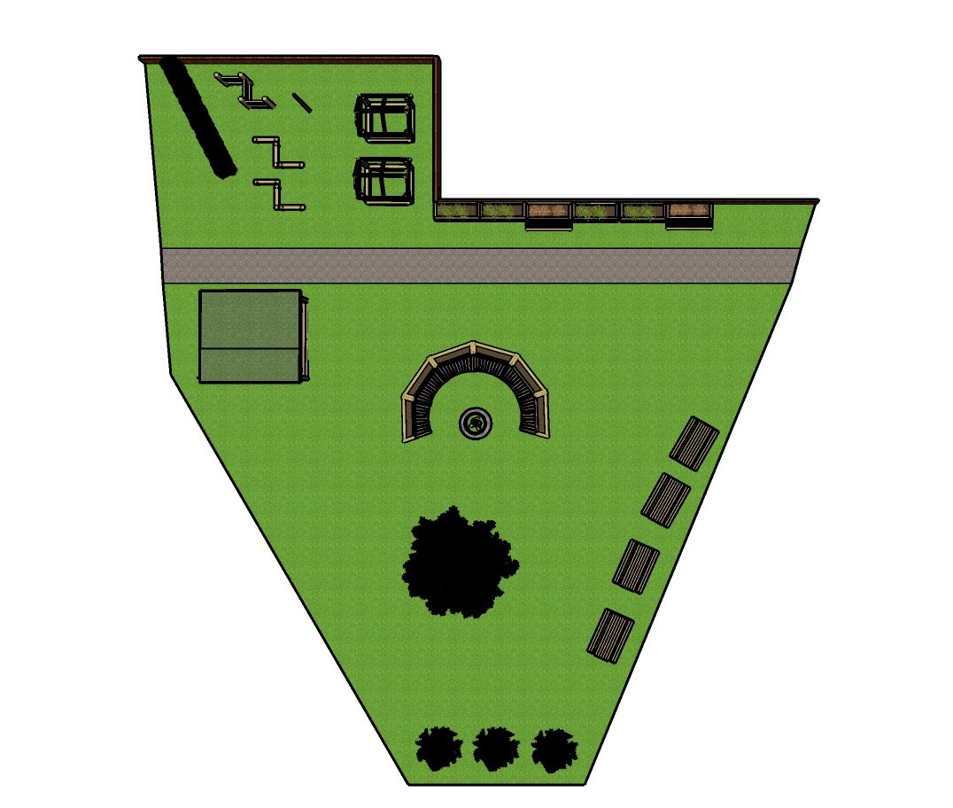
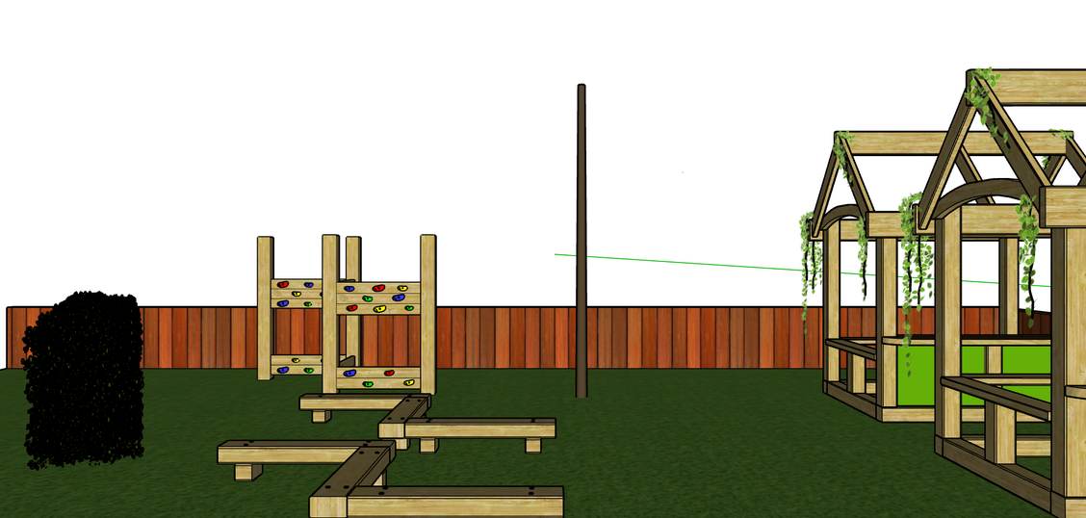
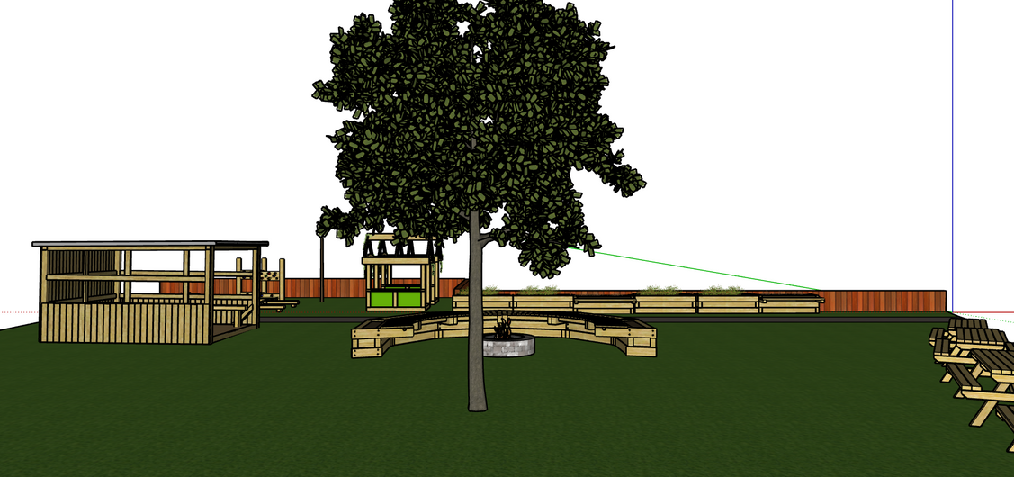
Sketchup

Slide 18
Implementation
Putting the design into action. Purchasing and installing equipment, planting, painting etc.
Activities:
    Implementation plan (Now, sooner, later)
    Change making day
Finding funding

Slide 19
Maintenance
Maintain what we have created.
Evaluation
Constantly asking questions like: What went well? What went wrong? Does it work? What shall we change?
Tweak
Make changes if necessary during the whole process.

Slide 20
Questions?

Slide 21

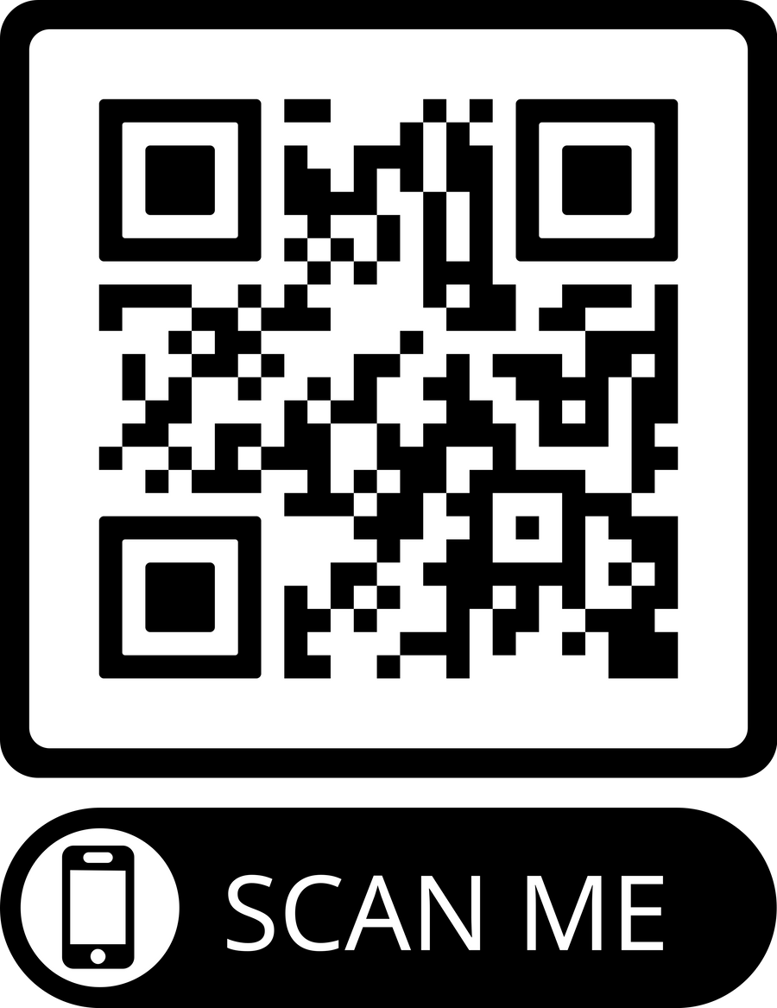
If you are interested in the course
Join our launch event:
27th March (Thursday) 12:30, ZOOM

Slide 22
Thank you
Valeria Kelemen
kelemen.v.valeria@gmail.com

