Slide 1
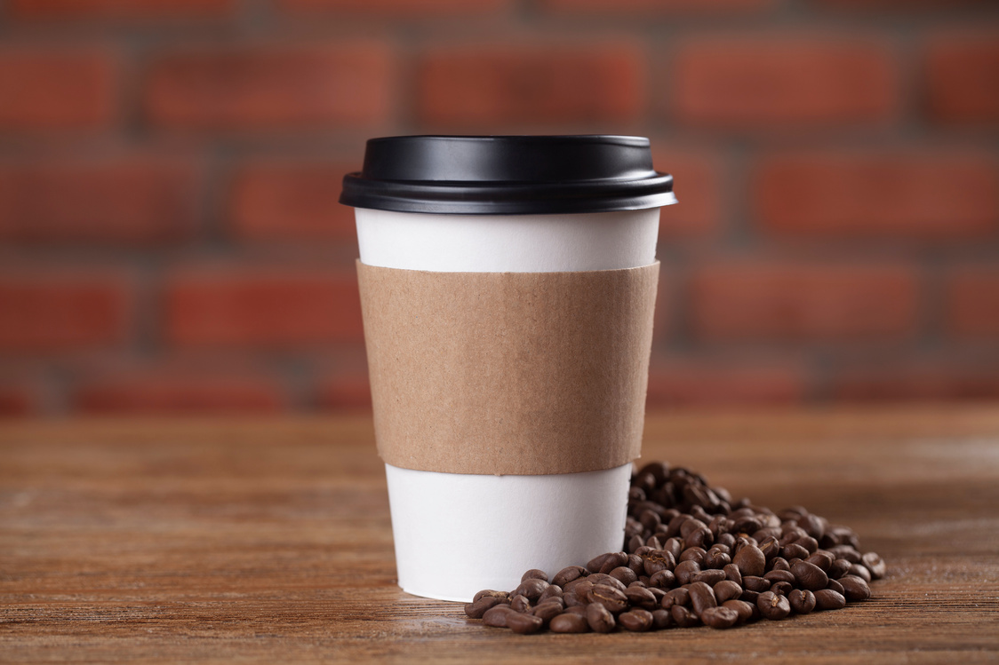
Insulating Coffee Cups
INTRODUCTION
An insulator is a material which is a poor conductor of heat. Insulation materials are non-metals and often have pockets of air which help to reduce heat transfer.
Students will work in groups of three to design and carry out an investigation to find out the best combination of insulating material for a coffee cup. This idea can be linked to insulating a home.
STUDENTS WILL LEARN
WHAT INSULATION IS AND WHY IT IS IMPORTANT TO HELP TACKLE CLIMATE CHANGE
HOW WE CAN REDUCE HEAT LOSS (E.G. A CUP OF TEA/COFFEE)
HOW TO MEASURE THE EFFECTIVENESS OF INSULATION
IN THE BOX
15 (-5 TO 100 DEGREES C) THERMOMETERS
30 COFFEE CUPS
4 STOPWATCHES
30 COFFEE CUP LIDS
0.5M OF BUBBLE WRAP
0.5M FLEECE
For each group (depends on group size):
3-4 thermometers
3-4 coffee cups (these can be reused)
A stopwatch
Materials provided (fleece, bubble wrap, aluminium foil)
Worksheet 4a
Also provided in the general box:
Masking tape
Scissors
You will need to provide:
A source of hot water
Other insulation materials if you wish to supplement, however those provided should be enough
TO PREPARE
You will need a source of hot water (heated to a maximum of 50 degrees Celsius and stored in an insulated flask for classroom use).
SAFETY
This activity involves hot water. Depending on the age of the students, the member of staff should be responsible for pouring water.
The water should be a maximum of 50 degrees Celsius, all the coffee cups should start at a similar temperature.
A school-based risk assessment must be completed before this activity begins.

Slide 2
Running the Activity...
Discuss with students, what we mean by insulation and examples of where we insulate. A thermal insulator is a material which does not easily allow heat through. Examples could be on a small scale e.g. travel cups, coats and gloves. It can also be a on a much larger scale e.g. homes and buildings. They are less likely to have seen an insulating flask, but this is a really good example of retaining heat (and reduces all 3 types of heat transfer (conduction, convection and radiation).
Elicit what insulating materials have in common – hopefully they will identify materials that are fluffy (which trap air), have a reflective surface and/or a ‘vacuum’ with no air in. Most examples the students will have an awareness of will be trapped air keep things warm.
Insulating materials are important because they reduce heat loss. Heat is often generated through fossil fuels and contributes to climate change. We generally don’t want to lose heat once we have produced it.
Once students have got an understanding of the types of materials, share with them the 3 materials provided in the box. Get them to think how you would use them to keep a cup warm (and still be functional and safe).
Give each group their cups, lids and thermometers. Ask them to plan their experiment using the planning sheet. The worksheet can accommodate a maximum of 4 different cups.
They can choose to put multiple materials on each cup or one type of insulation on each cup, as long as it is functional (and the lid can go on and off)
Once they have identified and set up the ways that they are going to insulate their cups, put on a flat surface and secure materials, ensuring the lids can be put on and taken off easily.
Either you or students (depends on age) need to pour water into each cup (approx. 2/3 full). This water should be a maximum of 50 degrees Celsius.
Once the cups have hot water in do not move them!
Carefully place lids on each coffee cup.
Students will need to record the start temperature of each cup using the thermometer – which can done through the small hole in the top (leave the thermometer in the cup for around a minute), these thermometers can be kept in throughout the experiment.
Start the stopwatch and record the temperature (on the worksheet). Depending on ability of the group they could record every 2 minutes for 20 minutes (generating 10 recordings for each cup).
After 20 minutes students can calculate the difference in temperature change for each cup, the one with the smallest change in temperature is the best insulator.
At the end of the session, allow the cups to cool enough to be able to be picked up to pour the water out.
Sharing and Extending Learning...
Students could investigate what sort of insulation there is in school or home (either the main building or in kitchens are good places to start).
What type of cups can be found in local coffee shops?
Can we investigate the ways of reducing single use coffee cups, e.g. Four solutions to the disposable coffee cup problem - BBC News or Viewpoint: The waste mountain of coffee cups - BBC News (weblinks).

Slide 3
Background Information...
Heat travels in different ways (conduction, convection and radiation). Conduction occurs through solids and metals the best. Convection occurs through liquids and gases. Radiation does not need a material and is a wave (like light). Heat transfer can be reduced, which helps to keep things hot.
Heat can also be reflected by shiny surfaces (the reason that car windshield sunscreens are usually shiny).
Insulating materials are important for several reasons:
It makes materials (like hot drinks) safer to handle and reduce the risk of burns.
It retains heat and therefore reduces heat loss (like in homes).
Reducing heat loss means we can reduce the amount of energy needed in the first place which is better for the environment, as most heat is still generated through burning fossil fuels.
Take it Further...
Students could research the different types of travel cups and mugs available either at home or in the staffroom. Are there some cups better than others, are there other important features as well as keeping the drink how which are important? For example, dishwasher safe?
Using the idea of insulating coffee cups, students may want to investigate the ways that homes can be insulated to reduce heat loss. This can include double and triple glazed windows, floor, roof & wall insulation. There are also novel ways of building houses with use natural materials, such as straw!
You can measure heat escaping from materials using the infra-red camera/digital thermometers which were used during covid to measure peoples’ temperatures.
More information
The best reusable coffee cups and travel mugs of 2024 (telegraph.co.uk) (weblink)
How to insulate your home and stay warm this winter - Energy Saving Trust (weblink)
The vacuum flask - Heat transfer - BBC Bitesize (weblink)
Skills Builder
These activities will help pupils develop essential life skills in...
For more info, visit:
www.skillsbuilder.org

